Slide 1



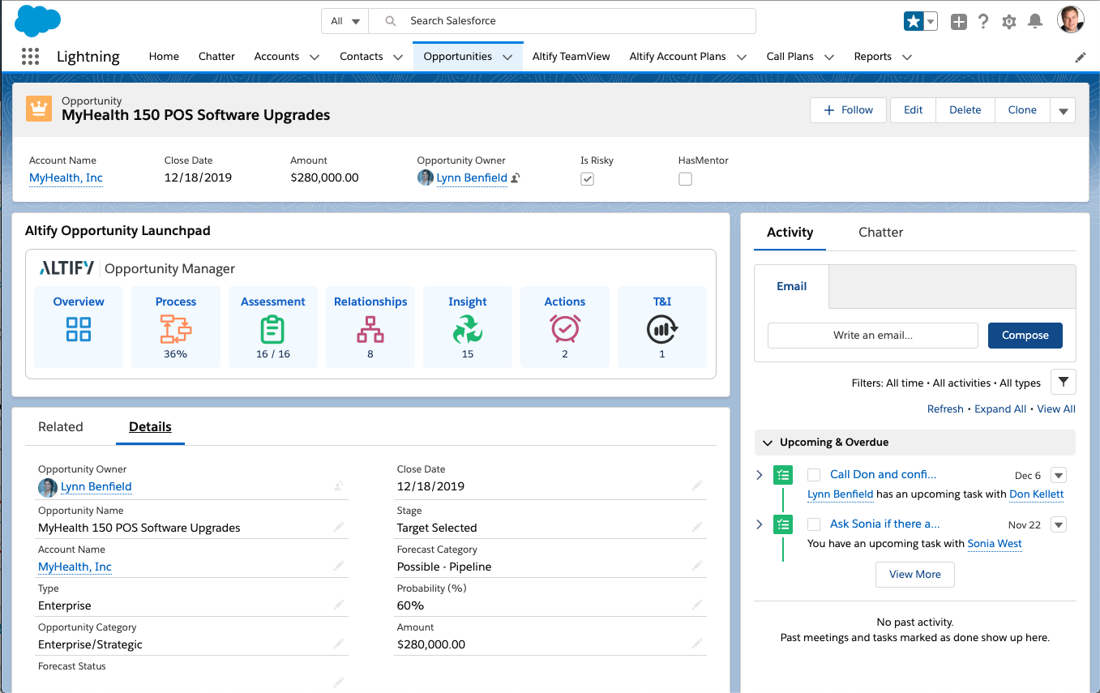
WIN DEALS THAT MATTER
Best Practices and Coaching Guide
© 2020 Altify. All rights reserved.
For customer use only and no usage rights conveyed. Nothing herein may be reproduced in any form without prior written permission.

Slide 2
PROPRIETARY AND CONFIDENTIAL
© Upland Altify 2020 The contents of this book and the associated materials are proprietary and confidential to and include trade secrets of Altify. Unauthorized use, disclosure, or reproduction is strictly prohibited. You may use these materials only on behalf of Altify licensees.
uplandsoftware.com/altify

Slide 3
Win Deals That Matter
Best Practices and Coaching Guide
TABLE OF CONTENTS
Spark Best Practices and Coaching Guide
  Insight Map 1
  Relationship Map 3
  Assessment 5
  Competitive Strategy 11
  Actions 16
  Test & Improve 17
  TeamView 24
  Resources 26
i

Slide 4
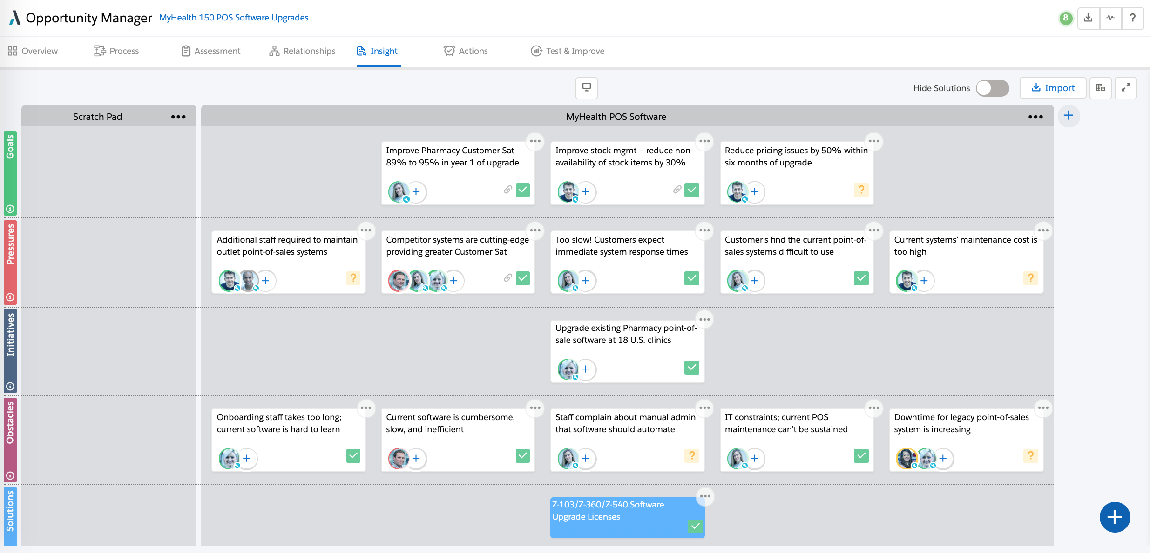
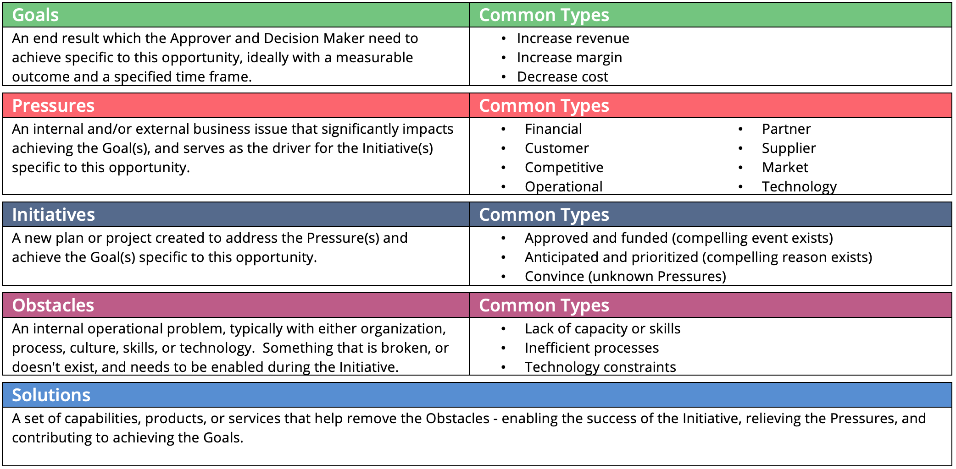
Win Deals That Matter
Best Practices and Coaching Guide
Insight Map
A graphical representation of the customer’s business problems, to be used by the revenue team, together with their customer, to visually link business problems to key players to provide business insights and identify potential solutions. This allows the revenue team, in collaboration with the key players, to identify and prioritize the business areas and potential solutions where value can be added by the team.
1

Slide 5
Insight Map Coaching Questions
Win Deals That Matter
Best Practices and Coaching Guide
Opportunity Owner: Review in Advance For | Reviewers/Coaches: Questions You Might Ask
Is there a defined Insight Map for this deal? Does the Insight Map make sense? Does it tell a logical story? Are items confirmed, and the customer’s decision maker or key player identified? Are goals and pressures specific, and do they have metrics where possible? Do initiatives represent key plans or projects the customer is undertaking? Are the pressures behind the initiatives comprehensive? Are the obstacles comprehensive and can some be solved with our solutions? Would a customer key player view this Insight Map as a good representation of their current business and desired state? | Have you triangulated the Insight Map with multiple key players? Who at the customer has confirmed the overall Insight Map? If not done yet, what is your plan to gain customer confirmation? Who are the most senior people in the customer’s organization who care about the success or failure of the initiatives? Who will be impacted if a specific initiative fails? Succeeds? How will they be impacted? What deadlines are associated with the initiatives or obstacles? What pressures can you prioritize where your solutions will have the most impact? Which obstacles are the most important to overcome, from the customer’s perspective? What solutions can you offer to address the customer’s obstacles?
Insight Map Best Practices
Entries are complete thoughts and tell a logical “story”.
Goals and pressures are specific and have metrics where possible.
Insights are confirmed with the customer and impacted key players are identified.
Initiatives represent key plans or projects the customer is undertaking.
More than one obstacle identified for each initiative; comprehensive and some can be solved with our solutions.
2

Slide 6
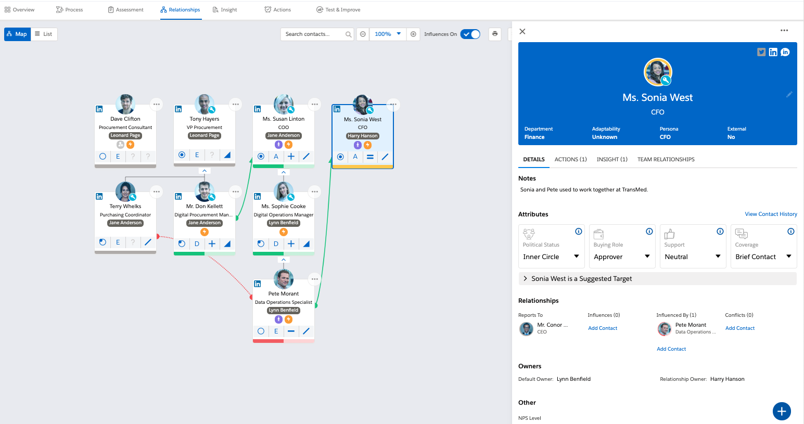
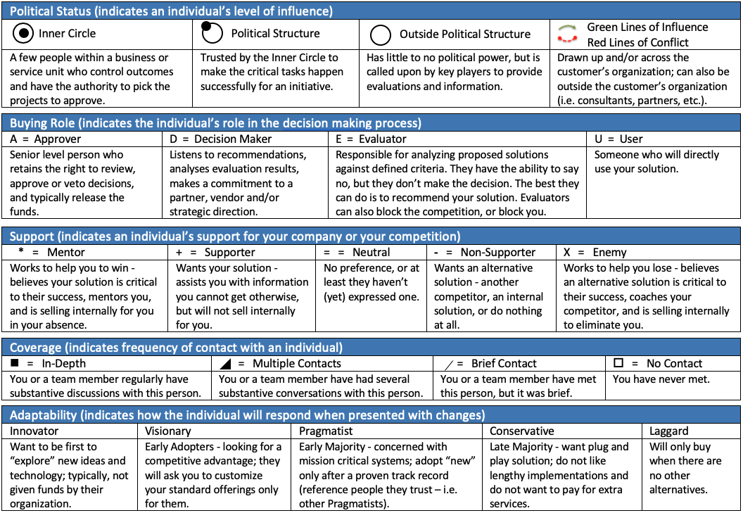
Win Deals That Matter
Best Practices and Coaching Guide
Relationship Map
Displays the people in the customer’s business who are influencing, or impacted by, the decision; their place in the organization hierarchy, the revenue team member responsible for coverage, the influence lines indicating who influences whom, and the attributes that help you to determine how to build your relationship with them.
3

Slide 7
Win Deals That Matter
Best Practices and Coaching Guide
Opportunity Relationship Map Coaching Questions
Opportunity Owner: Review in Advance For | Reviewers/Coaches: Questions You Might Ask
Does the map include all people who will either influence or be affected by the buying decision, including people we don’t know? Are key influencers outside the organization who can affect critical decisions, and/or our relationship status, also included in the map (consultants, partners, salespeople, etc.) where appropriate? Do the attributes have evidence to support your assessment? Political Status: Key Players (Political Structure and Inner Circle)? Buying Roles: Decision Maker, Approver? Support: Mentors, Supporters, Neutrals, Non-Supporters, and Enemies? Influence Lines: the path to key players? Coverage: On the key players? Leveraging the full revenue team? Is there a path to Executive Credibility? Have Mentors and Supporters indicated how to win? Is our team’s “ownership” of relationships logical? | Who outside the customer’s organization has influence (consultants, partners, etc.)? Where are they represented on your map? What evidence do you have that indicates who influences whom (green influence lines)? Each person’s background? How long have they been with the company? Who brought them into the company? Who are they connected to? Who is your main source(s) of information? How did you determine the key players (Inner Circle and Political Structure)? How do you know? What situations have you seen where they exhibited influence? What is the evidence behind people who are in conflict with each other (red conflict lines)? Who wins if we win? Why? Who told you? Who wins if the competition wins? Why? Who loses if we lose? Who loses if the competition loses? Who is the competition working with (if no Enemies or Non-Supporters)? What would the Relationship Map for your competition look like? Who are the key people that we need to know for this deal? With whom is the team spending the majority of their time? Why? Can they help you win the deal? Are we leveraging the full revenue team and partners for coverage? What is the major change/improvement that you need to see in this map to win this deal?
Relationship Map Best Practices
The map includes influencers who determine if the customer will invest in your solutions or your competitor’s.
The key influencers outside the organization who can affect the buying decision are identified.
There is an appropriate balance of Inner Circle, Political Structure and Outside the Political Structure.
There is an appropriate balance of people who prefer us, who are neutral, and who prefer an alternative.
Our revenue team is covering all levels of the buying organization.
4

Slide 8
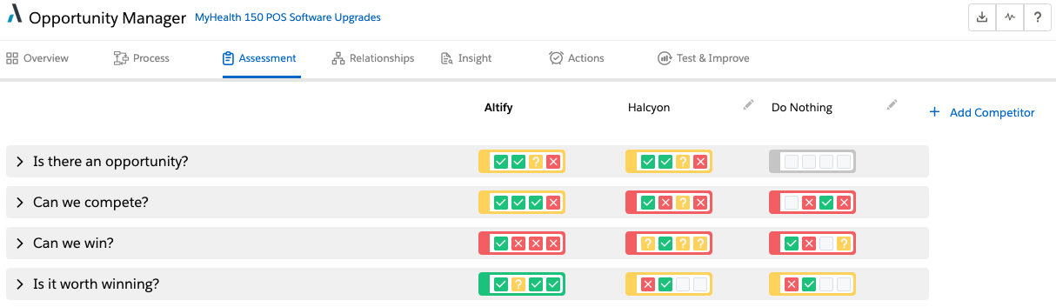
Win Deals That Matter
Best Practices and Coaching Guide
Assessment
The Assessment enables revenue teams to assess their opportunity based on 4 key questions:
  Is there an opportunity?
  Can we compete?
  Can we win?
  Is it worth winning?
As you can see below, the Assessment highlights each of the 4 key questions and the current state of the four indicators for each. By answering each indicator, you assess where you stand, and where the competition stands, in relation to this opportunity.
Assessment Best Practices
Review your opportunity assessment at critical points during the sales cycle, a minimum of once per stage is recommended.
Assess the Is there an opportunity, Can we compete, and Can we win indicators from the customer’s point of view.
Make an evidence-based assessment in order to fully understand your competitive advantages and disadvantages. Be clear on the current state of what we know and what we don’t know! As a result of this clarity, you’ll be able to focus your resources on the next steps to move the opportunity forward.
Note your evidence for each indicator to help align your team.
Collaborate together with your team on Actions to resolve the Unknown or No indicators.
5

Slide 9
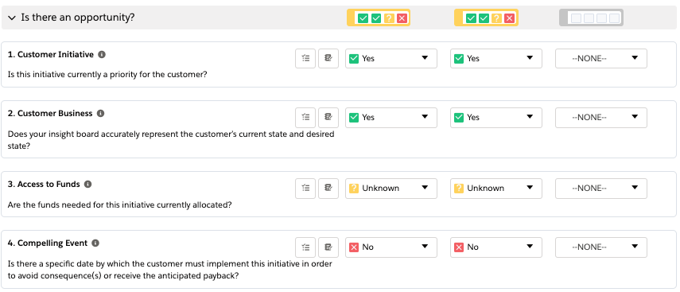
Coaching Questions
Win Deals That Matter
Best Practices and Coaching Guide
Assessment Key Question #1
Is there an opportunity?
Consider each of these indicators from the customer’s point of view.
You will only need to mark the indicators once as the answers for each apply to both you and your competition.
Opportunity Owner: Review in Advance For | Reviewers/Coaches: Questions You Might Ask
Customer Initiative Is this initiative currently a priority for the customer? What pressures created the initiative? Which key player is sponsoring the initiative? What resources have been allocated to the initiative? | Has the customer defined the initiative? Who is sponsoring the initiative? Why? What is the timeframe for the initiative? What is the relative business priority of this initiative vs. the customer’s other initiatives?
Customer Business Does your Insight Map accurately represent the customer’s current state and desired state? Who from the customer has reviewed and confirmed your Insight Map? What business metric(s) will the decision maker use to measure the goal(s) of the customer’s initiative? | What are the decision maker’s goals for the initiative? How does this initiative fit into the customer’s business strategy? What are their priorities for the upcoming year? What are their critical success factors? What are your sources of information?
Access to Funds Are the funds needed for this initiative currently allocated? What is the budget for this initiative? What are the key milestones in the customer’s budget process? Who needs to approve the investment? When can the funds be made available for this initiative? Are funds connected to the compelling event? | What is the budget for the entire project? Who will release the funds? How will the funds be released? When will the funds be available?
Compelling Event Is there a specific date by which the customer must implement this initiative in order to avoid consequence(s) or receive the anticipated payback? What pressures are driving this project? What are the risks and benefits if they make a change? By what specific date does the decision to proceed need to be made? When does the business approver need to start the project? What is the impact on the customer’s business of missing the date? | Which key player has the authority to approve this type of initiative? What are the consequences if the initiative is delayed? What is the payback to the customer if the initiative is completed on time? How will a decision affect the customer's business? What is the approver’s timeline to start the project?
6

Slide 10
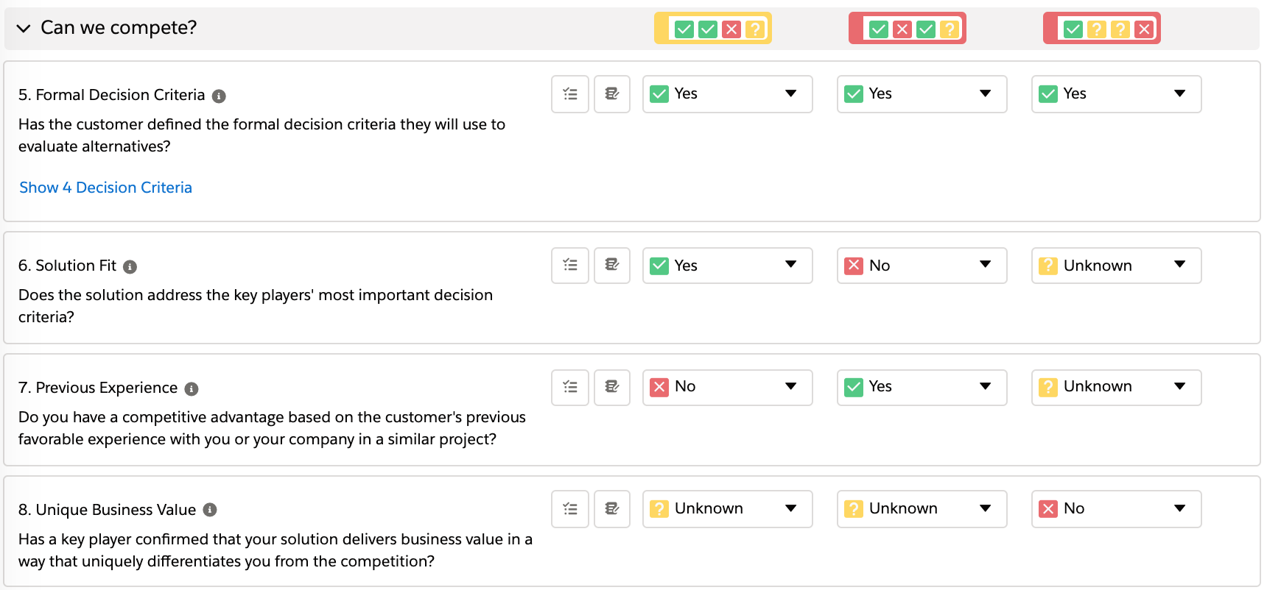
Coaching Questions
Win Deals That Matter
Best Practices and Coaching Guide
Assessment Key Question #2
Can we compete?
Consider each of these indicators from the customer’s point of view.
Assess the indicators Solution Fit, Previous Experience, and Unique Business Value for both you and your competition.
Opportunity Owner: Review in Advance For | Reviewers/Coaches: Questions You Might Ask
Formal Decision Criteria Has the customer defined the formal decision criteria they will use to evaluate alternatives? What are the customer’s defined decision criteria? How were the decision criteria decided? Which decision criteria are the highest priority? What are the key milestones in the customer’s formal decision process? Who will choose the short list of providers? | Of the defined decision criteria, which are the mandatory requirements? Can you rank the criteria highest to lowest based upon the priorities of the key players? What is the formal decision process? Who formulated the decision criteria? How?
Solution Fit Does the solution address the key players’ most important decision criteria? Is there anything about your solution that does not meet the key players’ most important decision criteria? If necessary, how would you shift the decision criteria to fit your solution? How well does your competitor’s solution fit the key players’ most important decision criteria? | Is the Solution Fit based on the Formal Decision Criteria? Does the solution help the customer with their compelling event? Are actions needed to ensure correct solution fit? What technical objections do we have to overcome to win? What external resources are required?
Previous Experience Do you have a competitive advantage based on the customer’s previous favorable experience with you or your company in a similar project? What previous experience has the customer had with you, your company and/or your solution, and how can you use this to your advantage? What is the customer’s prior experience with your competitor? | Who is the incumbent vendor, and how is their current relationship with the customer? What is the customer’s prior experience with our solution? How is this a competitive advantage? What is the customer’s previous experience with the competitor? How did they get involved in this opportunity?
Unique Business Value Has a key player confirmed that your solution delivers business value in a way that uniquely differentiates you from the competition? What business result does the key player value from your solution? How does the key player quantify the value? How does the key player differentiate you from your competitor(s)? | What specific measurable business value does the key player expect us to deliver? Have you confirmed that business value with other key players? Has a key player confirmed your differentiation? What business result does the key player value from your competitor’s solution? How is this a differentiator for the competitor?
7

Slide 11
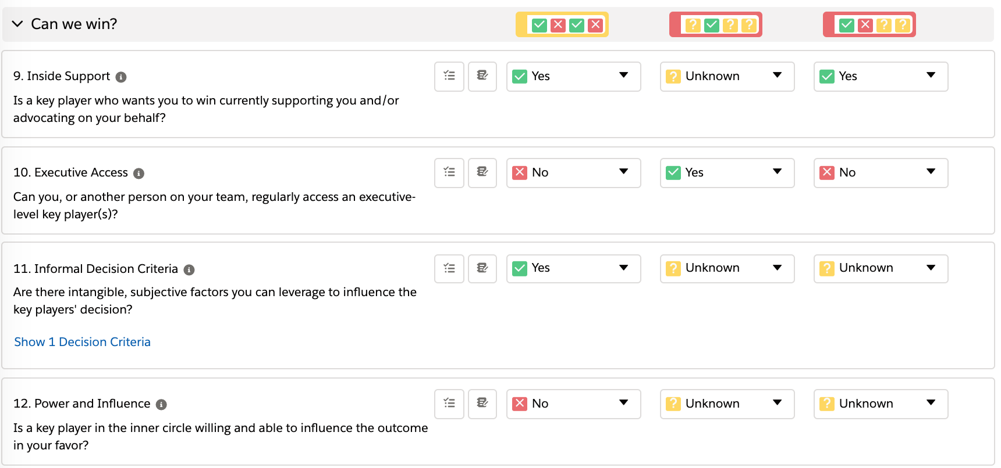
Coaching Questions
Win Deals That Matter
Best Practices and Coaching Guide
Assessment Key Question #3
Can we win?
Consider each of these indicators from the customer’s point of view.
Assess each indicator for both you and your competition.
Opportunity Owner: Review in Advance For | Reviewers/Coaches: Questions You Might Ask
Inside Support Is a key player who wants you to win currently supporting you and/or advocating on your behalf? What evidence do you have of the key player’s level of influence? What is motivating this key player? How does the key player win if you win, and/or lose if you lose? What has the key player done to indicate their inside support for you? What track record does this key player have of securing technical and commercial sign-off for similar projects? | Who in the customer organization wants us to win? Are they willing and able to act on your behalf? What is your evidence that they are key player(s)? What have they done to indicate their support? What is our evidence of supporter's credibility in the organization that makes them a key player? What is the connection to the political structure? Briefly describe the inside support that your competitor has?
Executive Access Can you, or another person on your team, regularly access an executive-level key player(s)? Who on your team can directly call on the customer’s executive-level key player(s)? Why is this executive giving you time? Which executive-level key player(s) can your competitor call on? Why is this executive giving your competitor time? | Who is the highest-ranking person involved in this opportunity that your team has met? Does someone on our team have return access to this executive with reasonable access time? Do we have the appropriate level of coverage at this level? Which executives do we need to meet? How will you gain access to them? With whom does the competition have regular access to?
Informal Decision Criteria Are there intangible, subjective factors you can leverage to influence the key players’ decision? What are the informal decision criteria (the private, unstated issues) that key players could use to make their decision if they believe that two or more suppliers meet the formal decision criteria equally? Which informal decision criteria are mandatory? How will you leverage the informal decision criteria to your advantage? | How will the decision really be made? What are the unstated issues? Whose private opinions do we know? Which ones count? How will the customer decide if it's a draw? How are these criteria connected to the Inside Support and Power and Influence indicators?
Power and Influence Is a key player in the inner circle willing and able to influence the outcome in your favor? What evidence do you have of the inner-circle key player’s level of influence? How has this person demonstrated their support for you? | Who stands to gain the most or lose the most from this decision? Who can change the rules to help you win? Who can create the urgency to help you now?
8

Slide 12
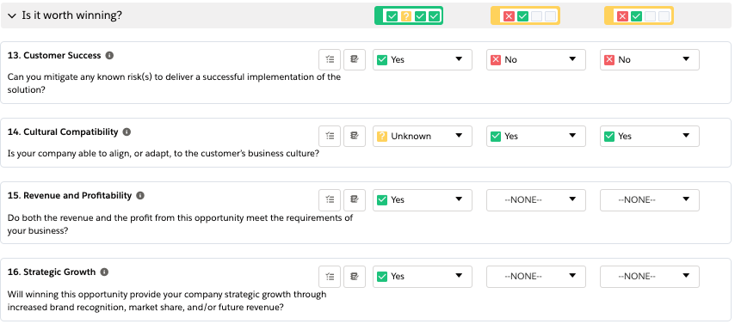
Coaching Questions
Win Deals That Matter
Best Practices and Coaching Guide
Assessment Key Question #4
Is it worth winning?
Assess the indicators Customer Success and Cultural Compatibility for both you and your competition.
Opportunity Owner: Review in Advance For | Reviewers/Coaches: Questions You Might Ask
Customer Success Can you mitigate any known risk(s) to deliver a successful implementation of the solution? What are the critical things that need to happen for the customer to be successful? If there are any third-party requirements, what are they? What risks have been identified, and what have you and the customer done to mitigate them? | Can we deliver on what we are promising? What is the customer’s ability to implement? What could cause this project to fail? What are the critical dependencies in our implementation plan? Are there any 3rd party requirements?
Cultural Compatibility Is your company able to align, or adapt, to the customer’s business culture? How do you characterize the customer’s business culture: bureaucratic, entrepreneurial, collaborative, or individualistic? How does your company’s business culture differ from the customer’s? How would your company need to adapt to the customer’s business culture? | How would you characterize the customer’s philosophy or culture? How would you describe the customer’s attitude toward vendors? Who is their most valued vendor and why? Are we willing and able to adapt to the customer’s business culture?
Revenue and Profit Do both the revenue and the profit from this opportunity meet the requirements of your business? What revenue does this opportunity represent for the company? What is the resource effort required to win this opportunity? What is the projected profit from this order? How could you improve the revenue or profitability of this opportunity? | What is the significance of this order to our company? To your quota? What are the future opportunities that will result from this sale? What is the profit for this order? Does it exceed our profit threshold? How could we improve the profitability of this opportunity?
Strategic Growth Will winning this opportunity provide your company strategic growth through increased brand recognition, market share, and/or future revenue? What strategic growth will your company gain if you win this opportunity? What is the overall strategic approach, investment, and estimated timing to achieve the growth? | What is the value of this sale to us beyond the revenue? How could you leverage this sale into other companies or markets?
9

Slide 13
Win Deals That Matter
Best Practices and Coaching Guide
10

Slide 14
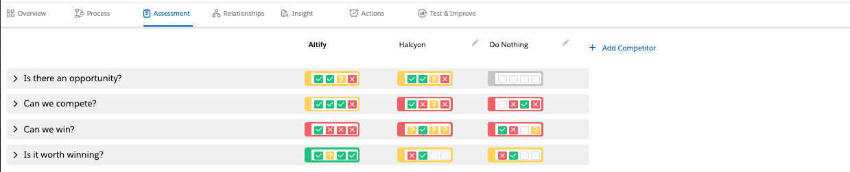
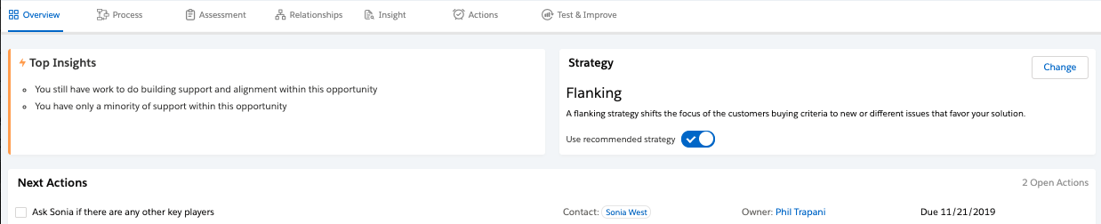
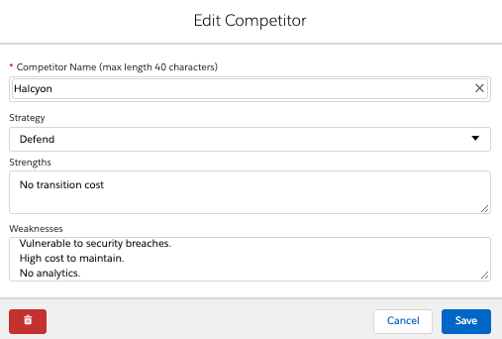
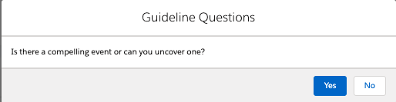
Win Deals That Matter
Best Practices and Coaching Guide
Competitive Strategy
To win an opportunity, you and your team will typically have to compete not only against other suppliers, but also against the customer's priorities and budgets which may tend to push them away from your particular deal. Utilize the Assessment page in your plan to align the team around your competition’s strengths and weaknesses for this opportunity.
You and your team can then develop a competitive strategy to overcome these factors. Once the team is aligned to the strategy, the only time you should consider a change in the strategy is when the ground rules change, or there is a major change in your target account.
There are two types of strategy, Attack and Position, to which the five (5) competitive strategies belong: Frontal, Flanking and Fragment are Attack strategies, while Defend and Develop are Position strategies.
 | ATTACK Compelling Event exists and you are in a position to compete |  |  | POSITION No Compelling Event exists or you are not in a position to compete
 | Frontal | Flanking | Fragment | Defend | Develop
Definitions | Direct approach based on client’s value perception of your overwhelming superiority in solution, price, or reputation vs their alternative. | Shift the focus of the customer’s buying criteria to a new or different issue that favors your solution. | Divide the opportunity into smaller pieces you can address in a superior fashion. | A proactive strategy that protects your position from the inevitable assault from the competition. | Create and communicate a compelling reason to change.
Purpose | To quickly and decisively subdue the competition. | To change the conversation and put your competitor in a react mode. | To get your “foot in the door” -or- You can’t win the entire opportunity (lack of relationships, business value, criteria, etc.). | To keep the competition from gaining ground within your account. | Business development strategy -or- To slow down the sale because you do not have a current solution.
Variations | Solution/Price Reputation | Alter the rules (disruption) Acknowledge and expand | Niche Peaceful co-existence | Isolate Insulate | Invest Delay
11

Slide 15
Win Deals That Matter
Best Practices and Coaching Guide
 | ATTACK Compelling Events exists and you are in a position to compete |  |  | POSITION No Compelling Event exists or you are not in a position to compete
 | Frontal | Flanking | Fragment | Defend | Develop
Guidelines for each Strategy | Value: must have an overwhelming advantage 3:1 customer perception in value Key Relationships: who can support and defend you internally Criteria: understand both formal and informal decision criteria UBV: unique business value defined by key player(s) | Key Relationships: who can support and defend you internally Criteria: you understand both formal and informal decision criteria UBV: unique business value as defined by the customer Right Timing: timing in this strategy is everything Right Target: focused targets, agendas and key individuals Right Issues: carefully pick the issues to address | Correct Base: confirm that you have selected the correct base or foot in the door to exploit future opportunities Support: inside support and confirmation from the customer that the subsidized value you bring is still deemed valuable | Higher Ground: expanding your relationships to more influential managers or executives Create Tangents & Diversions: and competitive traps to dilute the competitor’s efforts Be Indispensable: continue to demonstrate and articulate your credibility and business value you can deliver | Be There: establish presence for the future Learn: and continue to collect profile data Focus: on developing a relationship with a key player and capturing informal decision criteria Relationships: requires key influential relationships who can support and defend you internally
Other Key Points | Solid incumbent strategy Combines size, speed, and or surprise Easy to defeat because it is based on value perception Resource Intensive-people, capital, resources Blatant and obvious | This strategy could open the opportunity up to new competition Be clear about the decision criteria to alter or introduce, and be able to express the value to the key players Don’t play by the rules- you are taking a completely different approach that was NOT requested by customer Requires multiple levels of inside support/messaging | Should be considered a short-term strategy What makes this strategy different is that your objective is a limited target and you are not relying on the wholesale defeat of your competitors The implementation of this strategy also means your competitors will retain or earn some portion of the overall opportunity | Consider hosting ongoing scorecard or business reviews with key players to capture value, assess mood and learn of new opportunities Be aware of your competitor’s shifting strategies to win your customers Beware of self-isolation | Discovery via building an Insight Map and Relationship Map Qualify your ROI, continually refining your ROI
12

Slide 16
Win Deals That Matter
Best Practices and Coaching Guide
Competitor Counters
The information will help your team develop competitive counter strategies and tactics.
Competitor Strategy |  | Typical competitor tactics (tactics the competition uses to implement their strategy) | Countertactics (tactics you can use to block a strategy)
Compelling Event Exists AND You Are In A Position To Compete → ATTACK | Frontal | Establishes their features as standard specifications/criteria Leads with aggressive pricing, terms and/or timing Calls high, on strong relationships ‒ early to shape project; late to protect the position Relies heavily on their mentors for internal selling Positions project as migration path for their installed base; upgrade only, no switching costs, etc. Positions their knowledge of customer’s environment as a key criteria | FLANK: Alter criteria by expanding project scope, compelling event, or political influence DEVELOP: Slow decision process by expanding compelling event FLANK: Expand political structure to include mentor/supporter; help them see a reason to get involved FLANK: Highlight your advantages in a manner that infers competitor’s strengths are vulnerabilities FRAGMENT: Pursue a niche you can exploit
 | Flanking | Attempts to change specification/criteria to their advantages Calls high, to establish relationship ‒ early to influence decision criteria/process; late to stay in game and/or offer incentives Expands scope of project by creating new compelling events, expanding political structure, introducing new technology Positions your strengths as vulnerabilities, which in turn support their advantages Mobilizes the champions from other areas to get involved | FRONTAL: Accelerate decision process by emphasizing impact of compelling event DEFEND: Pre-condition decision makers/approvers to block competitor’s attempts to call high or involve others, thus mitigating their decision-making authority DEFEND: Emphasize keeping project focused to ensure compelling event is addressed DEFEND: Pre-condition key influencers to discredit any attempts to change focus from addressing the compelling event or decision criteria/process
 | Fragment | Focuses efforts on a niche or subset of project (project component, customer division, business unit, geographic region, etc.) Expounds benefits of a second supplier Attempts to look like a friend to you, support/complement your efforts, approach you with joint-venture idea Attempts to convince customer that project is in fact multiple projects Attacks one of your vulnerabilities they can exploit, accelerate decision before you can address vulnerability Calls high to position some or all of the above, and gain senior-level support to split the business | FRONTAL: Expound benefits of single supplier – consistency, coordination, accountability, pricing, etc. FLANK: Pro-actively address vulnerabilities with key influencers highlighting steps taken to eliminate problem, or similar projects were the issue was a nonfactor; also pre-condition customer that attempts by competitors to highlight these issues as vulnerabilities are the tactics of the “uninformed,” encouraging reflection on what else the competitor might not be current on FRONTAL or FLANK: Act friendly toward competitor’s peaceful coexistence tactics, but concede no share; fill the void yourself by expanding your offer or mitigating the niche FLANK or DEFEND: Use political influence to divert customer’s efforts to low potential/profit segment of the customer’s business
13

Slide 17
Win Deals That Matter
Best Practices and Coaching Guide
Competitor Counters
The information will help your team develop competitive counter strategies and tactics.
Competitor Strategy |  | Typical competitor tactics (tactics the competition uses to implement their strategy) | Countertactics (tactics you can use to block a strategy)
NO Compelling Event Exists OR You Are Not In A Position To Compete → POSITION | Defend | Projects still uncertain, actively working to establish significance of compelling event Doesn’t block your attempts to establish a beachhead; may have a reason for letting you in the door; i.e., X = -1 Blocks your access to key influencers by smothering them with attention Spreads fear, uncertainty and doubt (FUD) about your encroachment Expands their presence in other customer divisions, increasing senior level exposure Conducts “Annual Partnership Meetings” with key customer influencers | DEVELOP: Support competitor’s efforts to establish a compelling event, track their activity via supporters to be close by and informed if they are successful FRAGMENT: Carefully qualify beachhead business conceded to easily by incumbent competitor FRAGEMENT or FLANK: Identify a new niche opportunity and act quickly to create the compelling event and to secure the business DEVELOP: Identify and implement your own political alignment strategy aimed at different divisions or “high potential” managers
 | Develop | Attempts to slow the decision process down by spreading FUD, hint about pending new releases, recommend needs analysis Invests resources; i.e., time, people, senior management, etc., to close ground (if they are losing but still have hope) or establish position for future competition (if they are really losing and have no hope) Works to create/build significance of compelling event, introducing research, calling high to create bias for action, etc. | FRONTAL, FLANK or FRAGMENT: Accelerate the decision process by emphasizing the critical nature of addressing the compelling event quickly, highlighting consequences and payback DEFEND: Pre-condition key influencers to guard against competitor’s attempts to invest resources which will slow down efforts to address compelling event DEFEND: Keep your eyes open, enlist champions and keep competitive intelligence up-to-date to detect early warning signals that competitor’s “investing” tactics are succeeding
14

Slide 18
Strategy Coaching Questions
Win Deals That Matter
Best Practices and Coaching Guide
Opportunity Owner: Review in Advance For | Reviewers/Coaches: Questions You Might Ask
Competitors Are we aware of the competition; other suppliers, alternate uses of capital, build it yourself, do nothing? What is our knowledge of each competitor’s alignment within the customer’s organization? Do we understand each competitor’s strengths and weaknesses? What insights do we have regarding the strategy each competitor will most likely employ? | What is the competition proposing? What are all alternatives the customer is considering to solve this problem? Are the strengths and weaknesses specific to this opportunity? Not the account or market level. Have the strengths and weaknesses been confirmed with your mentor or supporter?
Our Strengths and Weaknesses Are they realistic? Are they from the customer’s key player(s) point of view? What actions are in place to emphasize our strengths and minimize our weaknesses? | Are our strengths and weaknesses specific to this opportunity? Do they go beyond the product and technical issues? Have they been confirmed by the customer’s key player(s), and do these matter to them?
Competitive Strategy Does the customer have a compelling event? Are we in a position to compete? What is our position relative to the competition? | How did you go about selecting this strategy? Will your sales team clearly understand and agree on your approach? How could the competition defeat this strategy? Where are you vulnerable?
Competitive Strategy Best Practices
Know who the key players are, their formal and informal decision criteria, and your current relationship.
Assess the competitor’s strategy, strengths, and weaknesses – from a solution and relationship standpoint.
Position until there is a compelling event and good solution fit.
Respect and align with the caveats listed with each strategy, they significantly improve your odds of winning.
Once the team is aligned to the strategy, the only time you should consider a change in a strategy is when the ground rules change, or there is a major change in your target account.
15

Slide 19
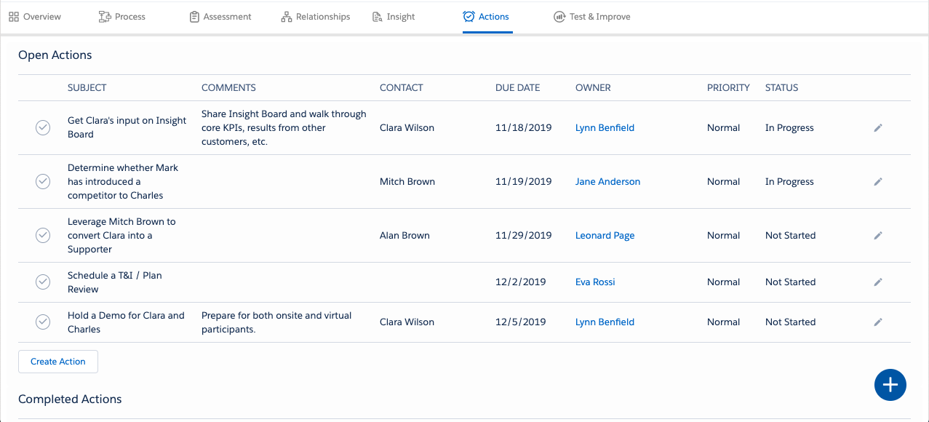
Win Deals That Matter
Best Practices and Coaching Guide
Actions
Revenue team’s who are aligned to the opportunity’s Assessment and Strategy are in a better position to apply focus and effort in areas that matter most, both to you and to your customer. As a revenue team, you want to build an action plan that will help address any gaps or vulnerabilities in your plan. You want to focus on actions that leverage the strategy you have selected to win the opportunity.
Action Coaching Questions
Opportunity Owner: Review in Advance For | Reviewers/Coaches: Questions You Might Ask
Are actions clear and simple to understand, or are they vaguely worded? Are there any random activities, or wasted resources? Do we have too much activity or resources driven by people Outside the Political Structure? Are any actions inconsistent with the strategy? Are we addressing all acknowledged vulnerabilities in the plan? Are we addressing the competitive political issues? Are there wide gaps in time? Are we missing anything? | How does this action advance your strategy? What do you want the customer to do as a result of this action? Has your mentor reviewed this plan? Has your revenue team bought into this plan? Does each action contain the following components: - What needs to be accomplished? - When should it happen? - Who will execute the action? - What resources will we need?
16

Slide 20
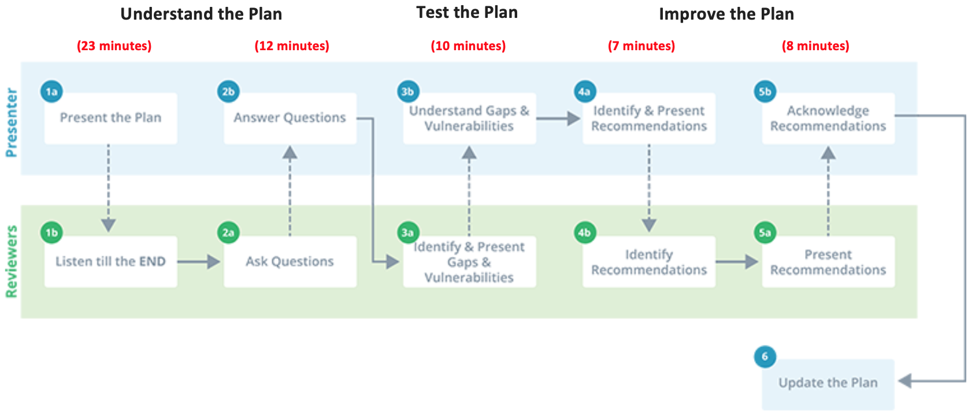
Win Deals That Matter
Best Practices and Coaching Guide
Opportunity Plan Test & Improve
What is Test & Improve?
Test & Improve is a best practice method for reviewing an opportunity in a collaborative environment. It allows revenue teams to leverage their cumulative experience to have the greatest impact on their customer and the opportunity.
The outcomes when done well include:
  Uncovering potential vulnerabilities and raising ideas to address them
  Developing a better understanding of
    your customer’s business/opportunity
    your relationships with your customer
    the business value from your offering(s)
  Better anticipation and blocking of competitors’ moves
  Alignment of the revenue team to the plan
  Ambient benefits from sharing ideas and best practices across teams
  Improved win rates and sales velocity
When should you conduct Test & Improves?
Revenue teams should establish a weekly recurring time for Test & Improve sessions. Friday mornings from 8:00-9:00 and 10:00-11:00 are fairly common. This allows opportunity owners to schedule and adequately prepare, and reviewers to block the time and engage.
Which opportunities should we Test & Improve?
Of course, the short answer is ‘the opportunities you need to win’. Here are some useful scenarios revenue teams often use:
  Early stage to Test & Improve their Position strategy
  Mid stage to Test & Improve their Attack strategy
  Late stage to Test & Improve the Close plan
Who should participate?
The presenting team should include the individuals actively engaged in the development of the opportunity plan.
The reviewing team should include peer sellers, revenue team members with knowledge of the competition and partners, along with the revenue leaders required to decide on resources and/or focused investments.
How long does it take?
As illustrated below, Test & Improve is a three-step process. Most opportunity plans can be reviewed in
1-hour; 35 minutes to understand the plan, 10 minutes to test the plan, then 15 minutes to improve the plan. Timing may vary depending on level of participation and complexity of the opportunity but avoid the temptation to take short cuts in order to save time. Plan ahead and schedule the time necessary to complete quality Test & Improve review sessions for opportunities you need to win. If you are wondering why, take a second look at the six (6) outcomes when done well. The investment is worth it!
17

Slide 21
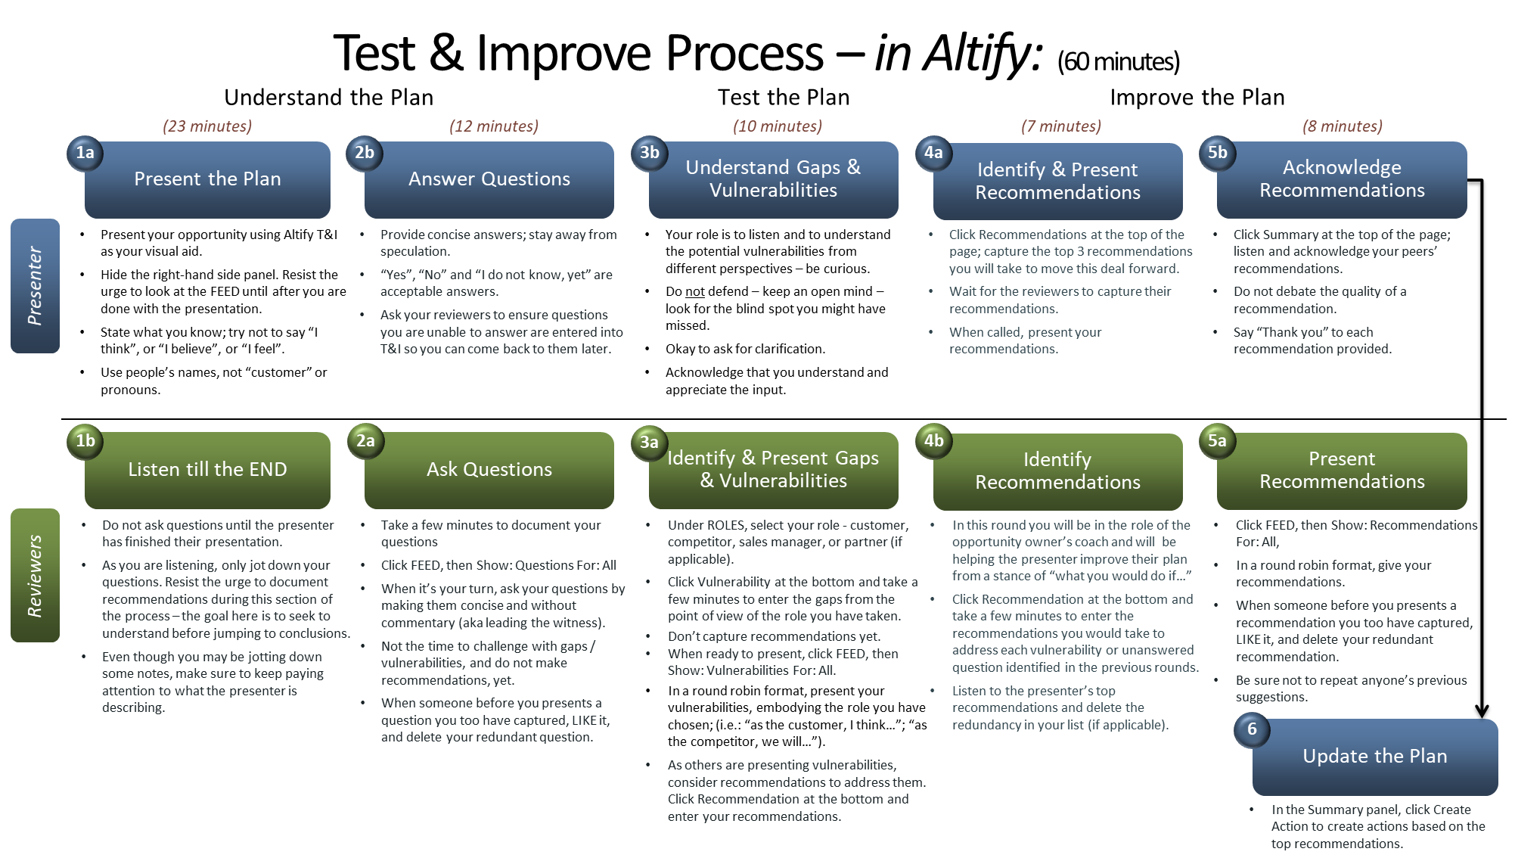
Win Deals That Matter
Best Practices and Coaching Guide
Let’s now walk through best practices for each of the three steps. The blue shades in the diagram are actions by the presenters, while the green shades are actions for the reviewers. There should also be a facilitator who guides the team through the process.
18

Slide 22
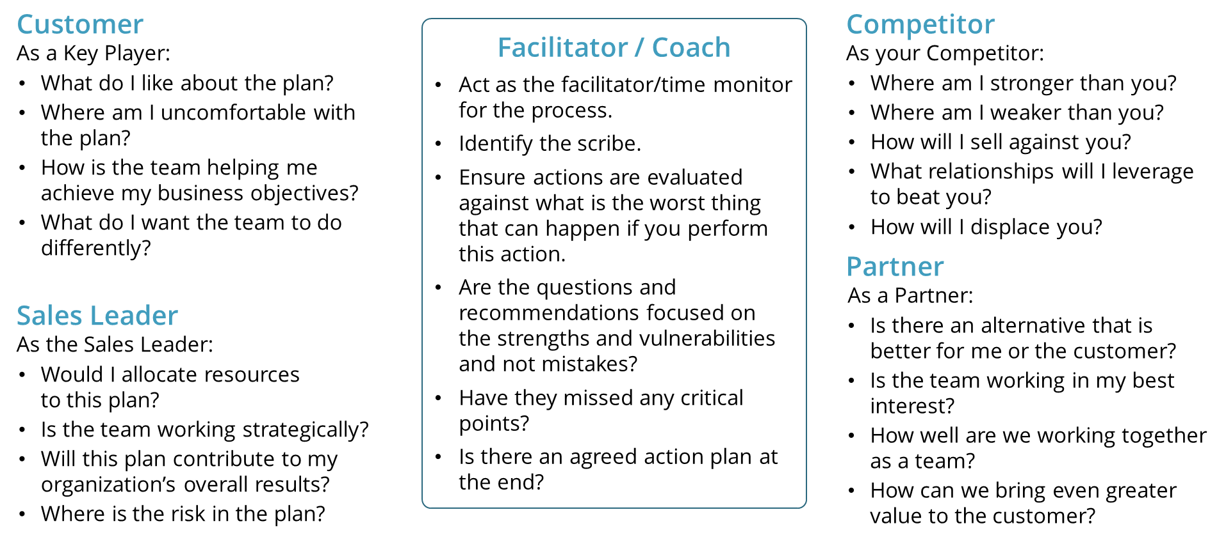
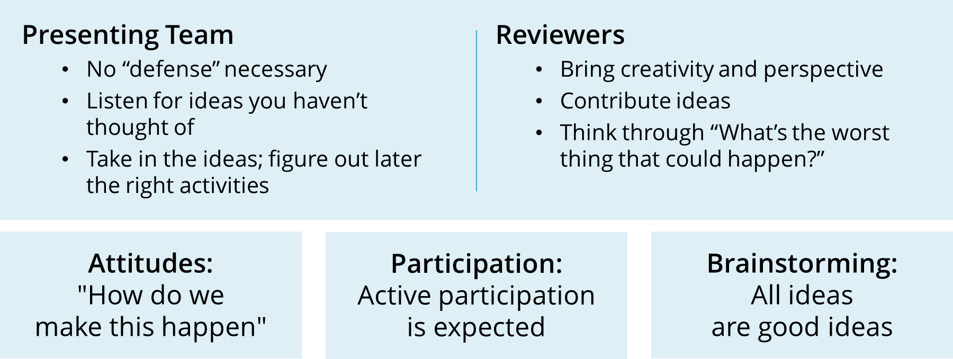
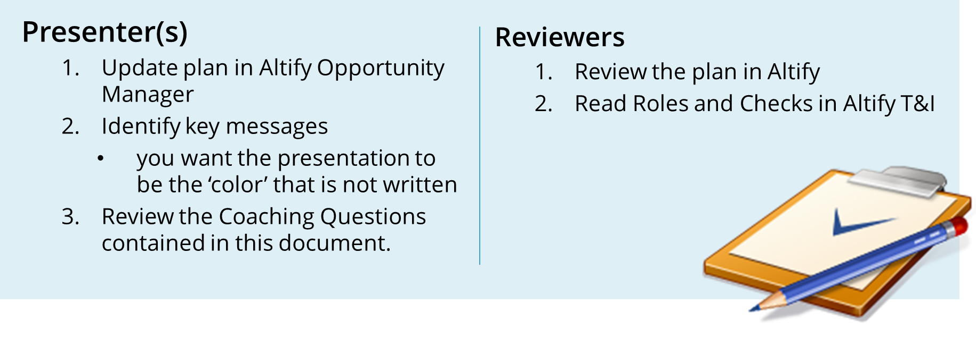
Win Deals That Matter
Best Practices and Coaching Guide
Perspectives for Reviewers
It is often helpful to have the reviewers take on certain roles in the process. If you have a number of reviewers available, you can set up teams according to these roles. The reviewers will represent their assigned role or perspective when reviewing the plan and making recommendations.
Rules of Engagement for the Test & Improve
Preparing for the Test & Improve
The Spark Coaching Questions contained in this document are an excellent preparation guide for the presenting and reviewing teams. They provide details on 1) what to look for when reviewing the plan in preparation for the Test & Improve and 2) possible clarifying questions to ask during the session.
19

Slide 23
Win Deals That Matter
Best Practices and Coaching Guide
Preparing the Presentation
The following script is a suggested flow with estimated timing (25 minutes) to help the presenting team prepare for the Test & Improve presentation. Core team members involved in developing the plan should contribute to the overall presentation.
# | Topic | Source | Minutes | Notes
1 | Overview of the Customer and Opportunity | Process | 1-2 minutes | Briefly provide a high-level overview of the customer’s business and your history with them: The solution you are selling, order amount, and anticipated close date Where you and the buyer are in the sales process
2 | Status of Key Relationships | Relationships | 4-5 minutes | Describe Key Player Support: For you: What is your evidence that you have Supporters and Mentors? What do they win if you win? How do they win? How have they demonstrated their support for you? For something else: Who are your Non-Supporters and Enemies? What do they win if you lose? How do they win? How have they demonstrated their support for your competitor? What are your relationship development priorities and strategies?
3 | What the Customer Needs to Achieve | Insight | 4-5 minutes | Tell the customer story – describe: The customer’s Goals and who the Approver/Decision Maker is for each The Pressures and how they are impacting the Goals The Initiative and the Obstacles that need to be enabled or fixed How our Solution helps to relieve their Pressures and contributes to achieve their Goals
4 | Current State and Resource Focus | Assessment | 4-5 minutes | Use the 4 key questions to present how you are doing vs. your competition, your competitor’s strengths and weaknesses, and where you are currently focusing resource efforts: Is there an opportunity? Can we compete? Can we win? Is it worth winning?
5 | Strategy and Concerns | Overview | 2-3 minutes | Present your strategy and primary concerns: Verbalize the details of your strategy to win the opportunity Are there requirements that will block us or block our competition? Where might your strategy be affected? Where are you most vulnerable? Other than price, why might you lose?
6 | Asks | Actions | 2-3 minutes | Explain your high priority actions: Where do you need help?
20

Slide 24
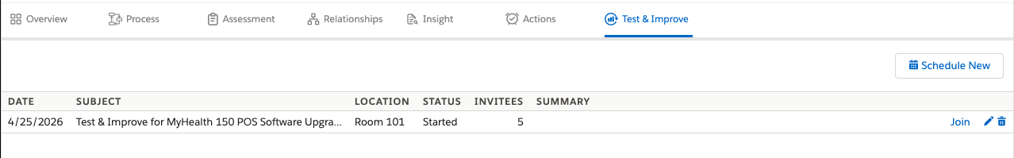
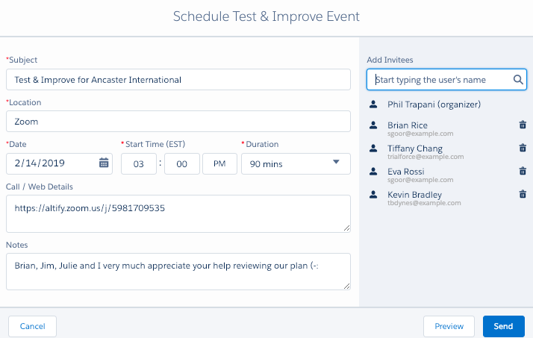
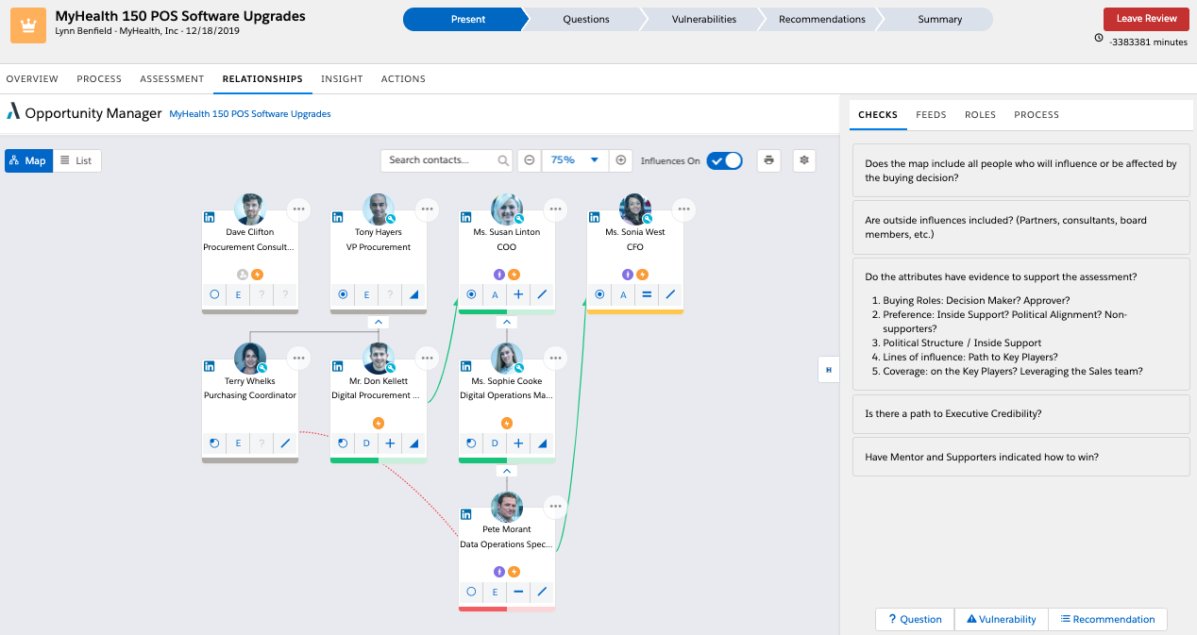
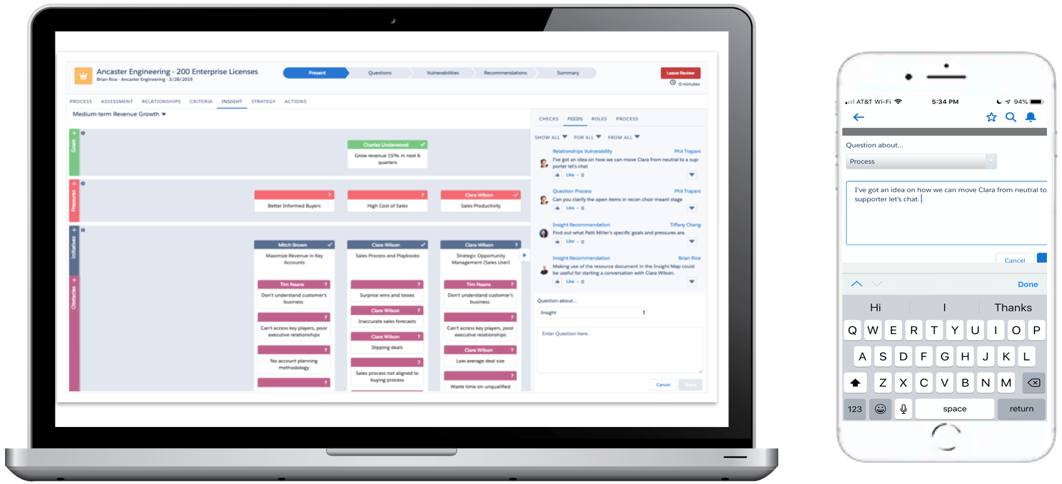
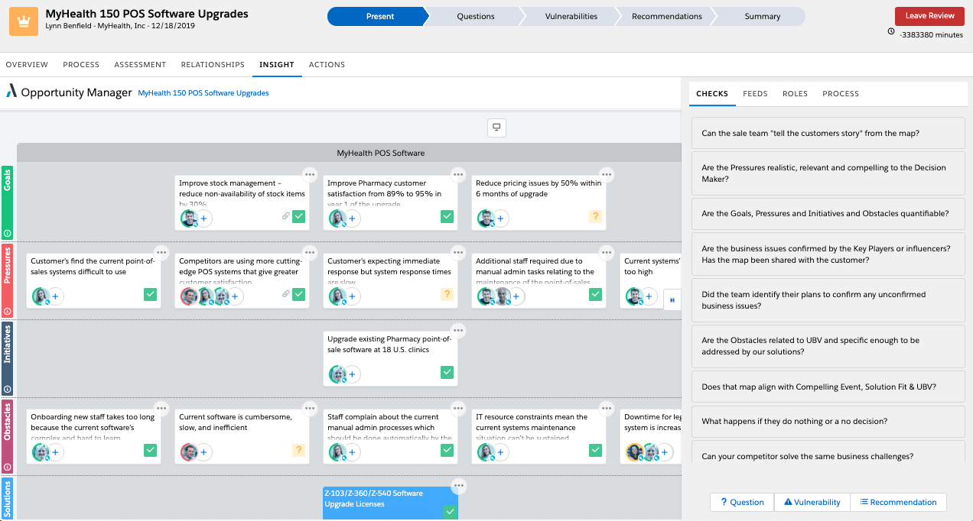
Win Deals That Matter
Best Practices and Coaching Guide
Let the Spark Tool Help with Your Test & Improve
The Spark Test & Improve tool provides a digital structure for your meeting. It’s a must when teams are spread across geographies and virtual meetings are the norm.
Scheduling triggers an email calendar invitation to your participants with a URL to the opportunity plan.
Preview mode provides presentation best practice coaching.
The Spark T&I tool removes the need for a scribe; reviewers can submit their questions, vulnerabilities, and recommendations from their phone or computer.
21

Slide 25
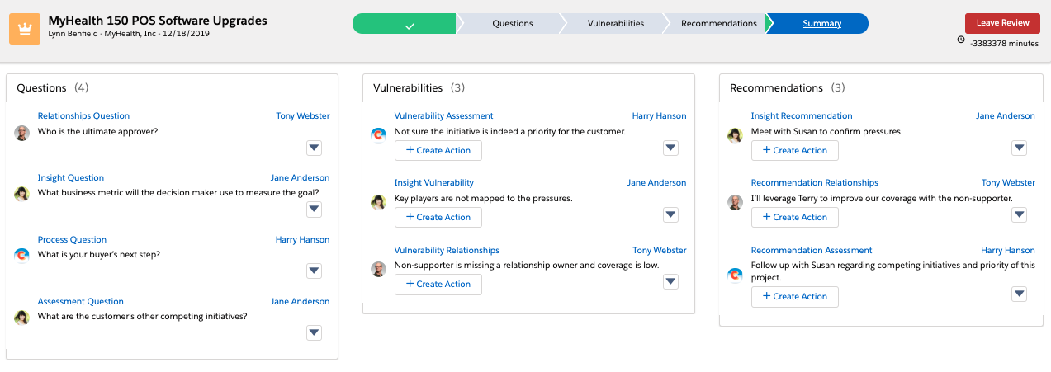
Win Deals That Matter
Best Practices and Coaching Guide
Questions, vulnerabilities and recommendations raised by reviewers are captured as a permanent record in the Summary making it simple to refer to them at a later date.
Best Practices When Conducting Virtual Test & Improve Sessions
Facilitator / Coach
Explain the Test & Improve process, timings and assign reviewing roles.
Manage the conversation and time for each step.
Instruct participants to enter their questions, vulnerabilities and recommendations at the appropriate time.
Remind people to stop entering information when the time is up.
Capture additional recommendations during the final conversation that may be missed.
Presenter(s)
Launch the Test & Improve session to begin.
Present, answer questions, share vulnerabilities, and lead off the recommendations section as directed by the facilitator/coach.
Reviewers
View the opportunity on the presenting screen while the opportunity owner is presenting. Remain on the presenters screen unless you have two screens available to display both simultaneously.
Use your phone or computer to enter your questions, vulnerabilities, and recommendations as directed.
22

Slide 26
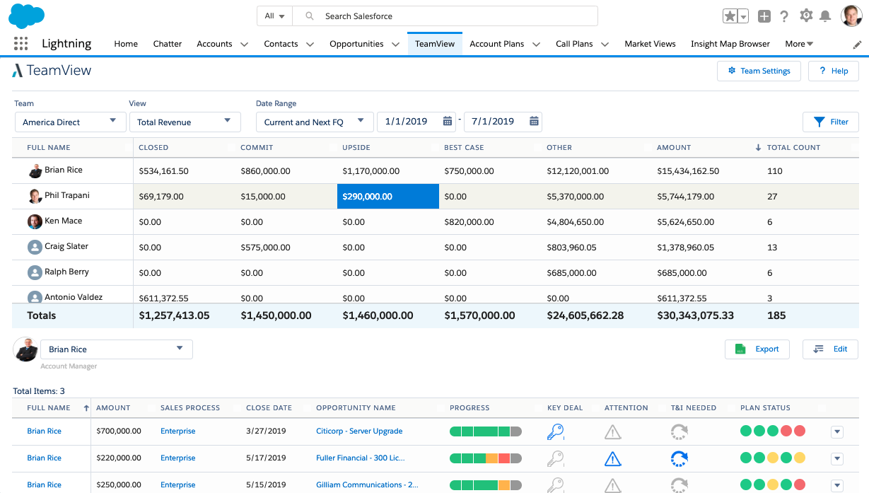
TeamView Coaching Questions
Win Deals That Matter
Best Practices and Coaching Guide
TeamView
To optimize customer revenue, a sales leader needs to focus resource investments for each opportunity in their pipeline. TeamView provides insightful ways of looking at your sales pipeline, so that you are well prepared for revenue team meetings and have all the data you need for forecasting and reporting to higher management.
TeamView helps you to see:
How opportunities are progressing,
Which opportunities need attention, and
When a seller’s opportunity needs your coaching and support.
Collaborate with your revenue team to improve productivity. For example, assess your team’s pipeline in advance of a call, mark the deals you want to review, and focus on those during the call.
Questions You Might Ask
How solid are the deals in each pipeline category; i.e. Commit, Upside, Best Case? Review the opportunities within each category. What is the Progress and Plan Status of my team’s Key Deals, and is the revenue team aligned on what to do next? Which deals are at risk? Are there mid-to-late stage deals with low progress on Plan Status, for example. What key changes have there been on the important deals? (check Opportunity History) Is there a clear plan of action for the opportunities marked for special attention? Have my team’s Test & Improve reviews been scheduled?
23

Slide 27
Win Deals That Matter
Best Practices and Coaching Guide
24

Slide 28
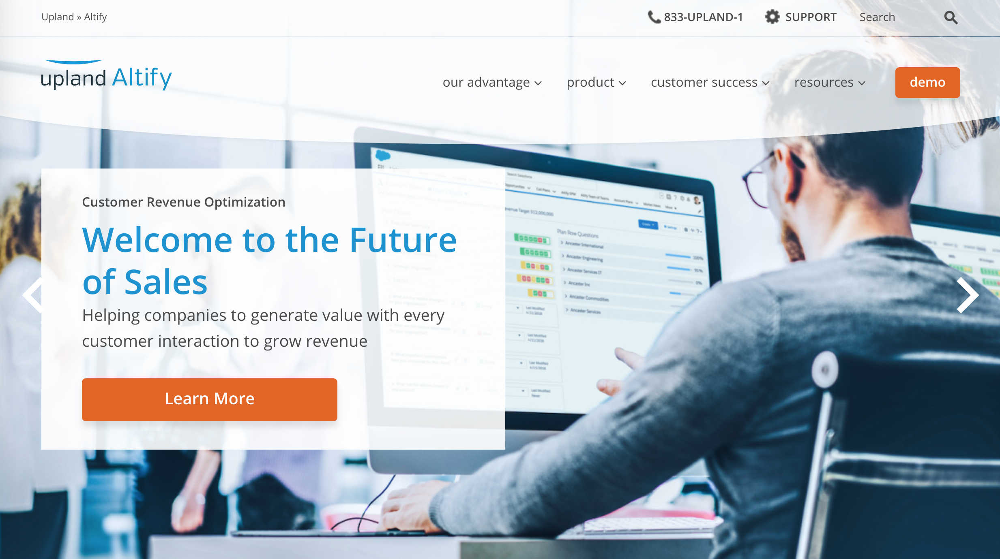
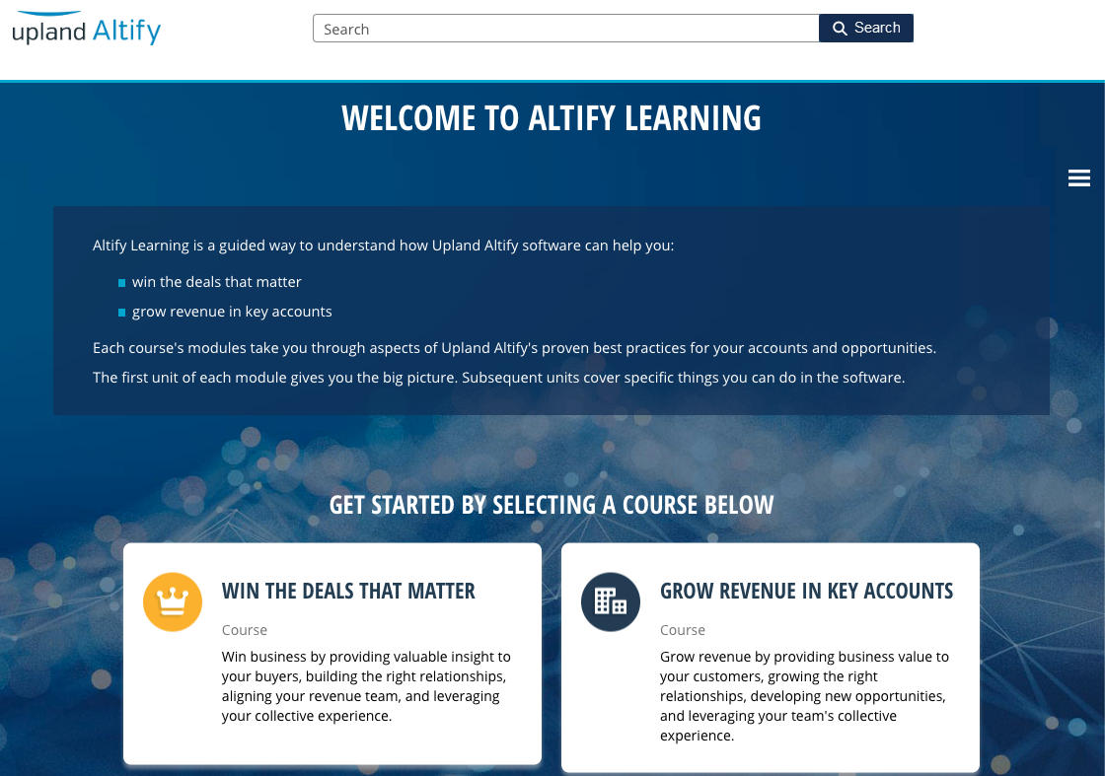
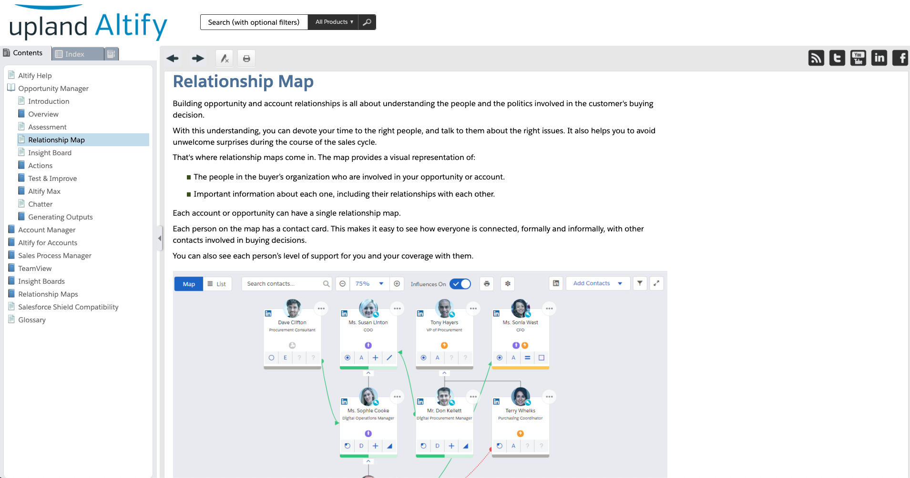

Resources
Many additional resources are available to support your usage of Spark.
www.uplandsoftware.com/altify/
Our website provides access to webinars, podcasts, videos, and publications
related to the Altify methodology and software.
Altify Learning
Altify Learning is a guided way to understand how Upland Altify software
can help you:
win the deals that matter
grow revenue in key accounts
Each course's modules take you through aspects of Upland Altify’s
proven best practices for your accounts and opportunities. The first
unit of each module gives you the big picture. Subsequent units cover
specific things you can do in the software.
Altify Online Help
Altify software includes interactive online help that provides answers to
the most common questions.
Click on the in the upper right-hand corner of the Altify screen, then
click ‘Online Help’.

