Slide 1
Your Proposal Development Team
January 2021
RFPrequests@teladoc.com

Slide 2
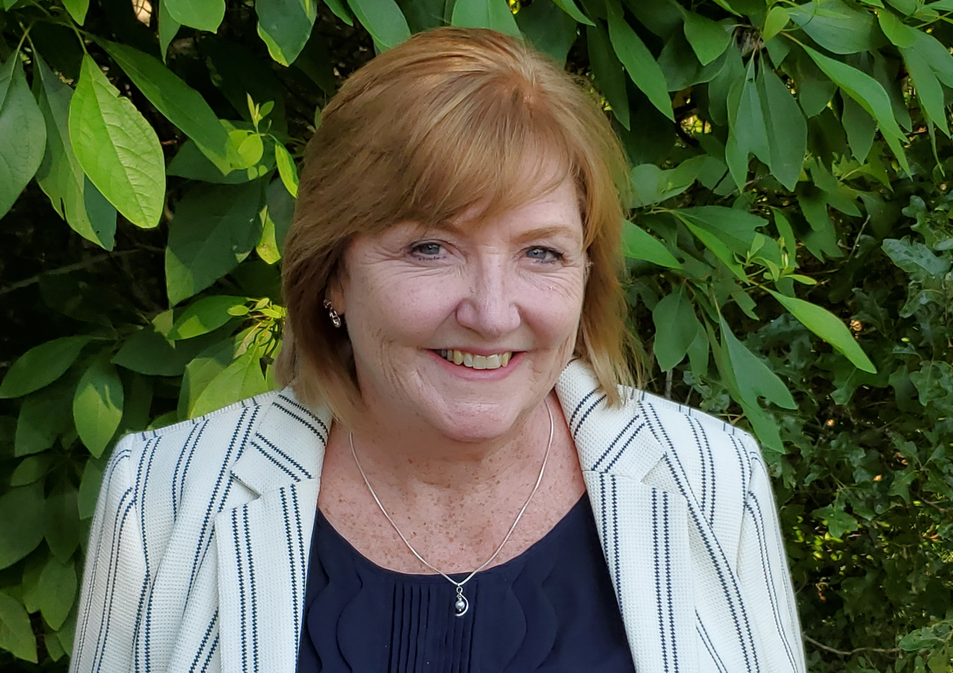
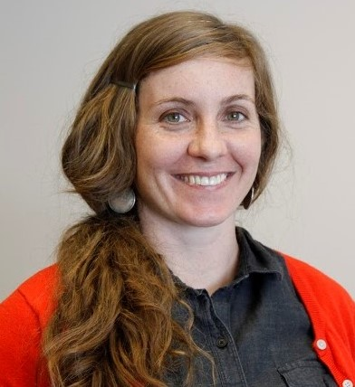
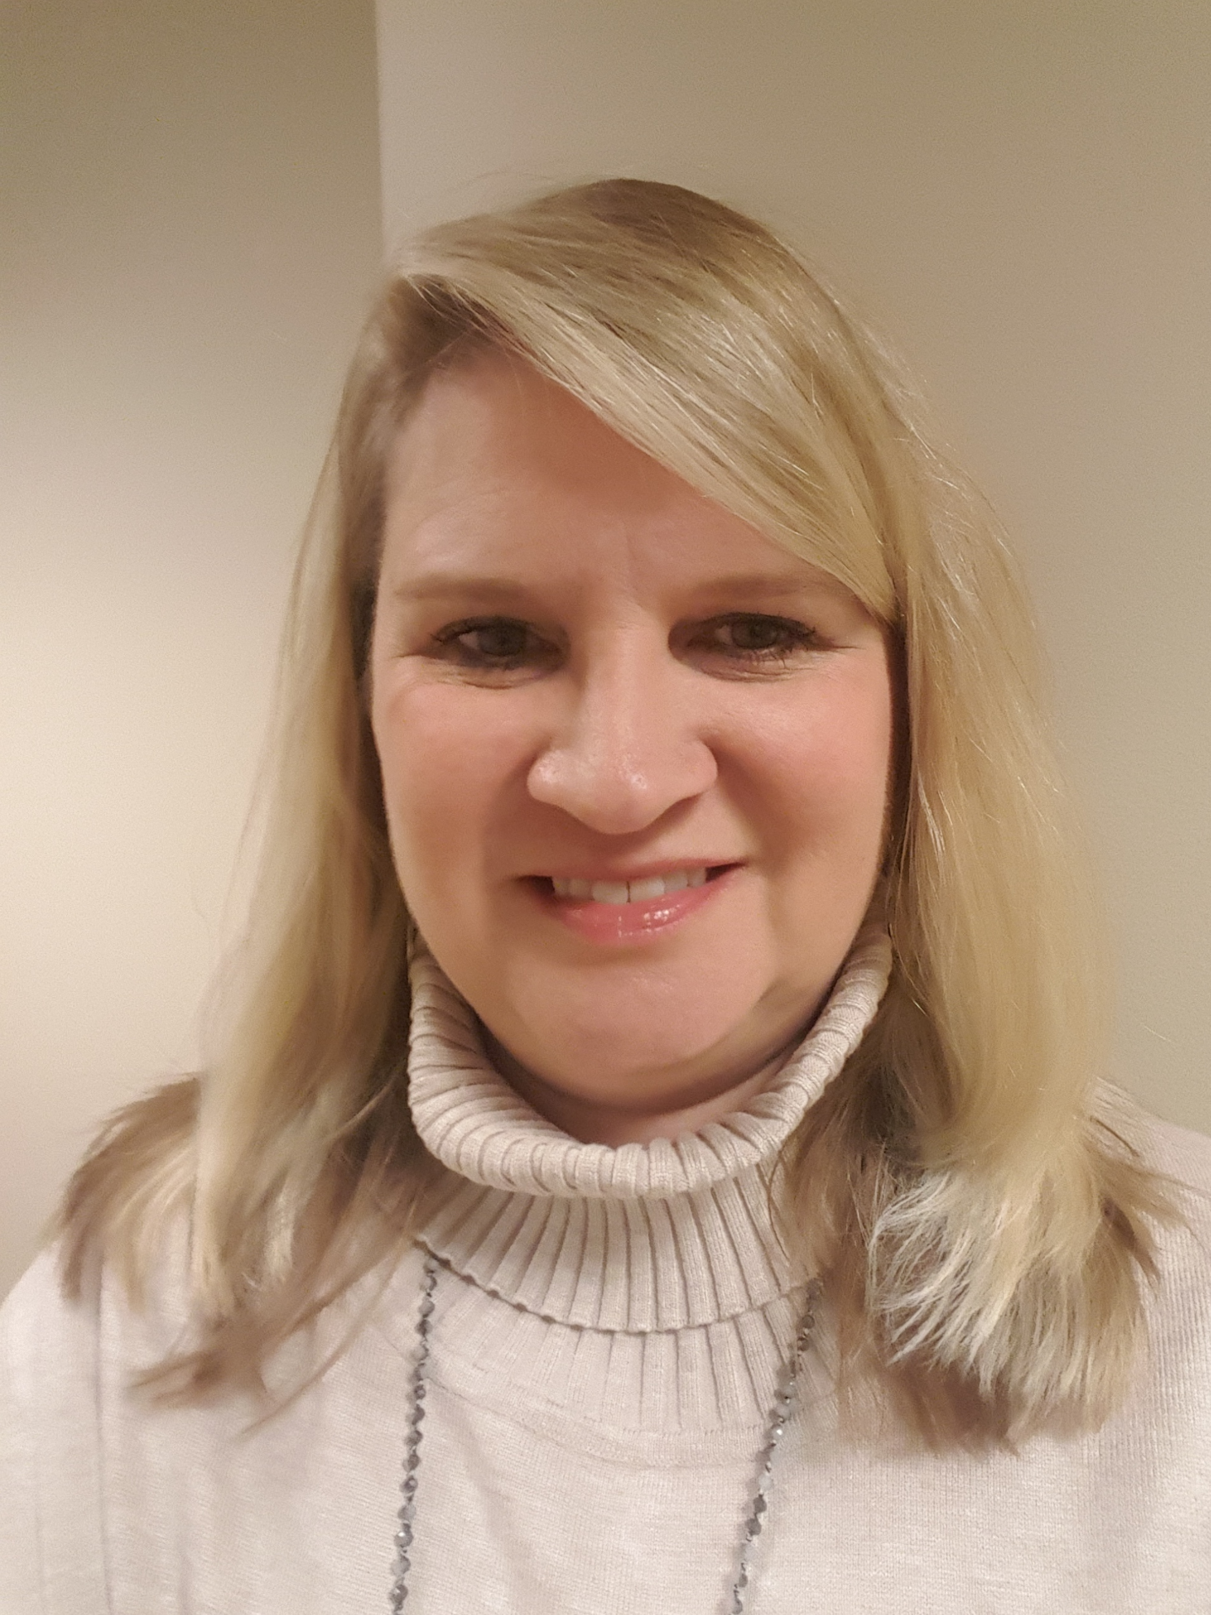
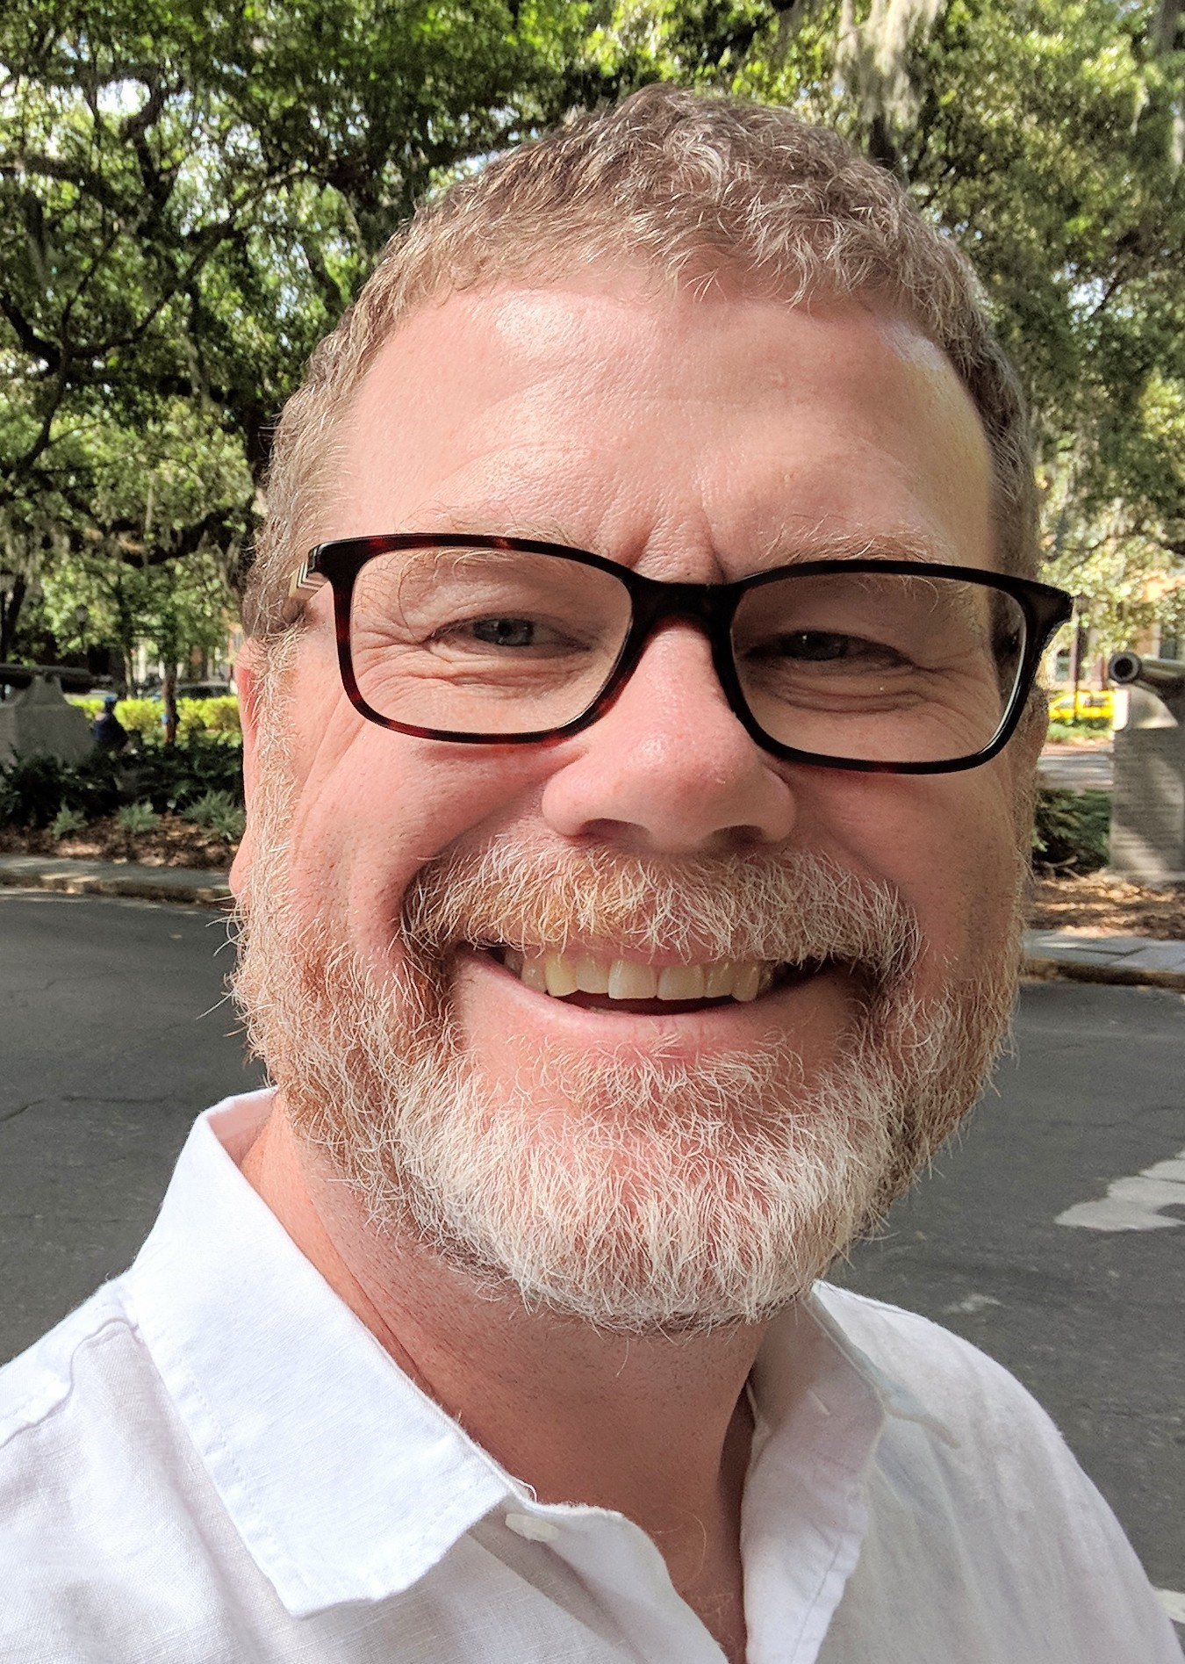
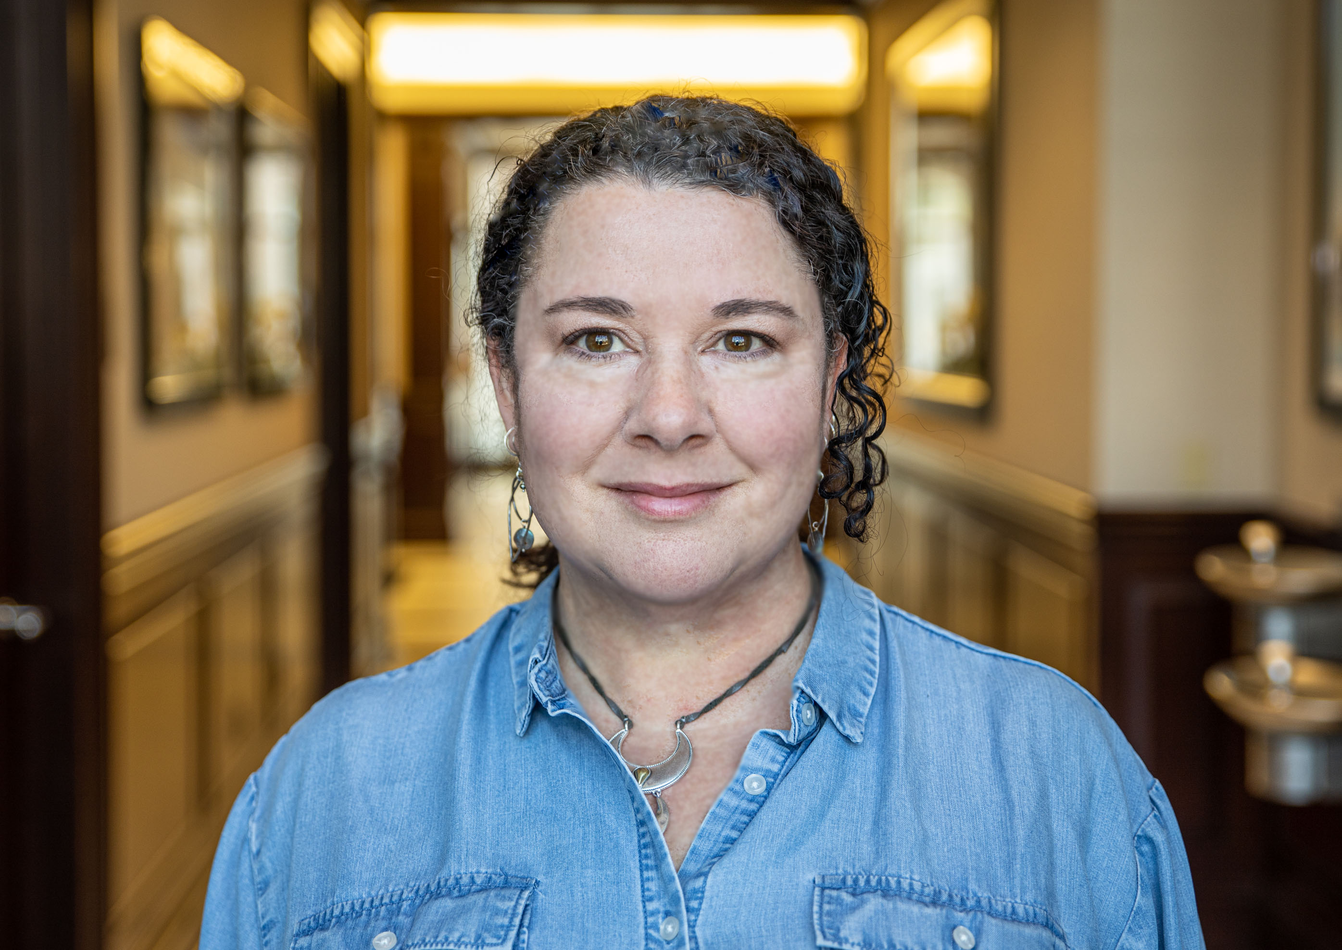
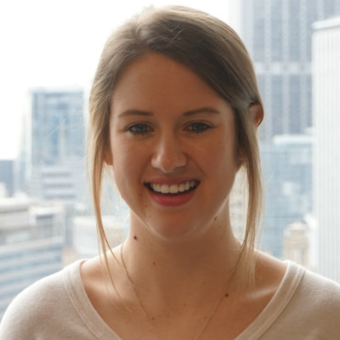
The Proposal Development team has >80 years of experience
Tracy Warren
Allie Hull
Proposal Writer
Livongo Solutions
Mary Solomon
Proposal Manager
HHS Solutions
Mary Solomon
Proposal Manager
HHS Solutions
Vanessa Elrod
Proposal Manager
USGH Solutions
Tom Ownbey
Proposal Manager
USGH Solutions
Group Health

Slide 3
The Proposal Development team exists to help Sales win
Our mission is to write winning RFP and RFI responses by:
Consistently applying best practices and standards of excellence
Sharing proposal expertise and guidance
Maintaining vetted and up-to-date proposal content
Providing meaningful reporting and analysis to support revenue goals

Slide 4
We use a process based on best practices
Receipt of RFP
Kickoff Call
Draft & Review
Submission
Post-Submission

Slide 5
What Sales can expect from us:
We are your partner in delivering successful proposals
Where we need help from Sales:
Prompt assignment of a resource
A kickoff call to understand the opportunity and win strategy & status calls
Solid review drafts
Project management throughout the response development, including interactions with SMEs
A final document that is timely, professional, thorough and in compliance with RFP requirements, and company style and data disclosure guidelines
Send us RFP & request immediately
Share what you know about the customer & the opportunity
Manage the strategy and customer relationship
Submit BAA & NDA requests
Provide pricing in required format
Promptly review drafts and provide meaningful feedback
Let us know how it went!

Slide 6
What else can we help with?
Model RFPs – We can provide you with a document to help your customer write their RFP.
Proactive proposals – We have a new approach to DIY proposals coming soon.
Notes:
The proposal lead manages the process:
Sets up and leads kickoff call
Defines schedule and manages proposal development process
Engages others as needed (e.g., Contracts, References, Product, IT).
Writes the proposal
Ensure compliance with RFP requirements
Complete/coordinate required attachments.
Develop 1st draft for review, including executive summary.
Incorporate input and develop final draft for approval.
Ensure compliance with RFP and Teladoc Health requirements.
Prepare final for submission in required format and archive final documents.

