Slide 1
Highspot Training Guide
2020

Slide 2
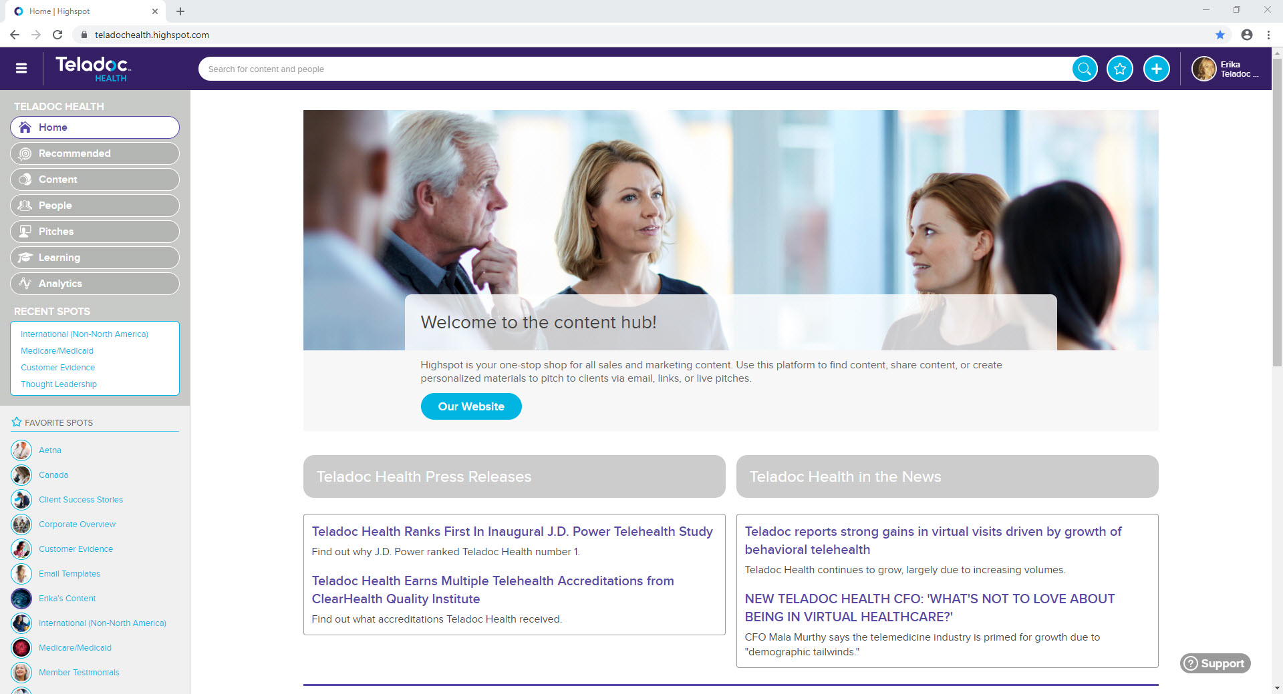
What is Highspot?
What is Highspot?
Highspot helps you spend more time selling, not searching. It’s the one place to find, customize, and pitch (send) content to prospects and clients so you can track what they are most interested in and tailor your messaging and offerings to close more deals, faster.

Slide 3
Making the most of Highspot
Using Highspot:
  You have access to the largest repository of content within the company
  You can connect your Outlook and Salesforce accounts to make the most of your Highspot experience
  Remix or edit a copy of a deck right in Highspot – no need to download the deck to your personal computer anymore for editing
  Easily pitch content to prospects and clients via emails, links and live meetings
  Track your pitches to see who opened it, for how long they looked at it and what they looked at
  Easily search and find content via the search bar or via spots
  To get started in Highspot, please review the onboarding material located here

Slide 4
Profile Settings
In this section you will learn how to edit your profile settings and link your accounts. For more information, please click here.

Slide 5
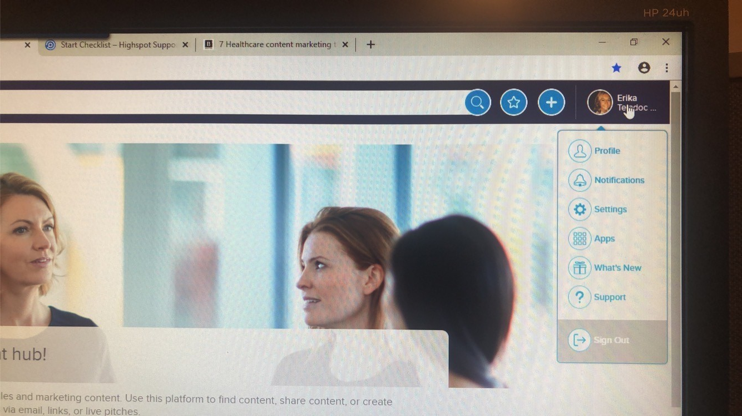
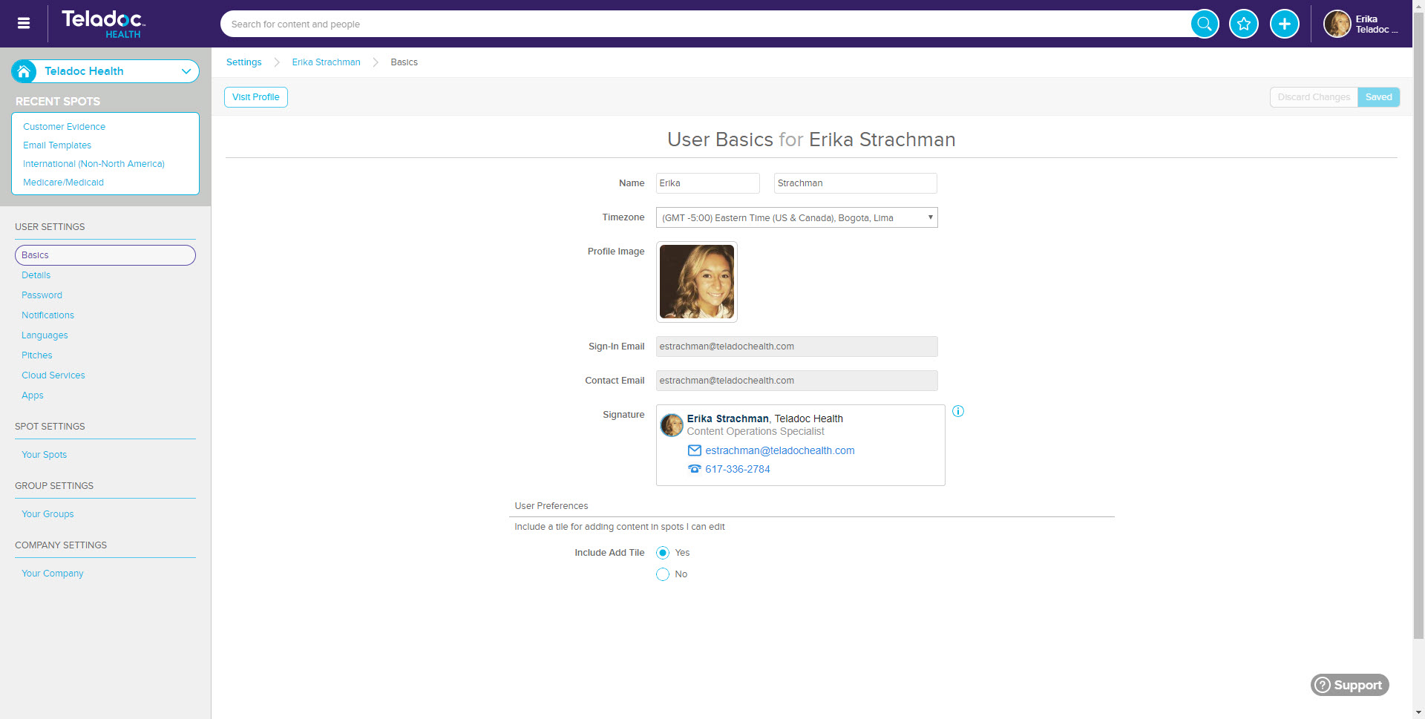
Configuring settings
1. From the homepage, click into your username. A dropdown menu will open. Click “settings”.
2. Your profile settings will open. You can edit your time zone. You can also upload a profile picture by clicking on the profile image.

Slide 6
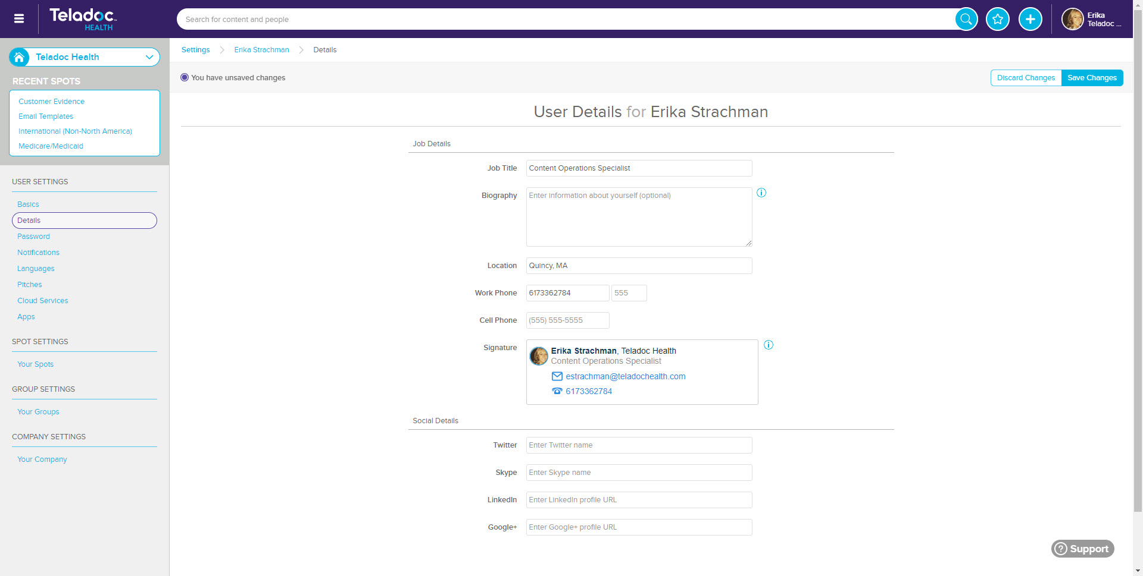
Configuring settings
3. On the left pane, click details
4. You can enter your job title, a biography (if you want to), your location, your work phone, and your cell phone. These will autofill your signature. Click “save changes” when finished. You can also fill in links to your social profiles if you want to.

Slide 7
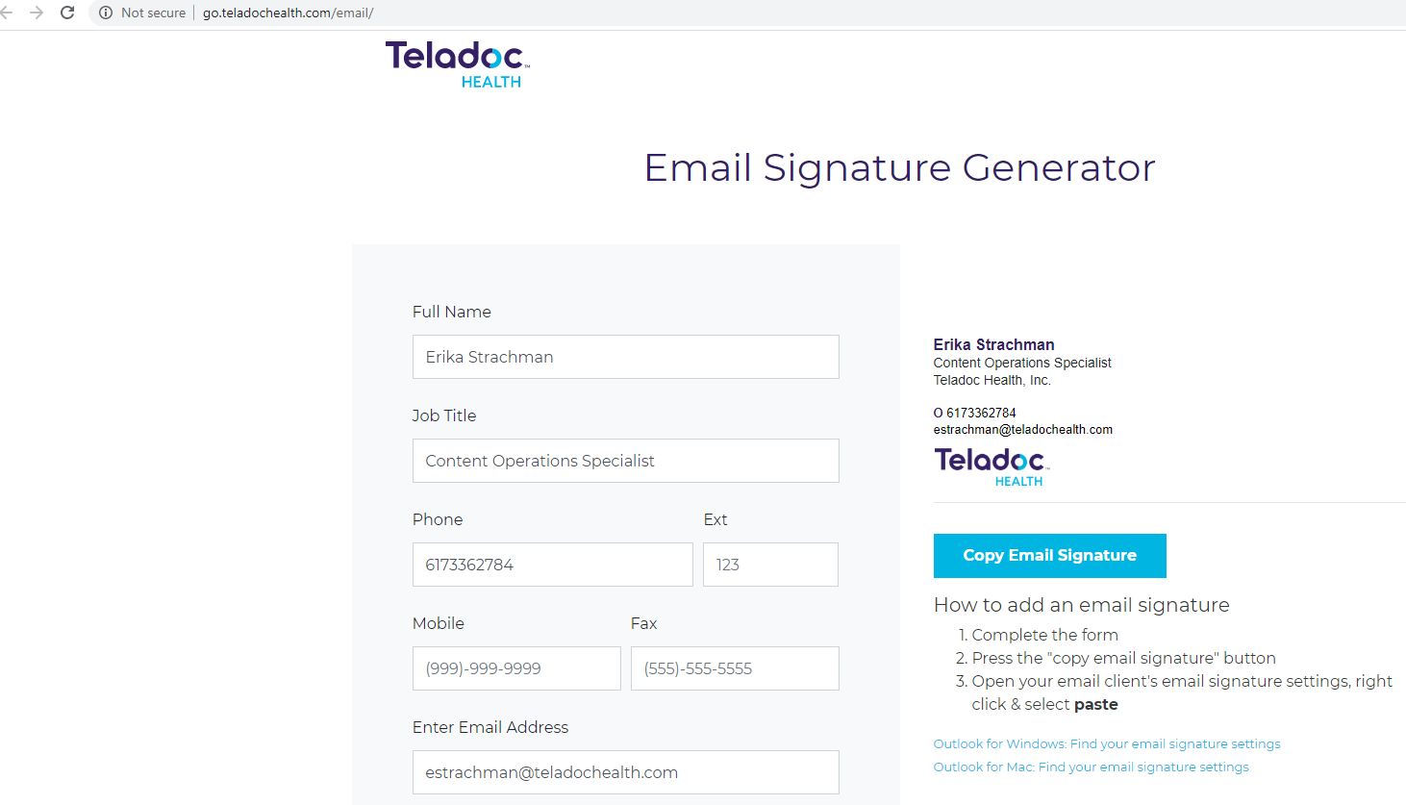
Adding your Teladoc Health signature
Go to: http://go.teladochealth.com/email/ and create your signature. When done, click copy email signature.

Slide 8
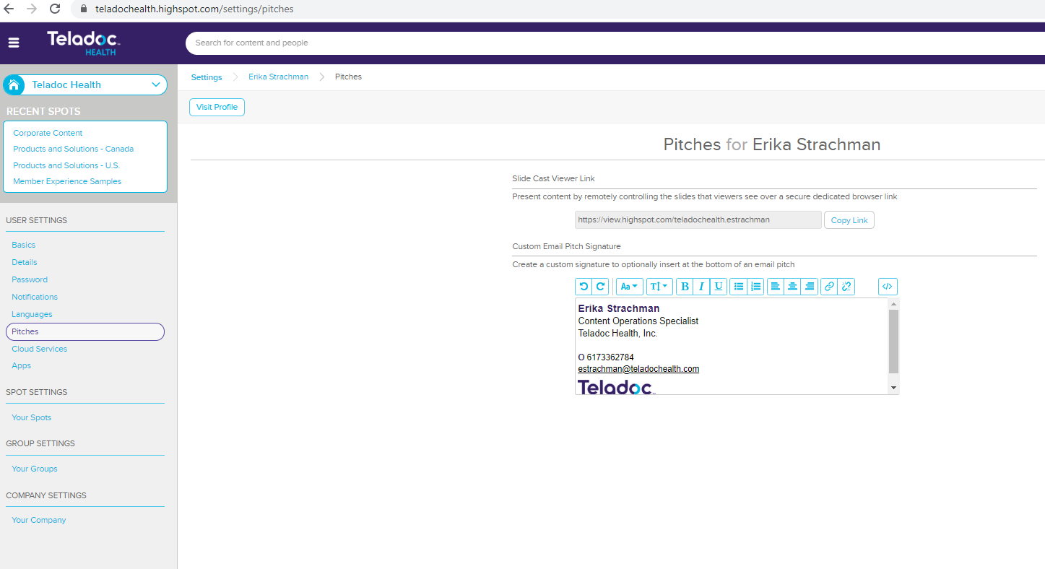
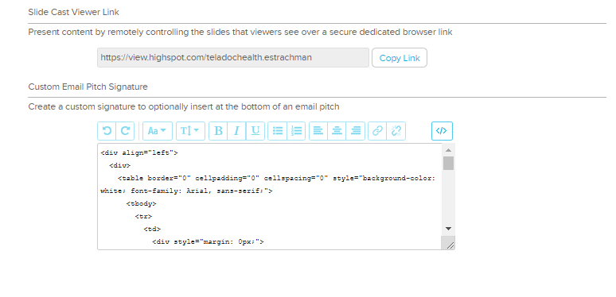
Adding your Teladoc Health signature
Then go into your settings in Highspot and click on the pitches link on the left-hand side. Then click the HTML text editor (</>) button.
Paste the email signature into the text from the email signature generator site.

Slide 9
Adding your Teladoc Health signature
Click on the HTML text editor (</>) button when you’re done and you will see your Teladoc Health logo.

Slide 10
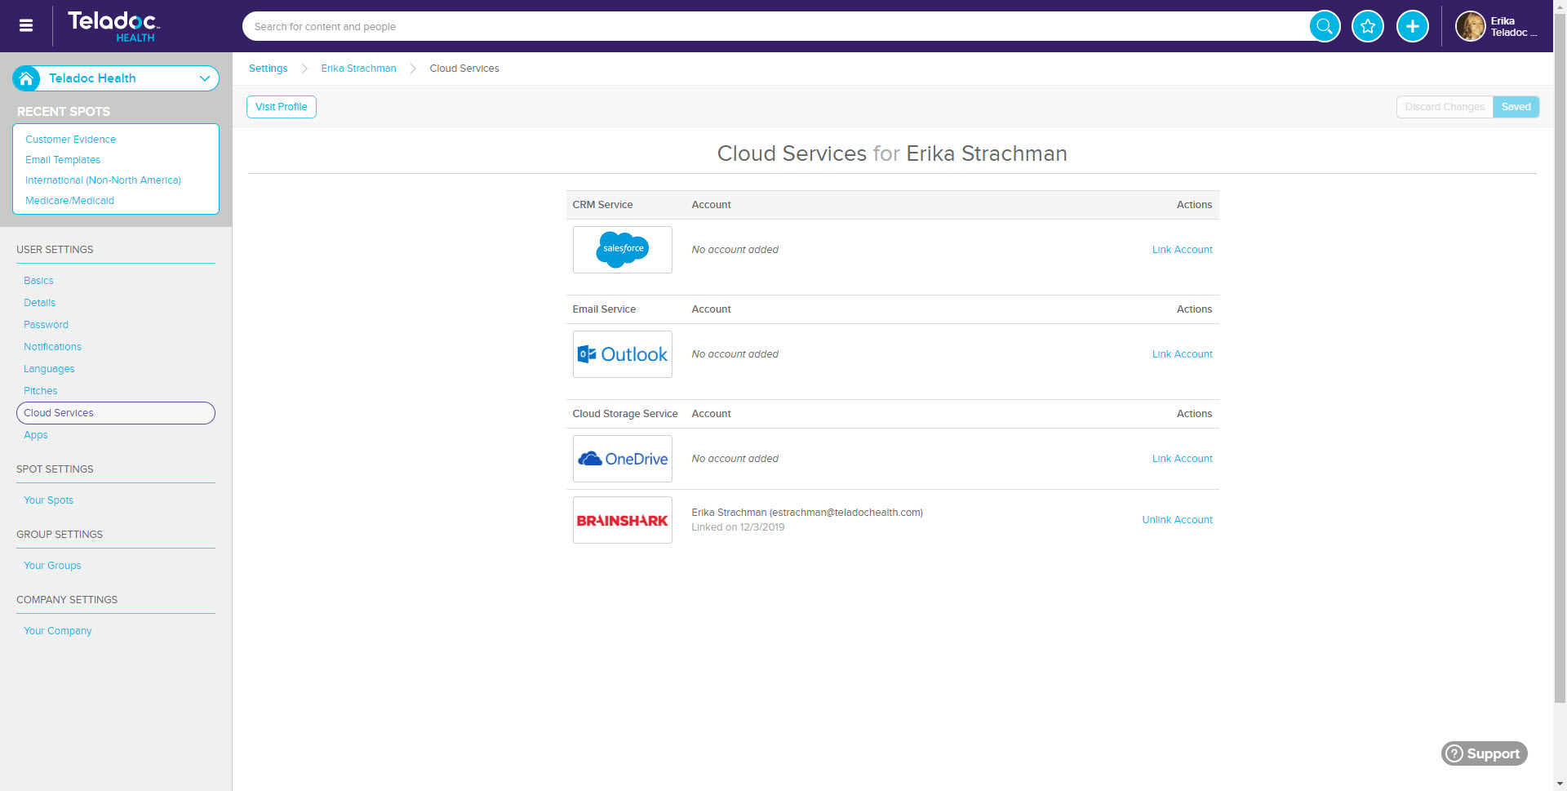
Linking your accounts
1. Within your profile settings, on the left pane, click “cloud services”.
2. You will see a list of accounts you can link to. Click “link account” for each you wish to connect to. A new window will open, and you will be prompted enter your username and password for those accounts.

Slide 11
Searching for Content
In this section you will learn how to search for content. Please click here to learn more about searching for content and click here to learn more about browsing for content in spots.

Slide 12
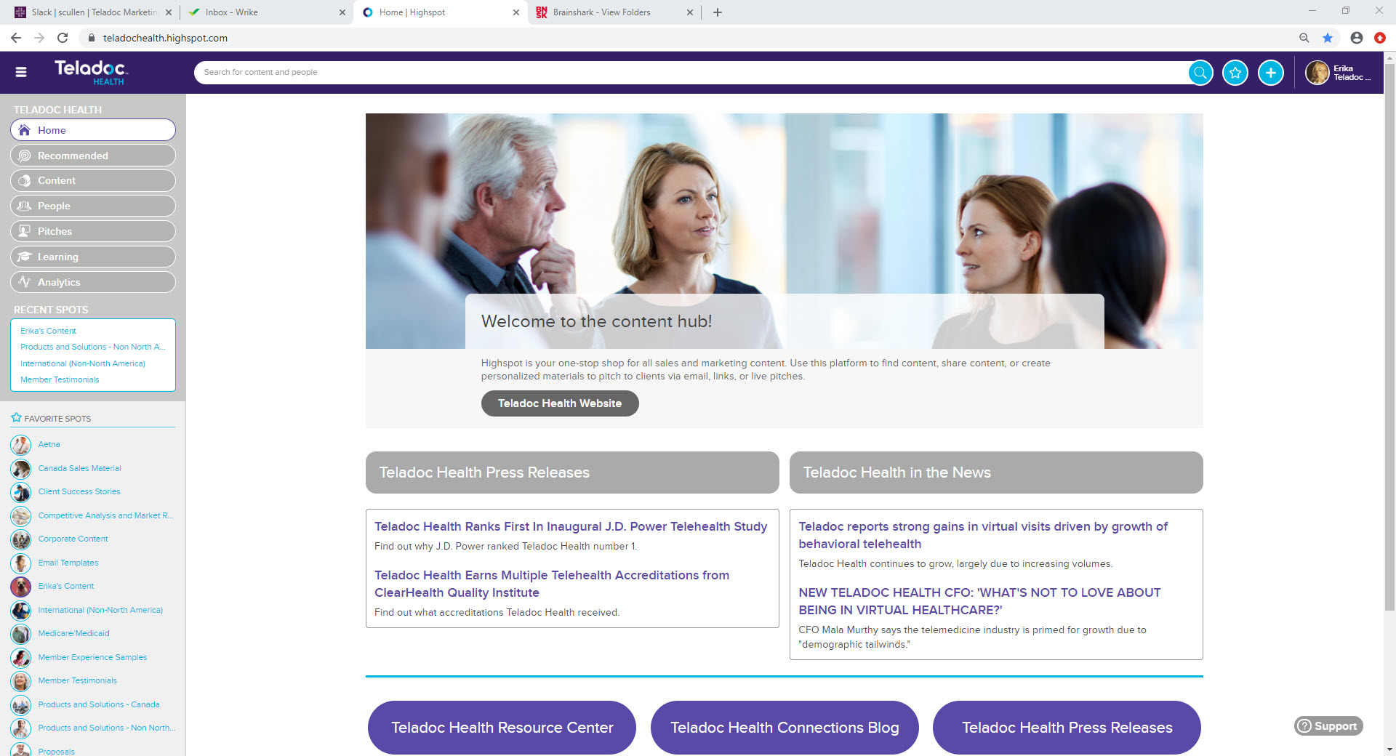
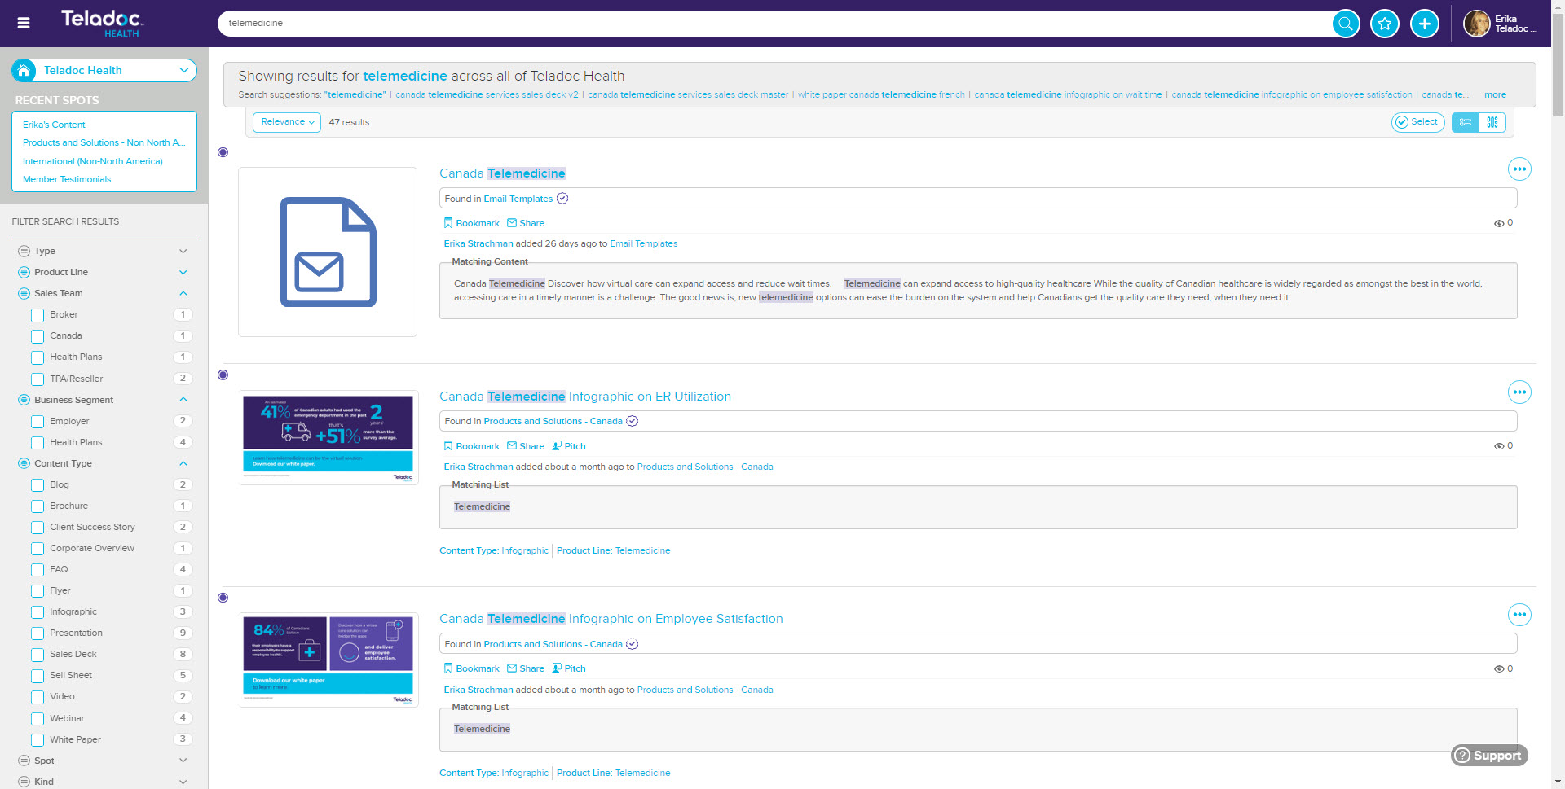
Searching for content (using the search bar)
1. From the homepage, type the name of what you’re looking for in the search bar.
2. A new page will open showing all the results from the words typed into the search bar. Scroll until you find the piece of content you’re looking for.

Slide 13
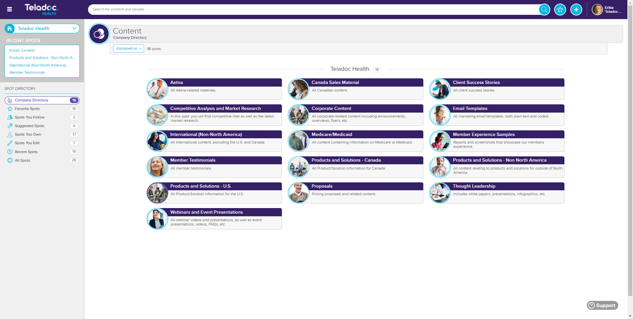
Searching for content (using spots)
1. From the homepage, select the content option from the left side.
2. A new page will open showing all the spots you have access to (spots are basically like folders of similar content).

Slide 14
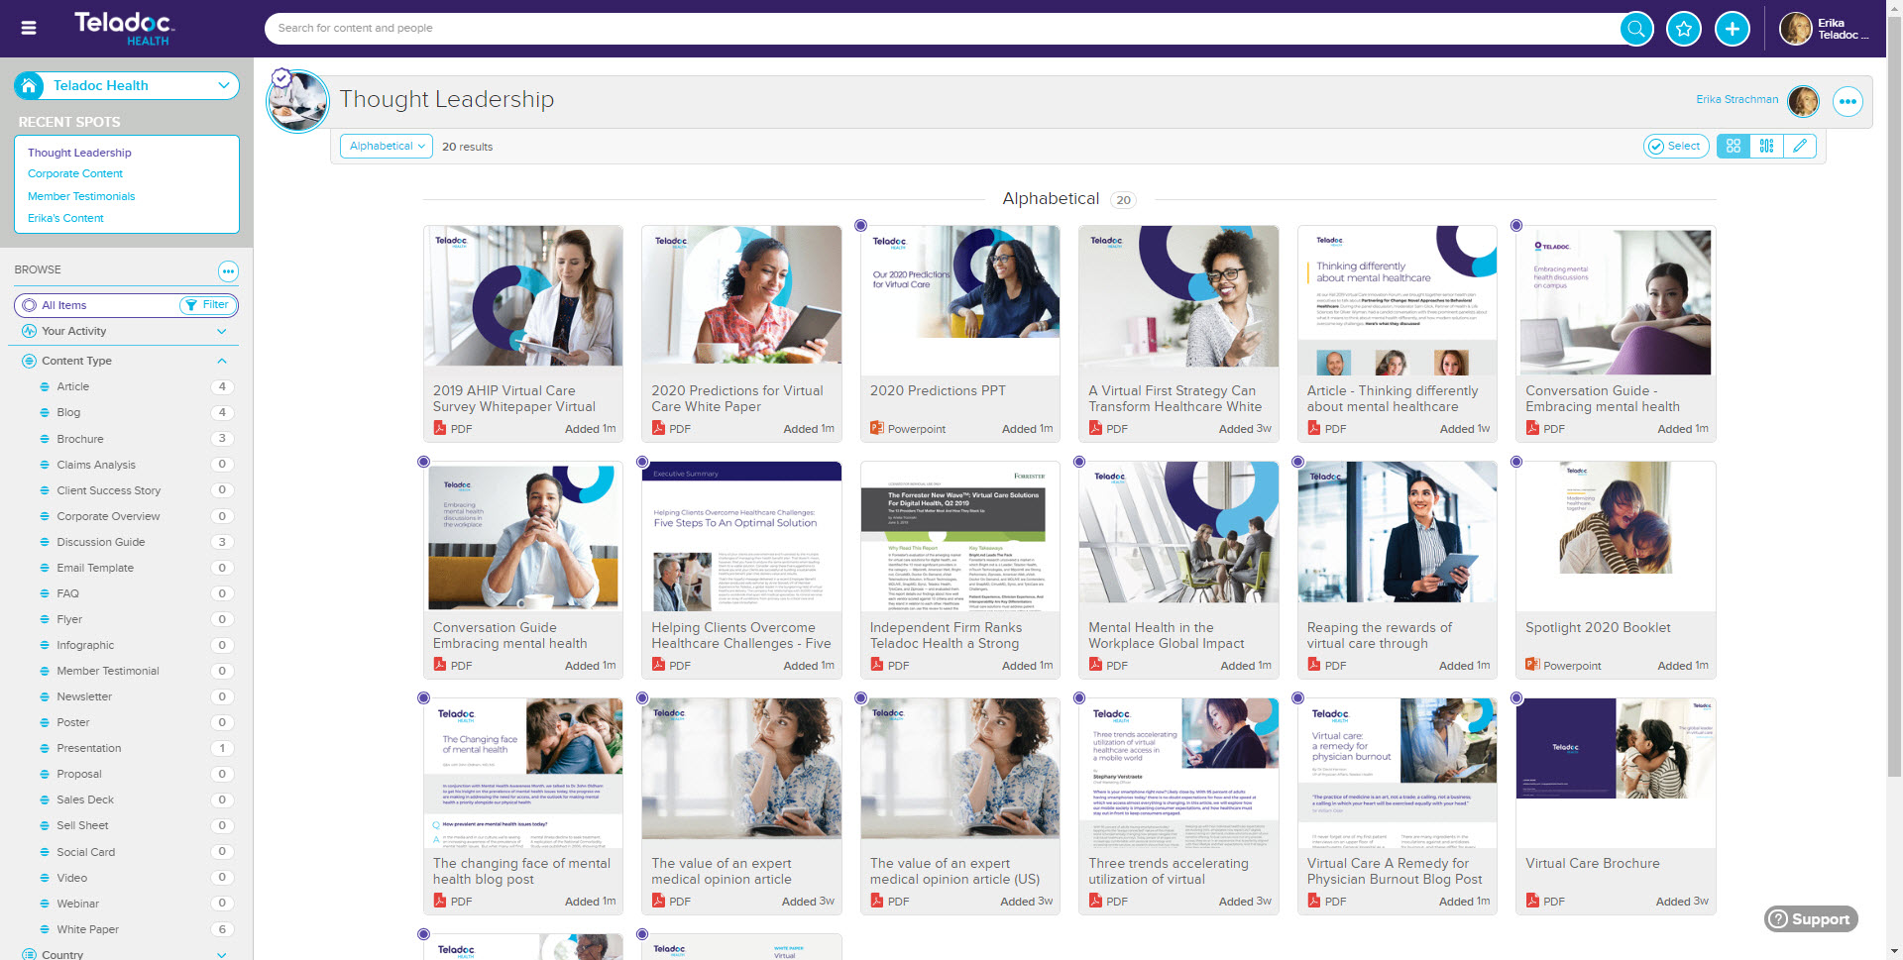
Searching for content (using spots)
3. Select the spot you wish to navigate into, and a new page will open into that spot. You can scroll through the spot to click directly into the piece of content you want to use or you can search by list groups on the left side of the page (i.e. content type, product line, country, etc.)

Slide 15
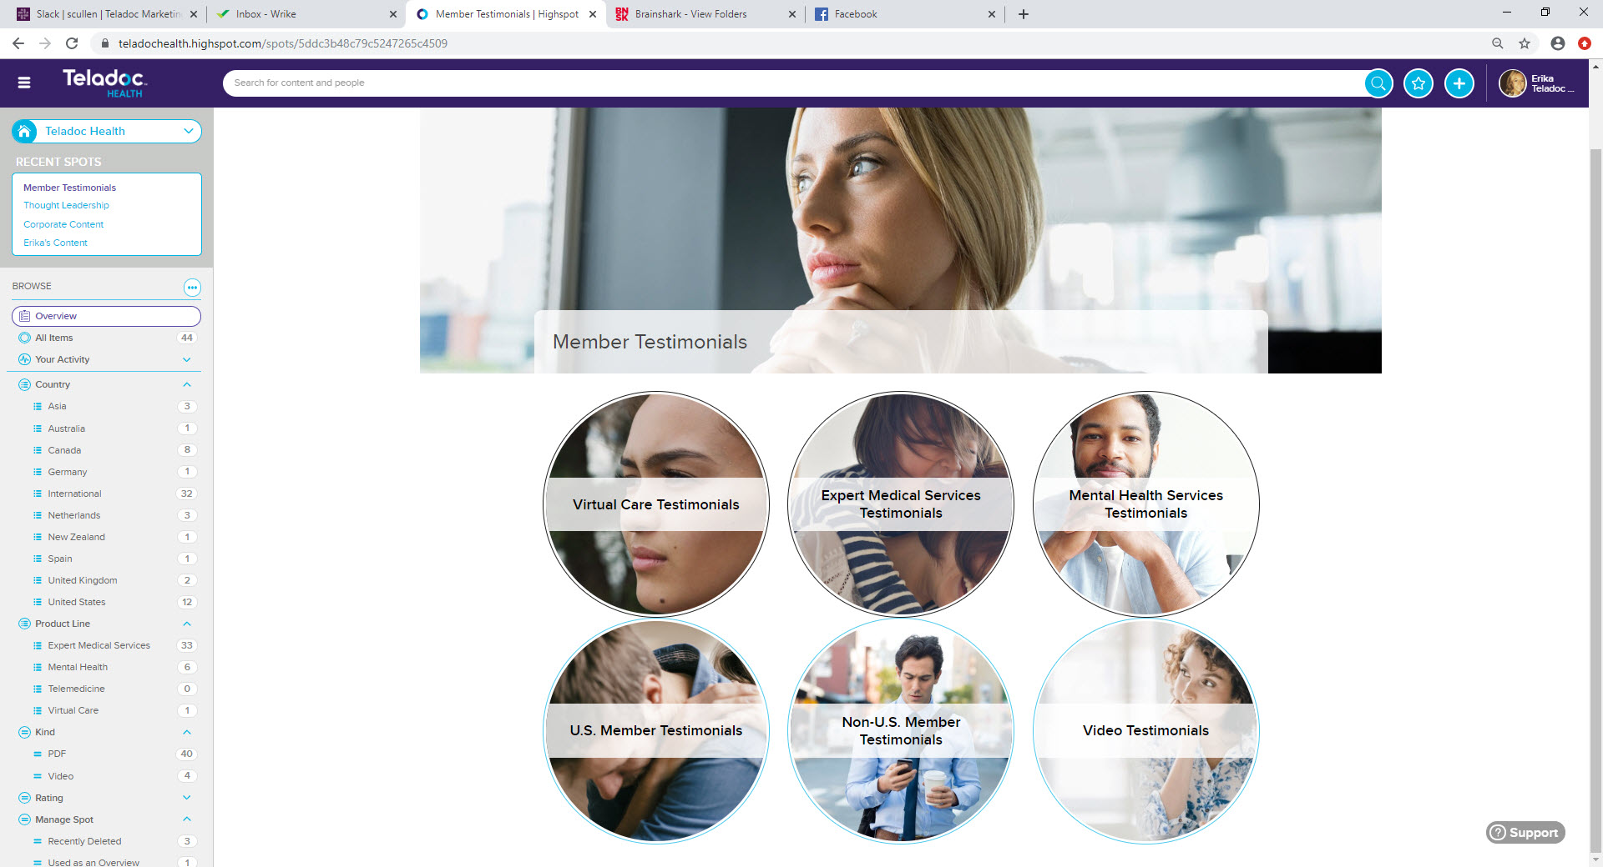
Searching for content (using spots)
** Some spots have overviews, which allow you to easily click into the content you’re searching for!

Slide 16
Remixing a Deck
In this section, you will learn how to remix a deck (adding in other slides, moving the order of slides, or deleting slides). To learn more, click here.

Slide 17
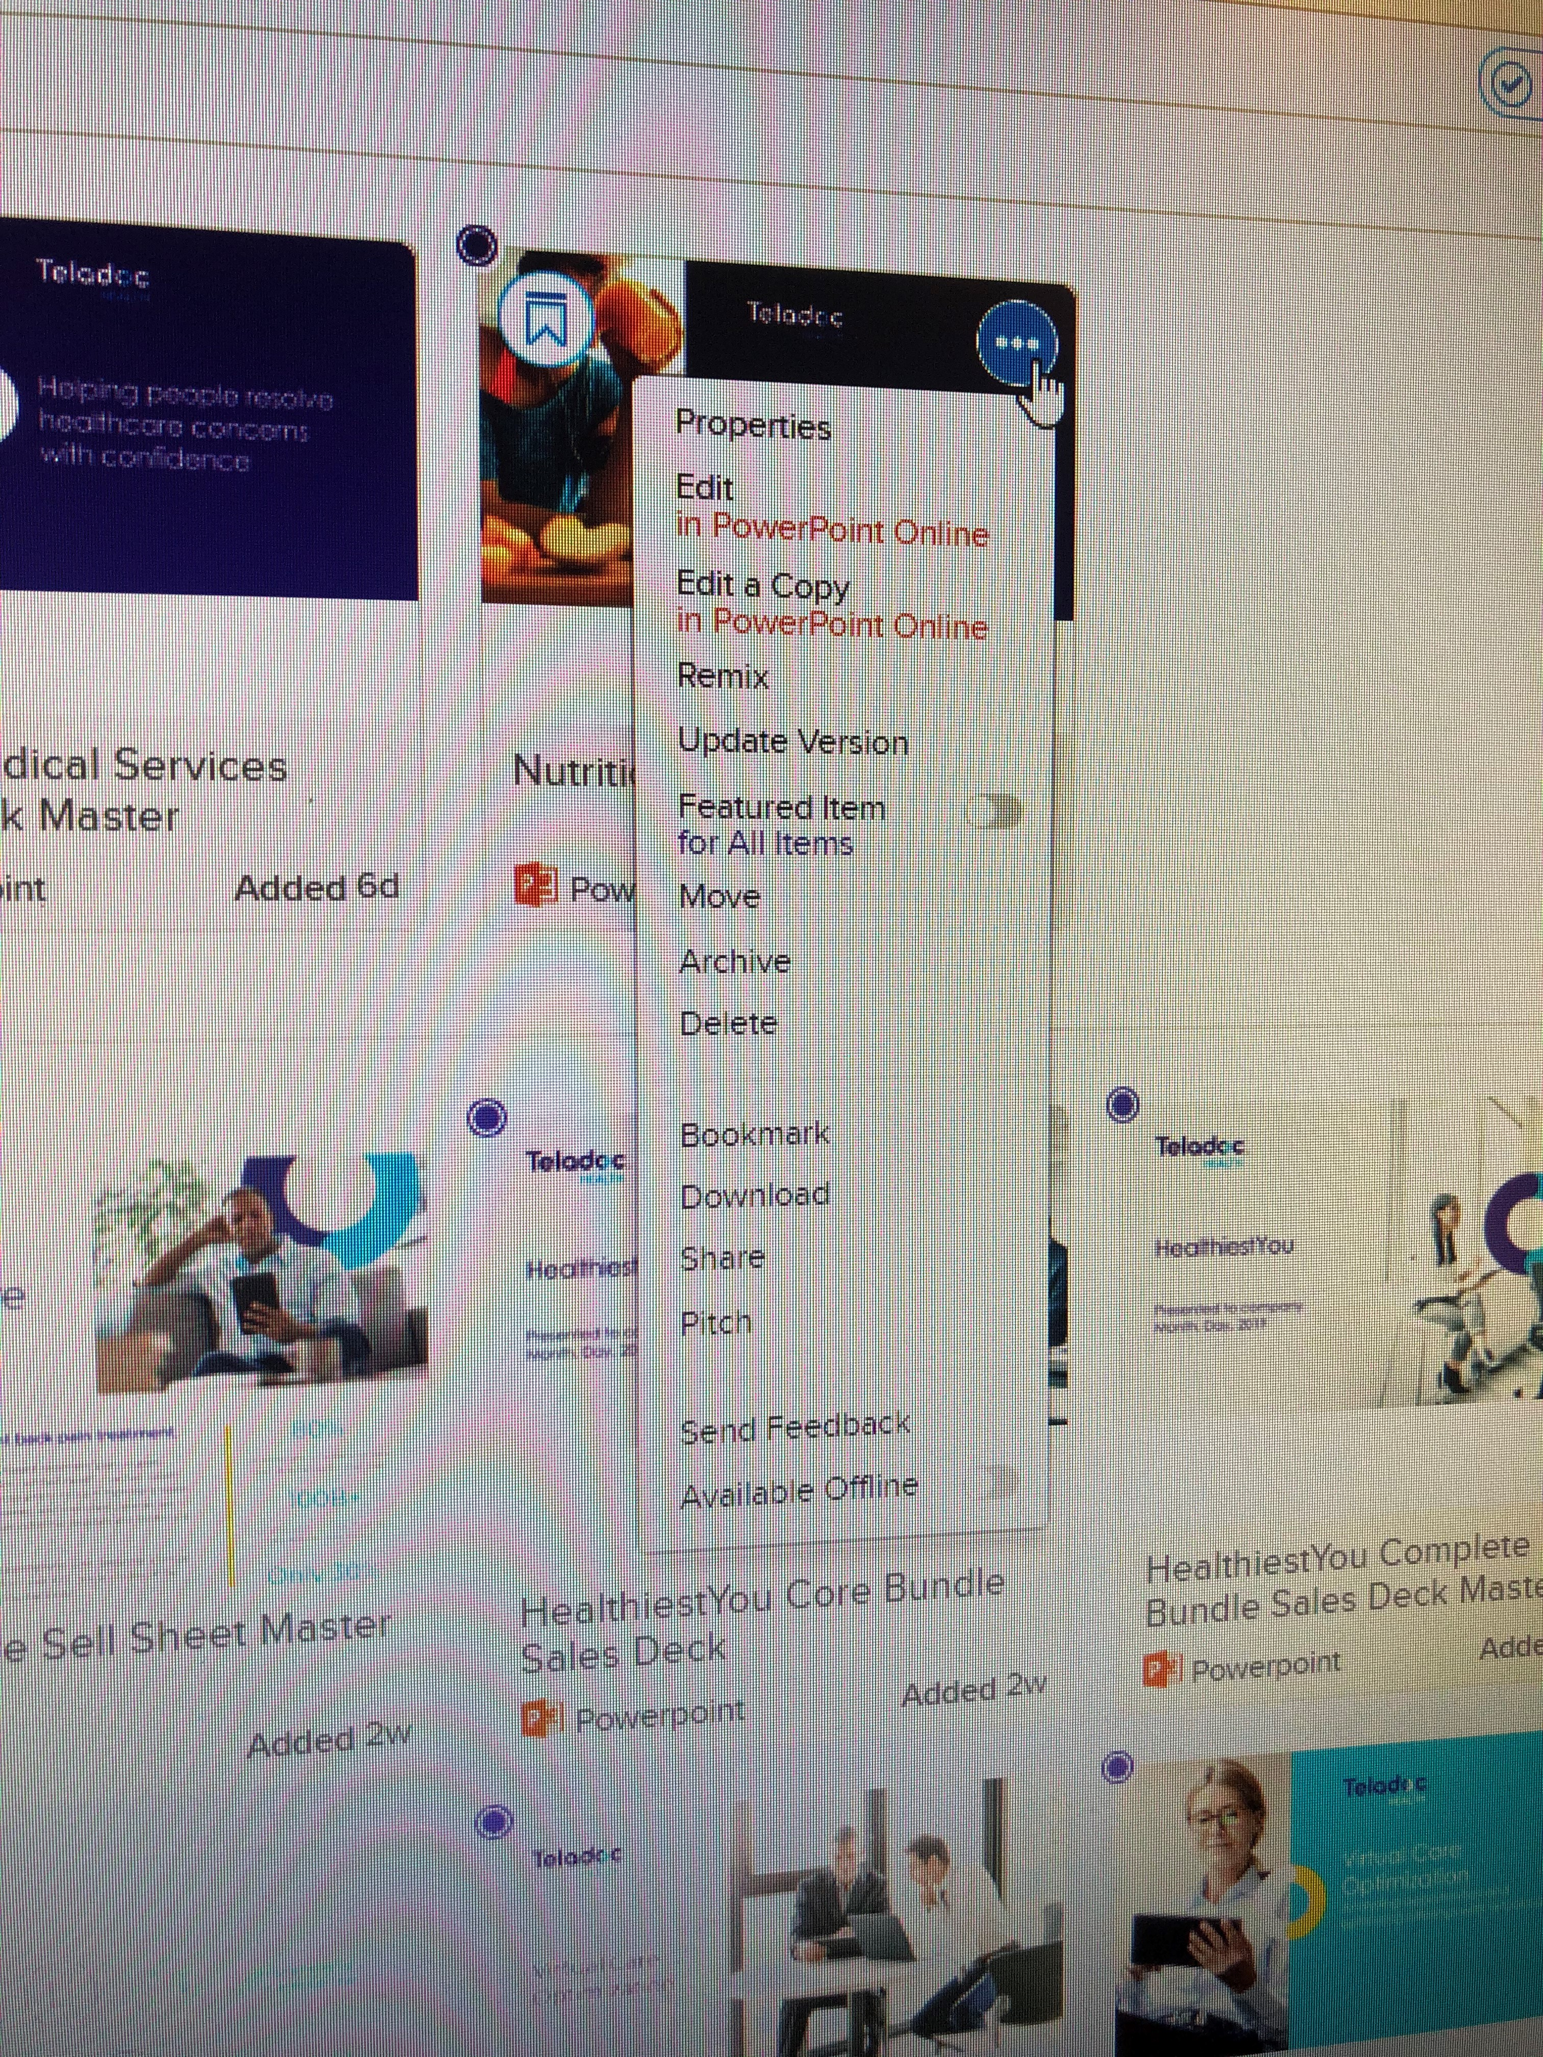
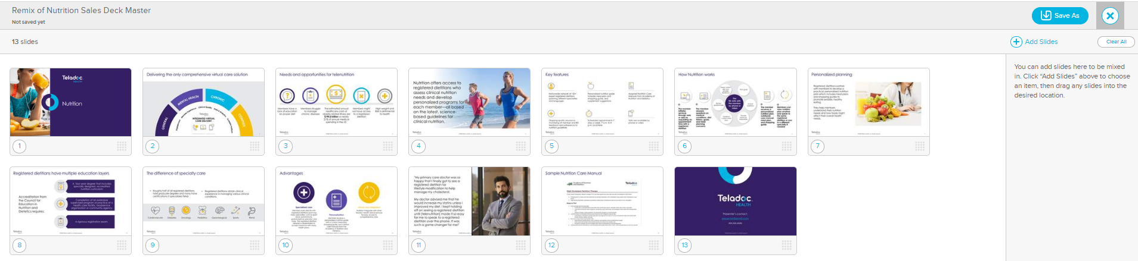
Remixing a Deck
Remixing a deck consists of changing the order of slides, adding slides, or deleting slides.
Once you’ve found the deck you want to remix, click the three dots and then click “remix”. A new window will open, and you can drag and drop slides to the order, delete slides, or add in slides using the +Add Slides button on the right. When you’re done, click “save as” and your remixed deck will save to your personal spot. You can choose to save your remixed deck as a PDF or as a presentation.
**When the master copy of a piece of content is updated, all remixed or edited copies of that content will be updated as well.

Slide 18
Editing a Copy of a Deck
In this section, you will learn how to edit a copy of a deck (adding in your name or logo of the client/prospect you’re presenting to). To learn more, click here.

Slide 19
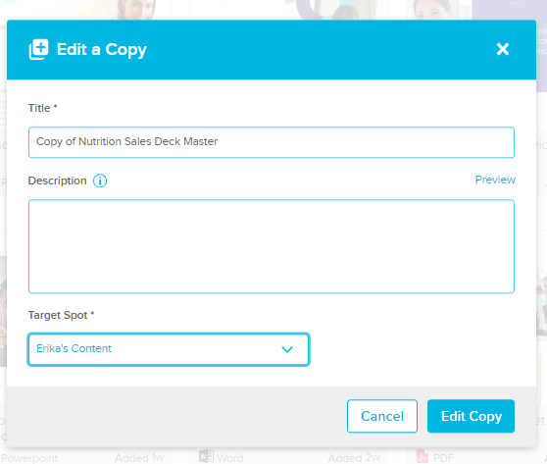
Editing a Deck
Editing a copy of a deck allows you to add in your logo or name in PowerPoint online.
Once you’ve found the deck you want to edit, click the three dots and then click “edit a copy”. A window will appear, and you can change the title of the deck and save it to your personal spot. Once you’re done, click “edit a copy”.

Slide 20
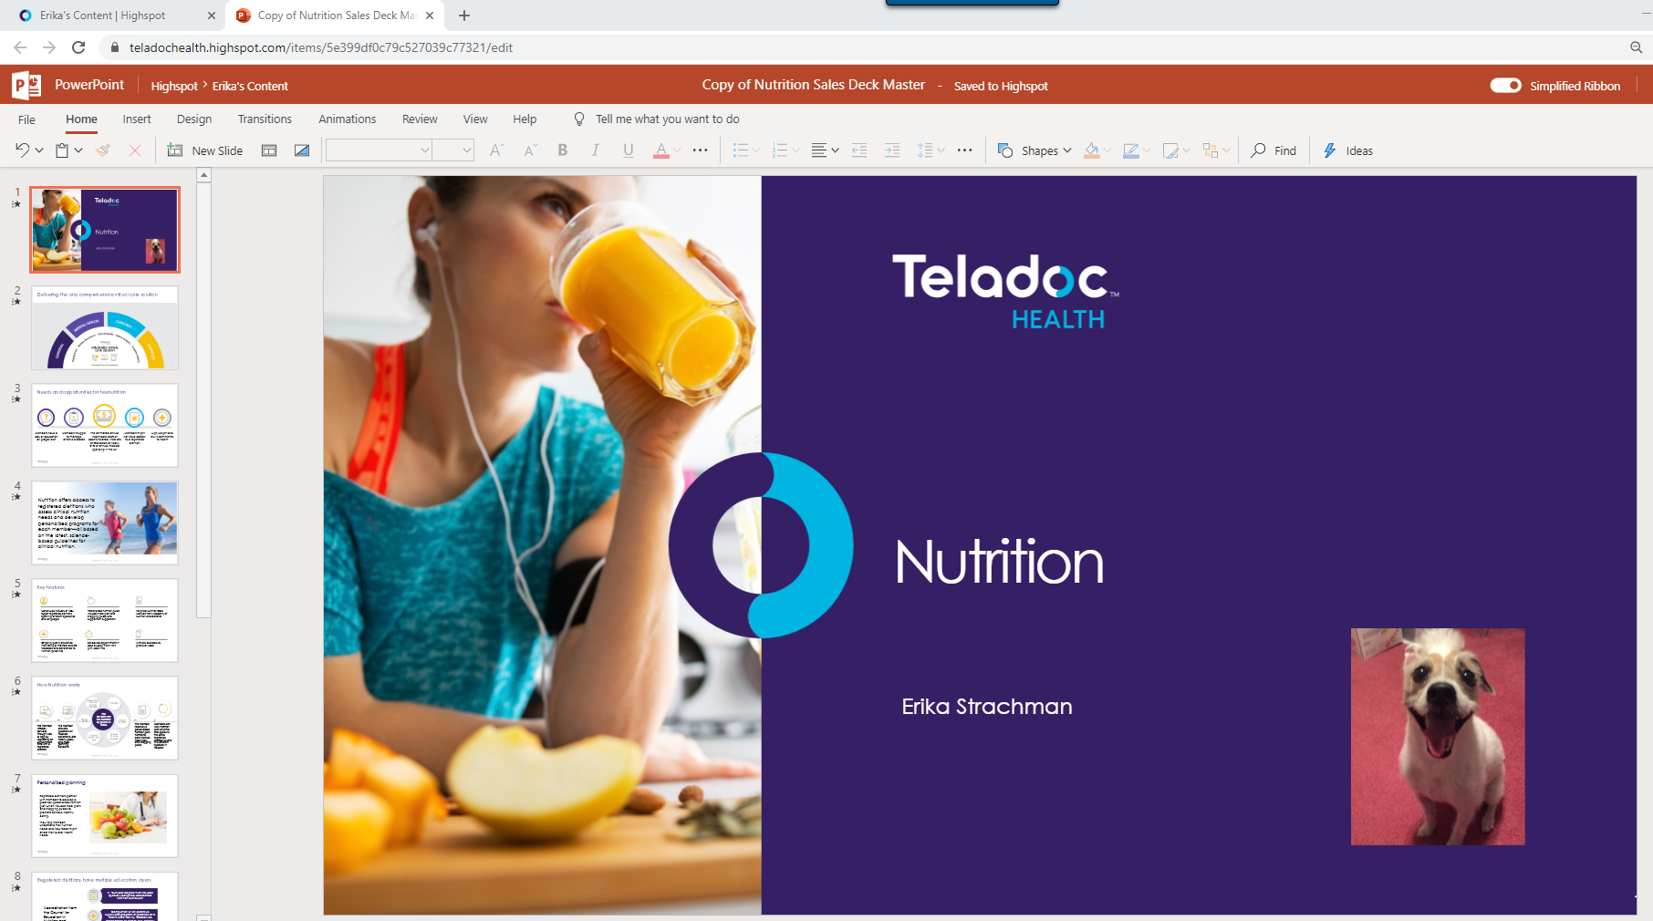
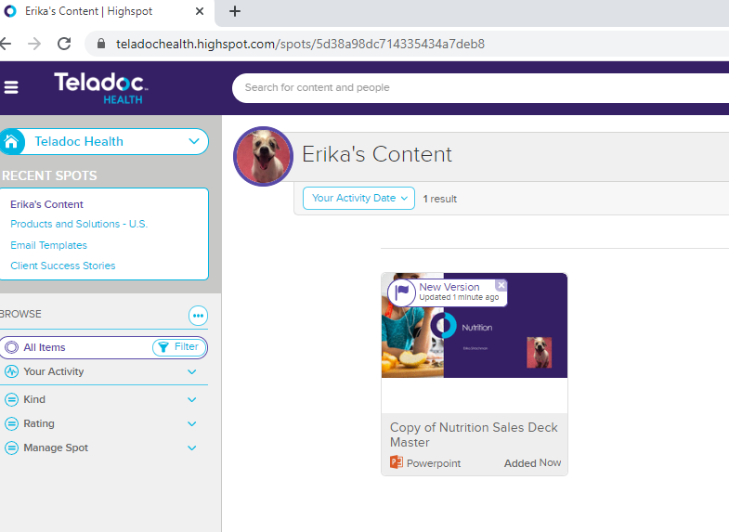
Editing a Deck
Editing a copy of a deck allows you to add in your logo or name in PowerPoint online.
A new window will open to PPT online, and you can make the changes you wish you make (i.e., adding your name or the logo of the prospect you’re presenting to). PPT online automatically saves your changes, so when you’re done, just exit out. Highspot will automatically bring you to your personal spot to access the edited deck.
**When the master copy of a piece of content is updated, all remixed or edited copies of that content will be updated as well.

Slide 21
Link Pitch
In this section you will learn how to pitch content via link.

Slide 22
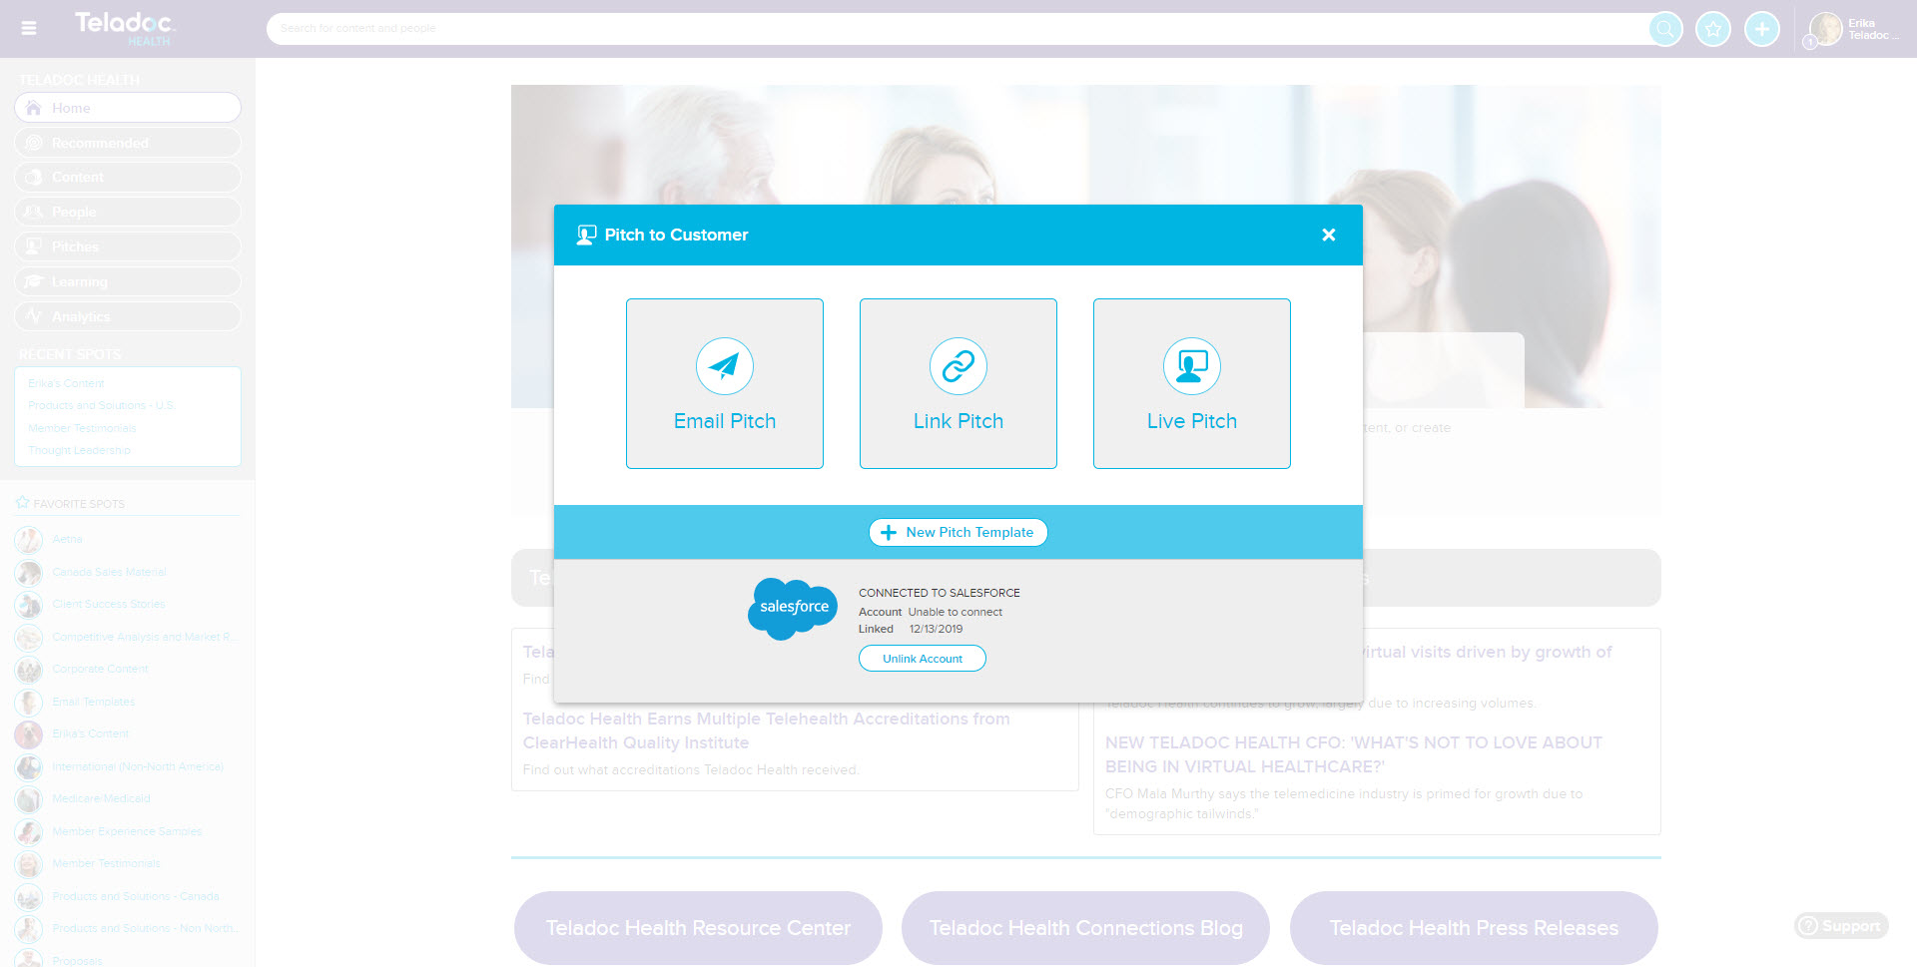
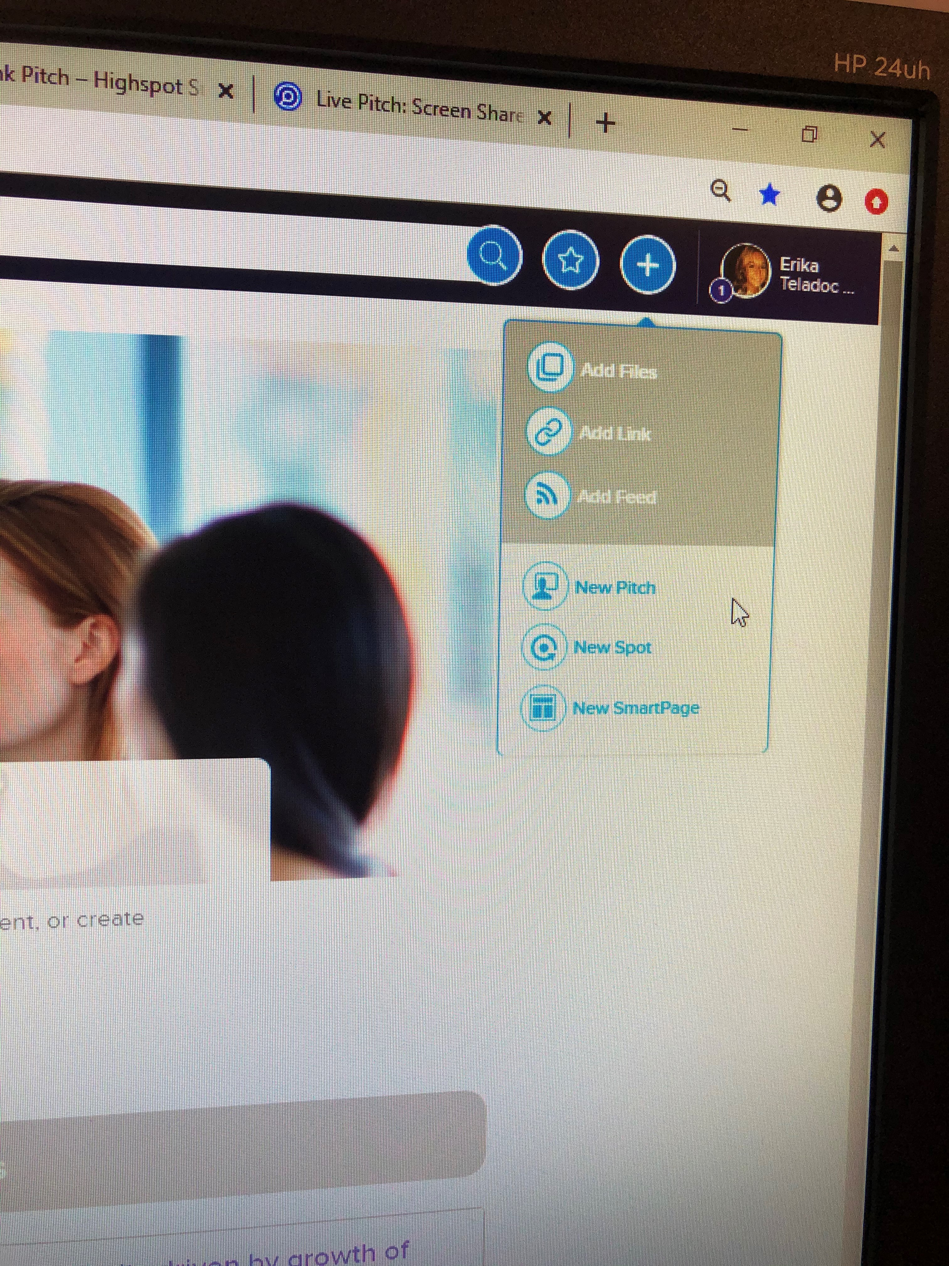
Link pitching
1. From the homepage, click the blue circle with the white cross in it and then click “new pitch”.
2. A pop up will open with the types of pitches. Please select “link pitch”.

Slide 23
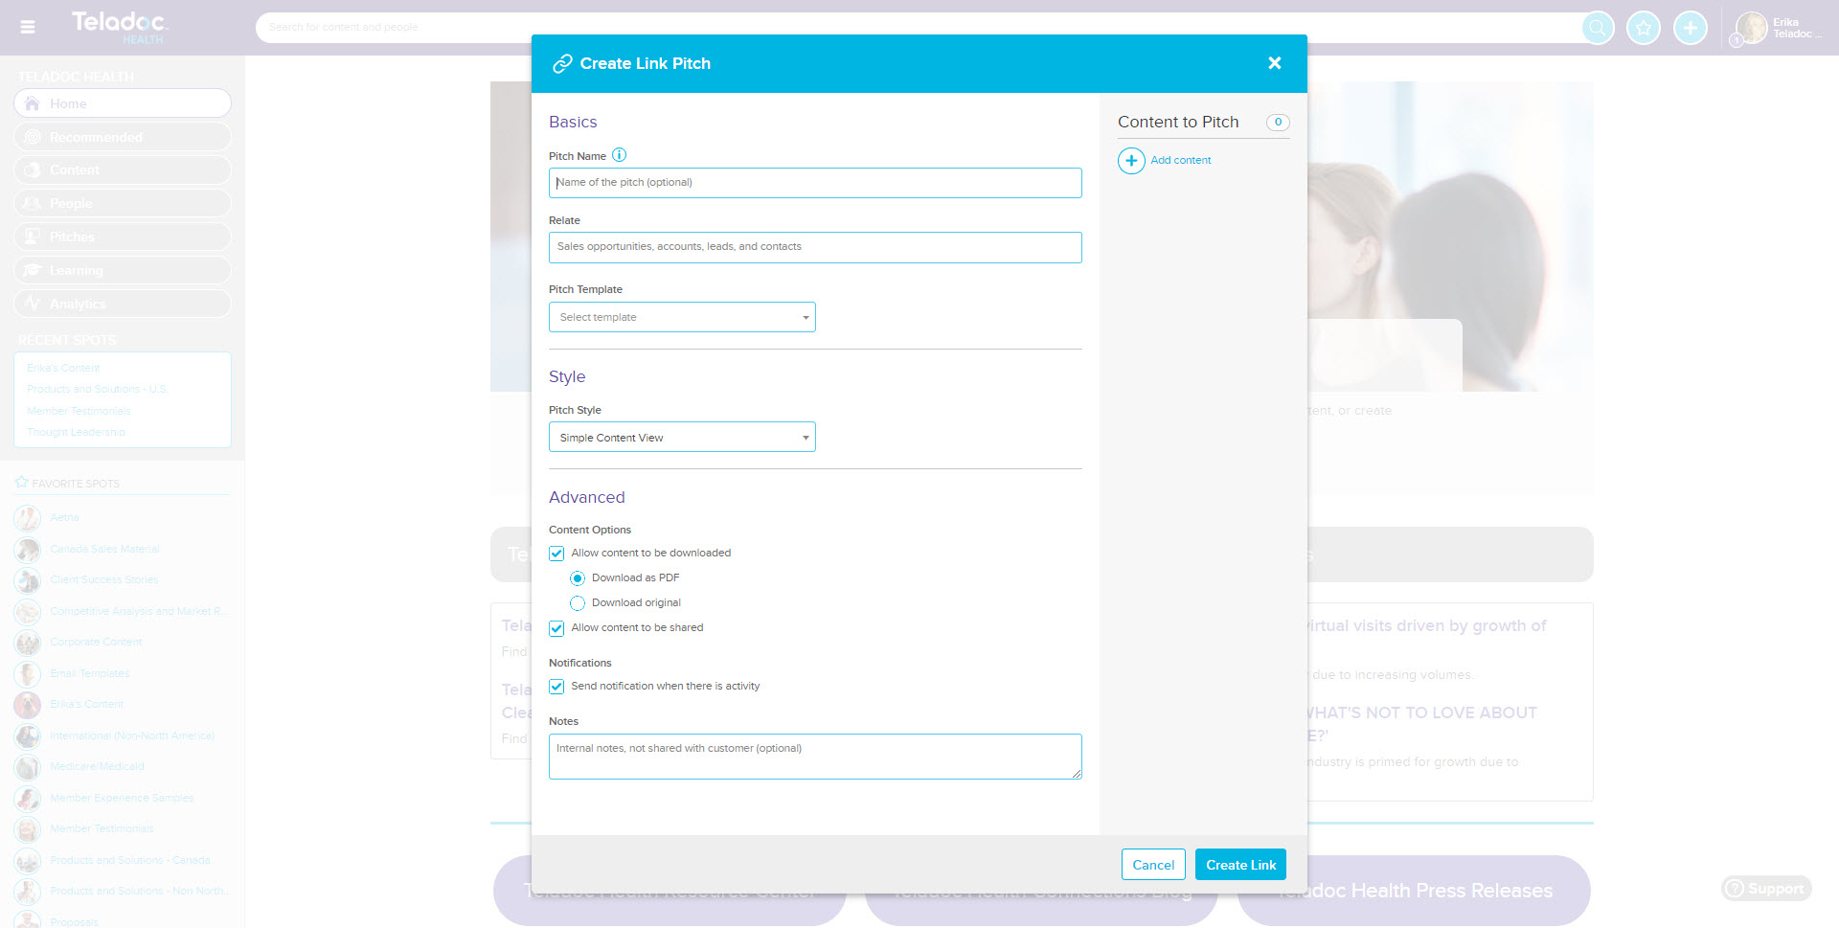
Link pitching
3. A pop up will open. Please fill out the pitch name (could be the name of the prospect you’re sending it to) and relate it to an opportunity, account or contact in Salesforce. You can choose a pitch template or pitch style, but it not required for a link pitch. Then fill out your advanced options: if you want content to be able to be downloaded or shared and if you want email notifications when there’s activity on the link. Ensure you add the content you want to pitch via the “add content” button on the right. You can include multiple pieces of content. Then select “create link”.

Slide 24
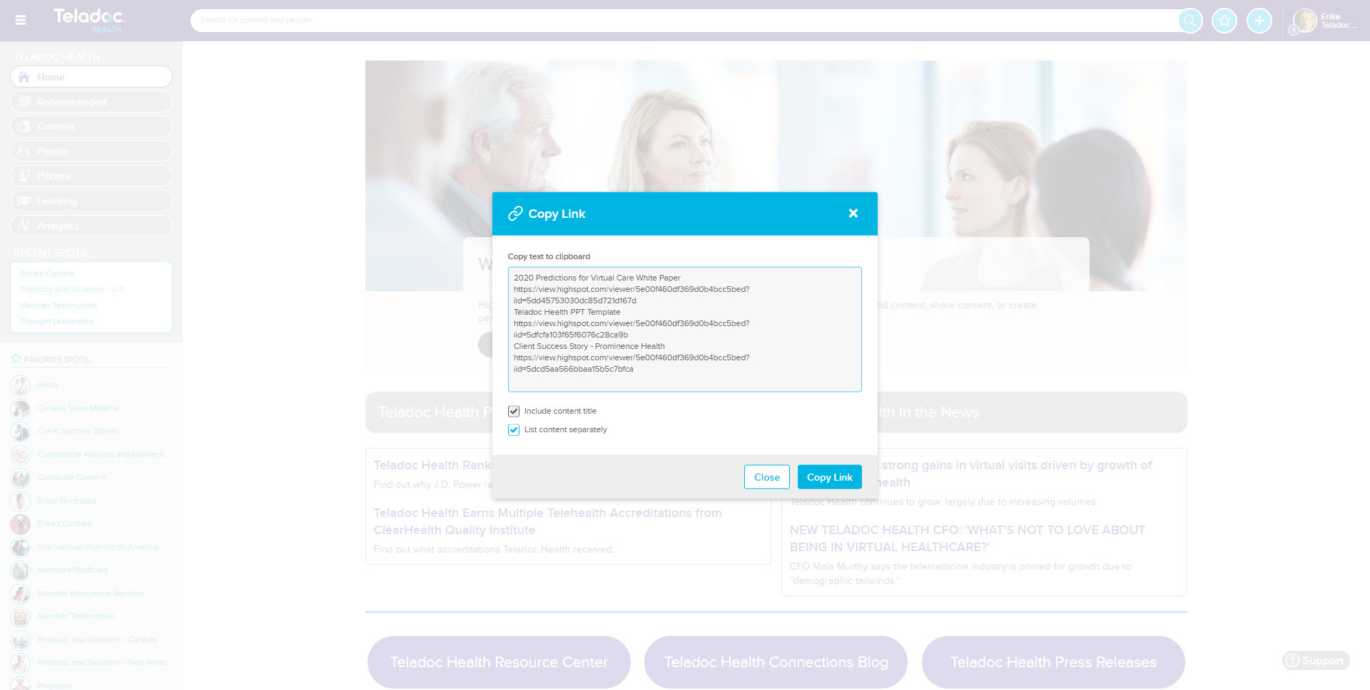
Link pitching
4. You can click “copy link” to copy and paste the link into an email or chat or LinkedIn to send it.

Slide 25
Email Pitch
In this section you will learn how to pitch content via email.

Slide 26
Email pitching
1. From the homepage, click the blue circle with the white cross in it and then click “new pitch”.
2. A pop up will open with the types of pitches. Please select “email pitch”.

Slide 27
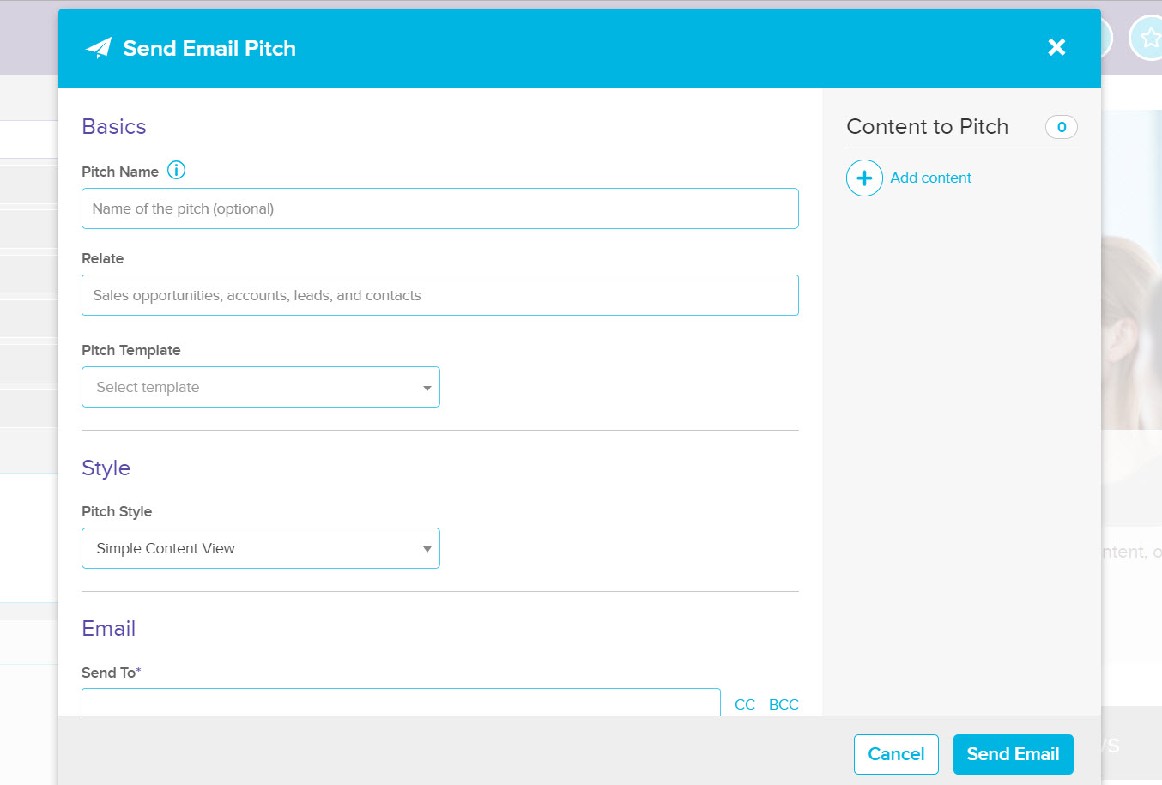
Email pitching
3. Name your pitch (i.e. client name, email name, etc.).
4. Add content you want to send.
5. Relate your email to an opportunity, account or contact in Salesforce.
6. If you’d like to use a pre-approved Marketing template, select a pitch template.
7. You can choose to include a pitch style as well (we will cover pitch styles in another section of this guide).

Slide 28
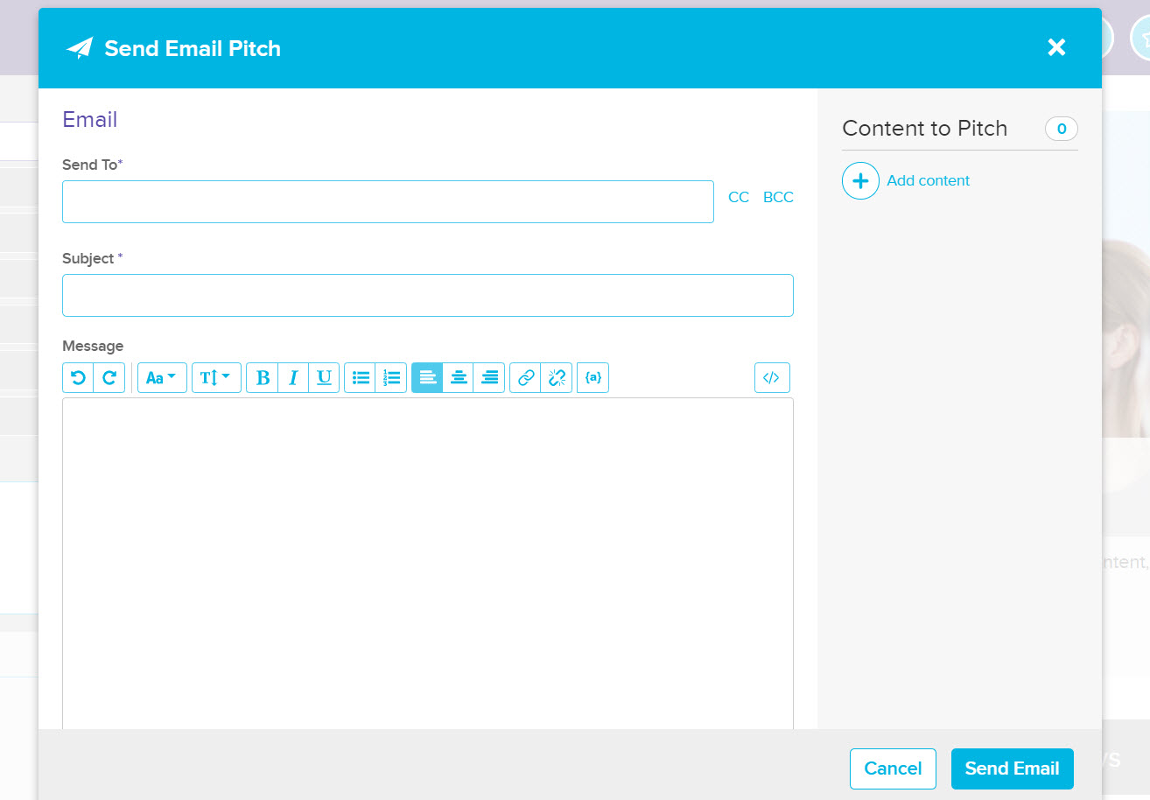
Email pitching
8. Type in the email of the person/people you wish to send the email to (you also have the option to cc or bcc people).**
9. Type in the subject of the email.
10. If you chose a template, the email body will pre-populate. If not, this is where you can type in your email message.
** Please note dynamic field options only work in the “send to” field. They do not work in the CC or BCC fields. It’s best to send emails to contacts within the same account or opportunity or one-to-one.

Slide 29
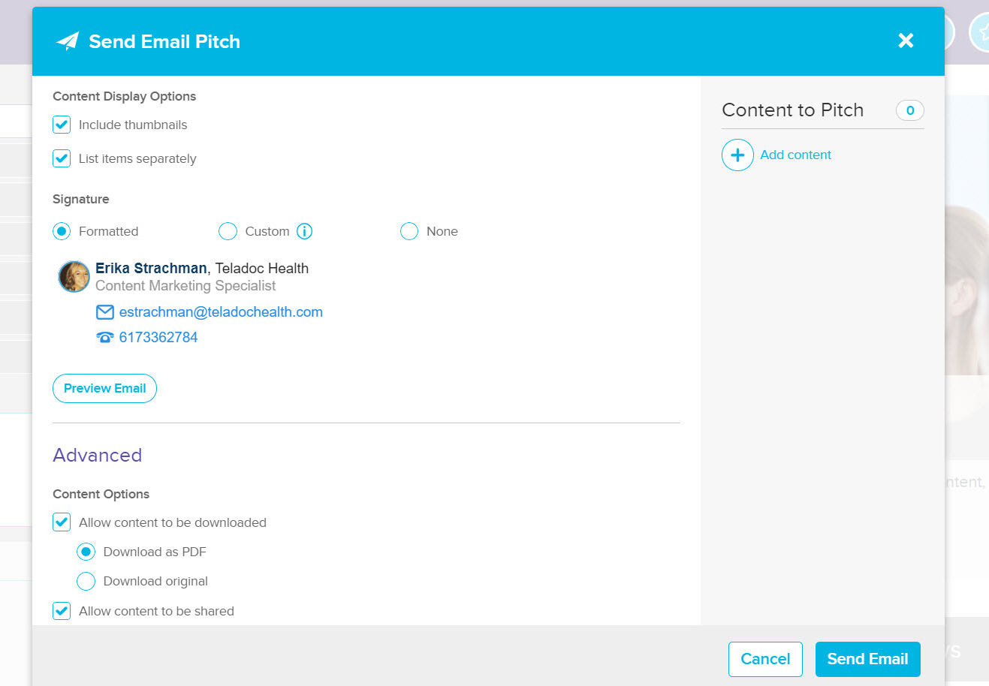
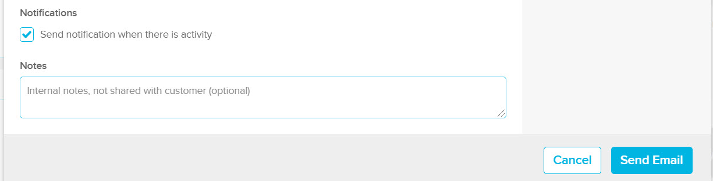
Email pitching
11. Choose how you wish your content to display.
12. Choose your signature. You can also choose to preview your email here too.
13. Choose your content options – if the content should be able to be downloaded and shared.
14. Select if you’d like to receive email notifications when there is an activity on your email.
15. Send your email.

Slide 30
Live Pitch
In this section you will learn how to pitch content via live pitch.

Slide 31
Live Pitching – Slide Cast

Slide 32
Live pitching – slide cast
1. From the homepage, click the blue circle with the white cross in it and then click “new pitch”.
2. A pop up will open with the types of pitches. Please select “live pitch”.

Slide 33
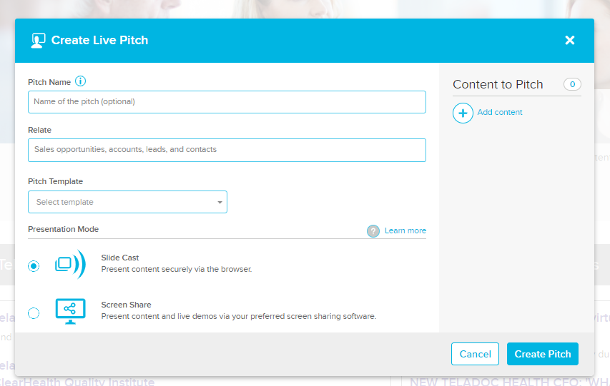
Live pitching – slide cast
3. Name your pitch.
A slide cast allows you to present content without having to use a screen sharing app.
4. Select the content you wish to pitch.
5. Relate the pitch to an opportunity, account or contact in Salesforce.
6. Make sure you have selected slide cast mode.
7. Click “create pitch”.

Slide 34
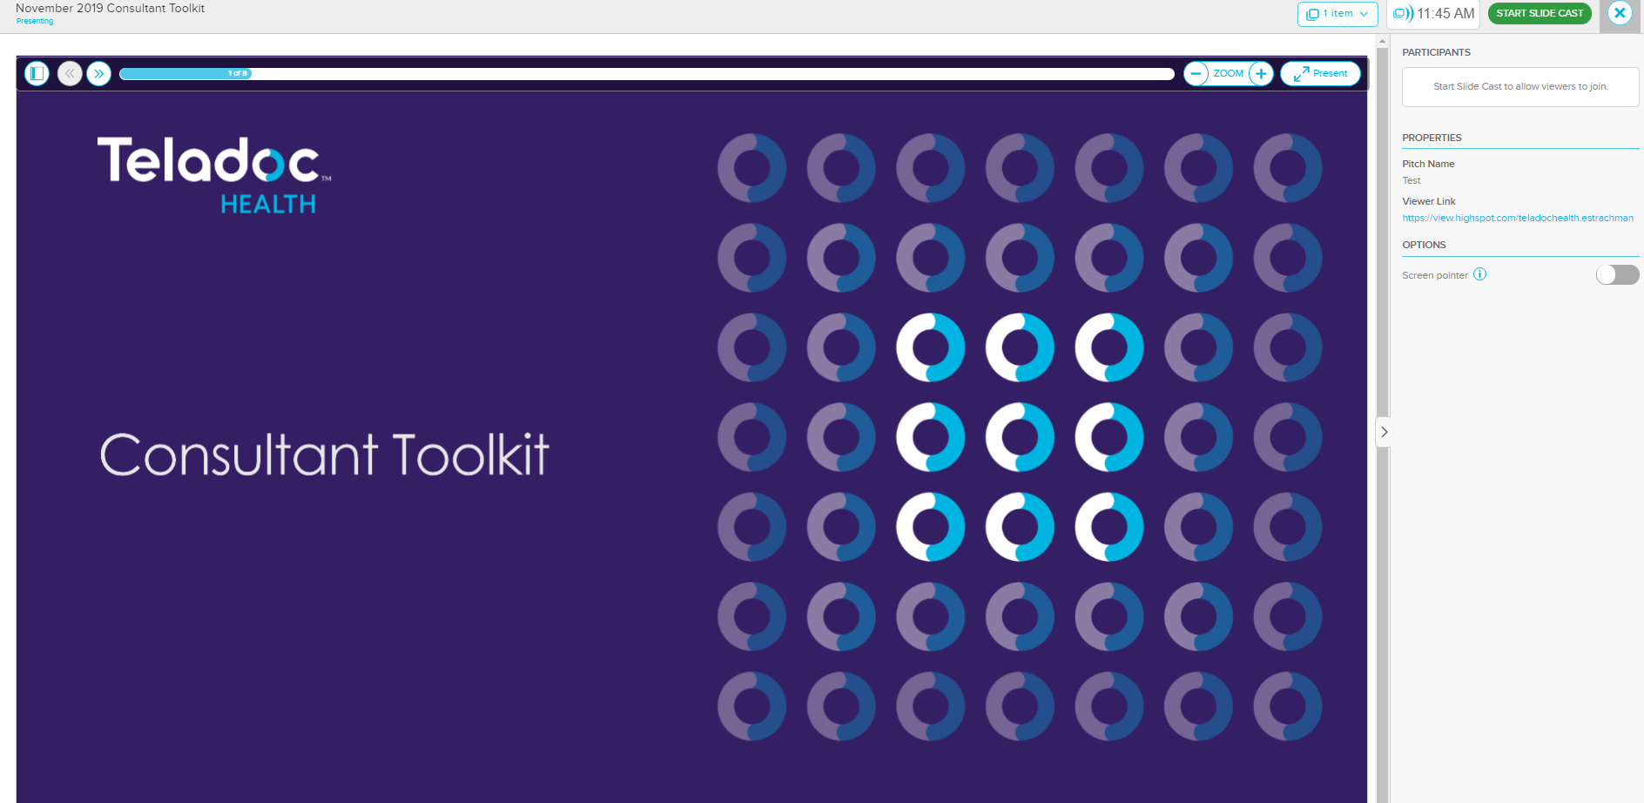
Live pitching – slide cast
A new window will open with your slide cast.
9. When ready, click the green slide cast button to start.
8. Share this link with participants.

Slide 35
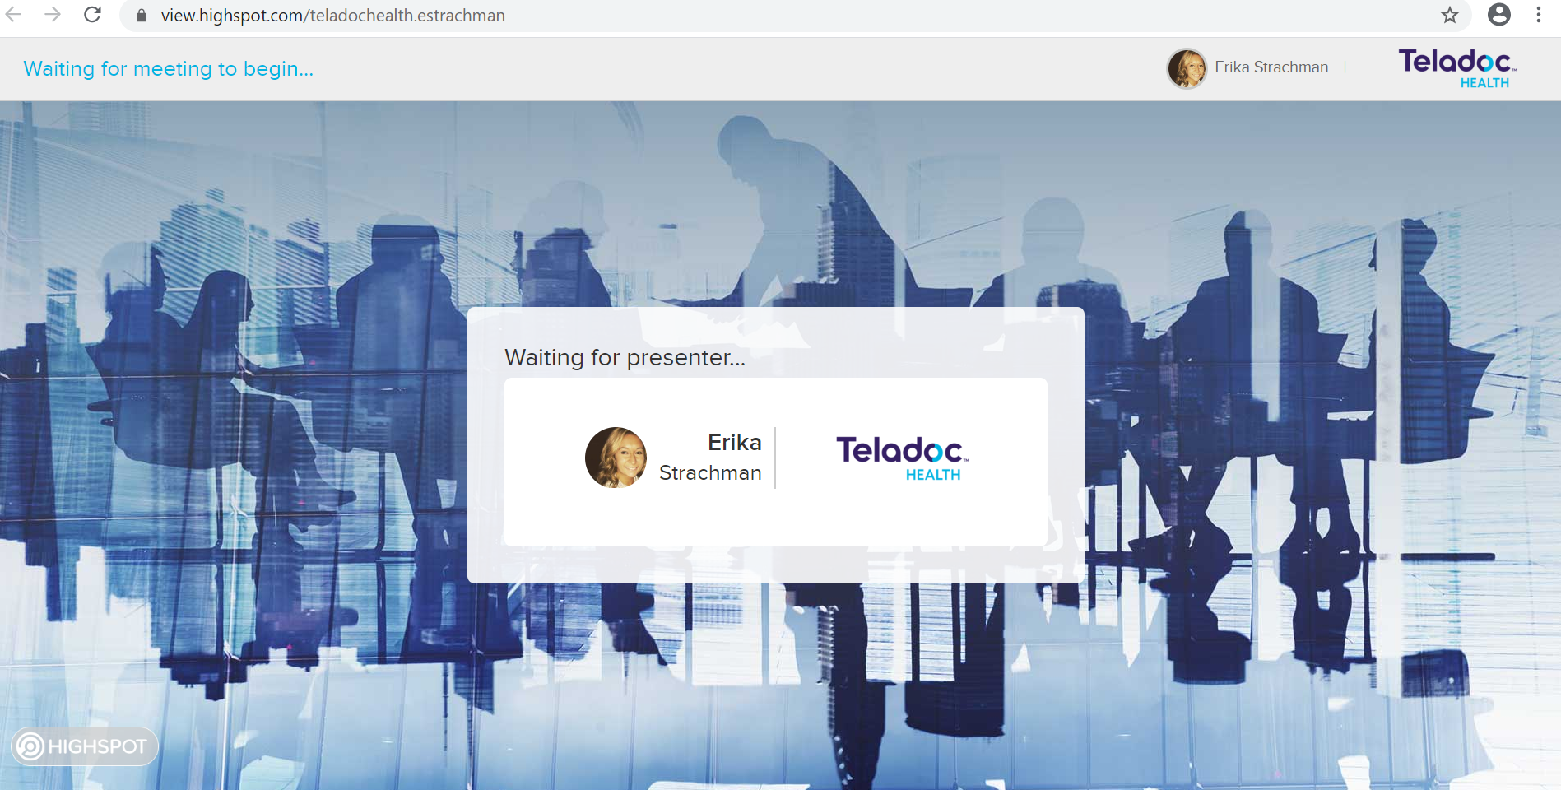
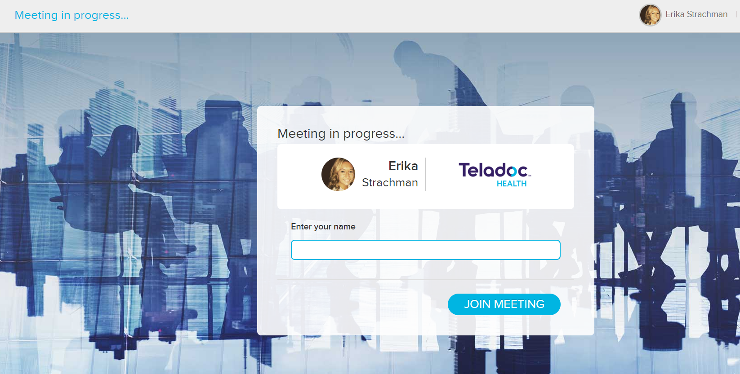
Live pitching – slide cast
Your participants will see the following when they go to the link you share with them until you click the green start slide cast button. Once you’ve clicked the start slide cast button, they will be required to enter their name to join the meeting.

Slide 36
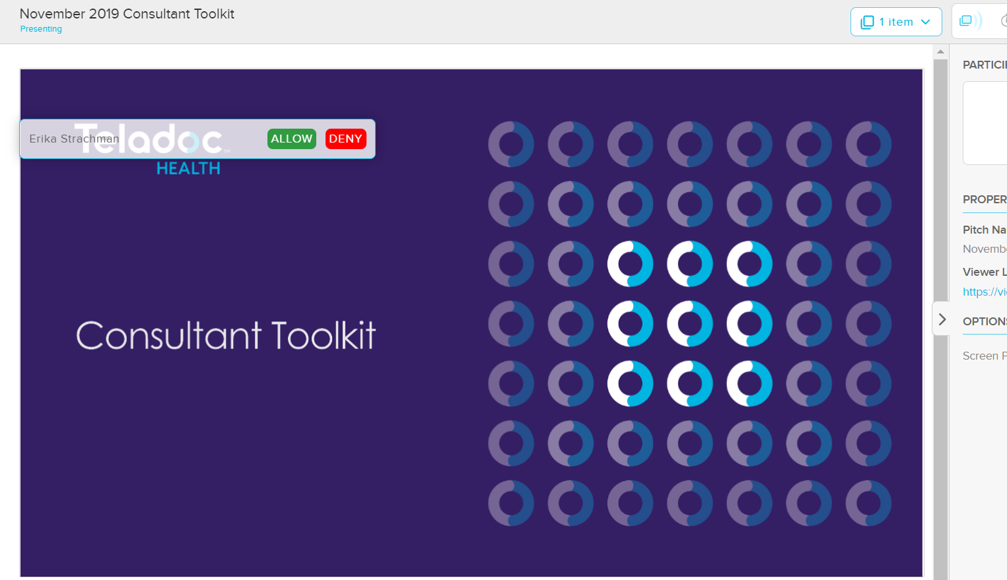
Live pitching – slide cast
Once you’ve clicked the start slide cast button, they will be required to enter their name to join the meeting. You will be required to allow or deny them entry. Once you click allow, you will see participants names on the right-hand side. You will be able to recap the pitch once you end it.

Slide 37
Pitch types and use cases
Pitch Type | Description | Recommended Use Case | Individual / Per-recipient View Tracking | Tips & Caution | DKIM Enabled / Email Linked | Sender Email | Message in Sent Folder | Resources
Email | Send an email pitch from within the Highspot UI | Send to one or multiple recipients at the same company. The reason is to have more personalization and there’s no mail merging through HS | Individual and Per-recipient | If you relate a pitch to 15 different contacts in SFDC, each activity will be recorded for every contact. Tip: Relate to opportunities | ✔ or email linked | name@teladochealth.com | ✔ | Email Pitch
 |  |  |  |  | ✘ and email not linked | user@highspot.com | ✘
Link | Provides a pitch URL usable for any web-based UI (LinkedIn, Web, Social Media) | Create a link to track interactions when the quantity is more important than the “who” clicked | ✘ | You will not receive an open notification from link pitches. | - | - | - | Link Pitch
Live | Present content either through screen sharing, webcast, or in person | Video or in-person meetings without switching screens. | ✘ | Useful for tracking presentation times, and gathering recipient contacts | - | - | - | Slide Cast Screen share & In Person
Outlook Plugins | Insert content into an email message in Outlook, O365, Outlook.com, or Exchange | Pitch directly from your inbox and track individual activities of recipients | Individual | Work directly from outlook. | N/A | name@teladochealth.com | ✔ | Outlook (Windows) Outlook (Universal)

Slide 38
Live Pitching – Screen Share

Slide 39
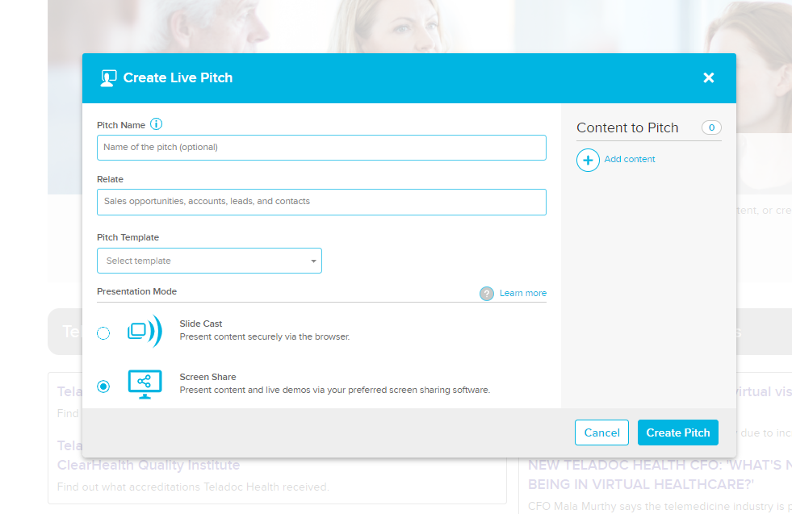
Live pitching – screen share
Create the name for your pitch (i.e. prospect name).
A new window will open with your screen share.
Add the content you want to share.
Relate the pitch to an opportunity, account or contact in Salesforce.
Make sure you have selected screen share mode.
Click “create pitch”.

Slide 40
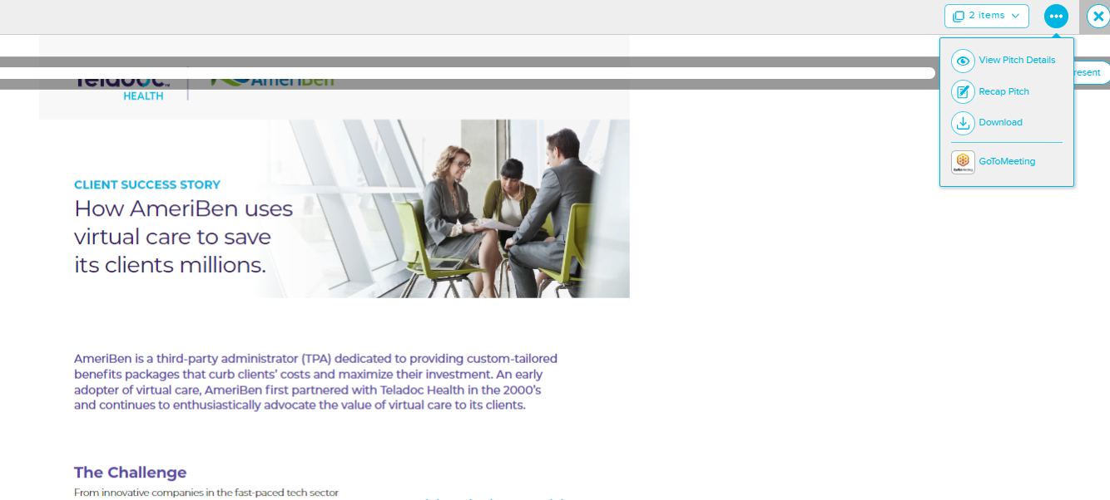
Live pitching – screen share
A new window will open with your screen share.
To start or schedule a meeting, click on the GoToMeeting link. Your GoToMeeting will open and you can choose to start or schedule a meeting.

Slide 41
Using Pitch Styles
For more information, please click here.

Slide 42
Using pitch styles
Pitch Styles enhance your pitches by giving you the ability to show your content in a personalized, customized portal. This richer and more visually compelling experience for buyers will benefit you through increased engagement, click-thru rates, and ultimately, wins.
To use a pitch style, click the + icon at the top of the screen, select pitch and then choose either email or link pitch.

Slide 43
Using pitch styles
Once you select an email or a link, a new window will open. From the pitch style drop down, select a template.

Slide 44
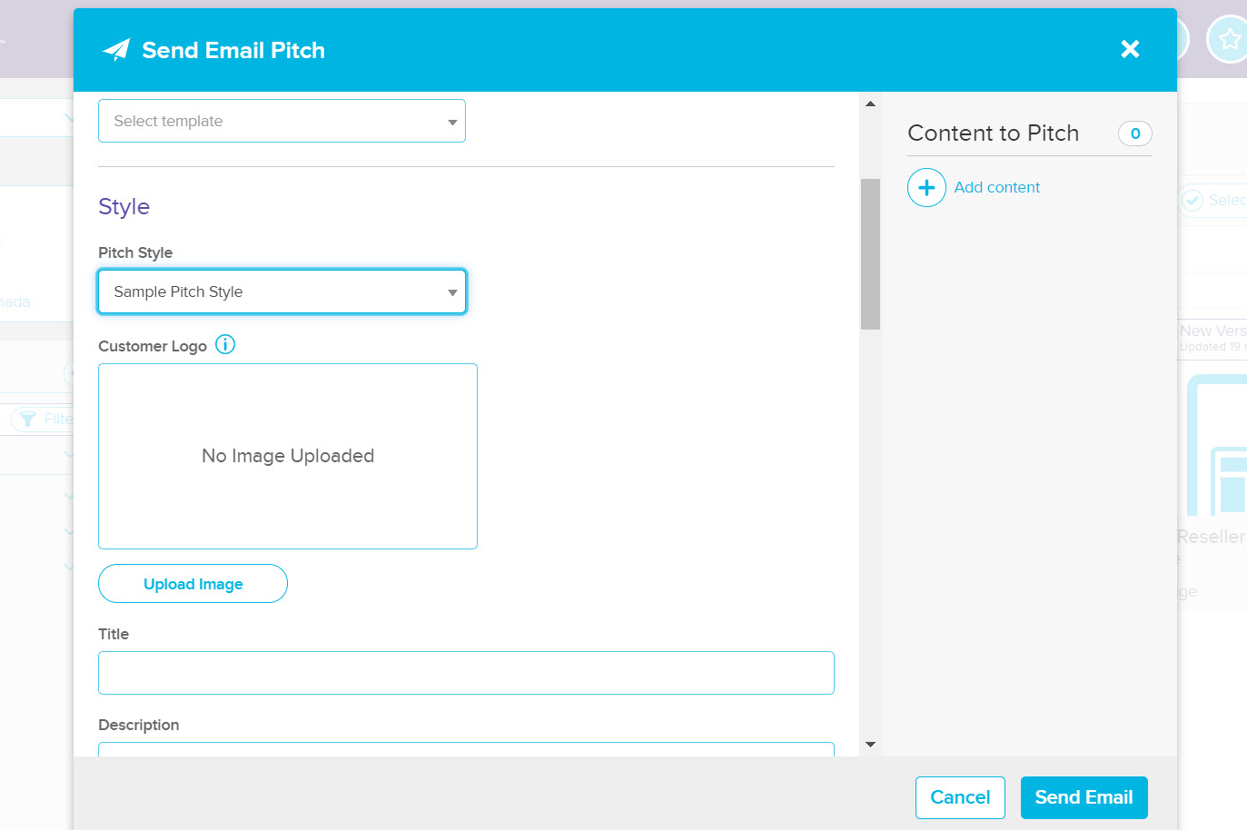
Using pitch styles
On the right, under Content to Pitch, select Add content to begin selecting items
Click Add Content when done. Hover over an item to position them in a specific order
Add a Prospect Logo, Title and Description. All 3 items will appear in your Pitch Style
When finished, be sure to add a recipient, subject and message before sending.

Slide 45
Giving Feedback/Rating Content

Slide 46
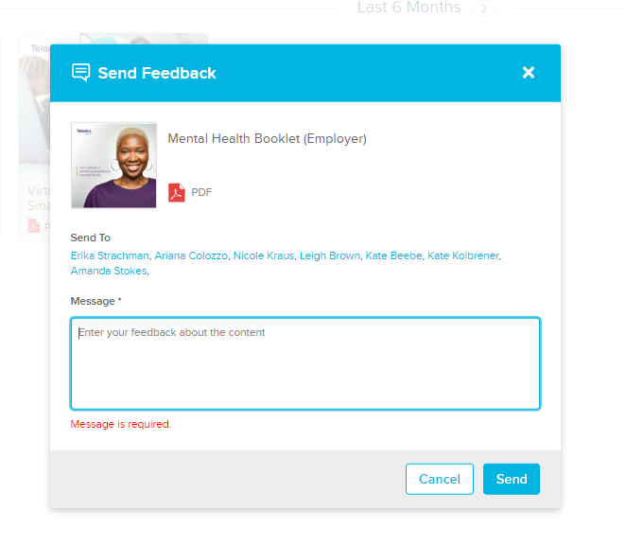
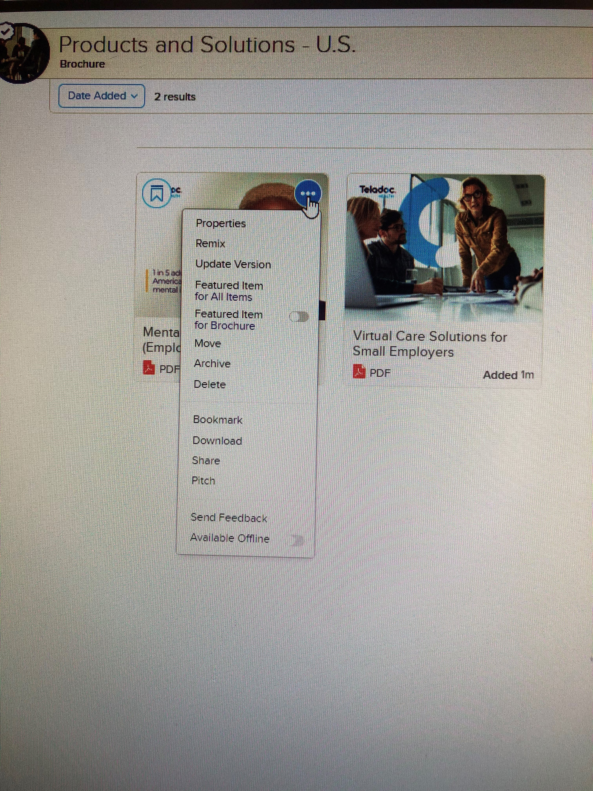
Giving feedback on content
Giving feedback on content is a private way to share typos, mistakes, or suggestions on content with the content owners.
Once you’ve found the content you want to give feedback on, click on the three dots, then click “send feedback”. A window will open which allows you to type a message to the content owners with your feedback for that content. Then click “send”. The content owner(s) will be notified via email as well as in Highspot directly.

Slide 47
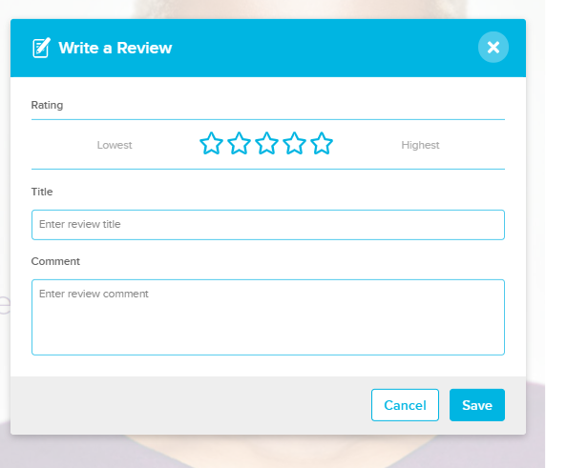
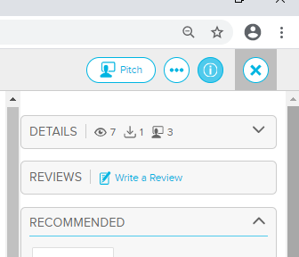
Giving feedback on content
Writing a review on content is a public way to share your feedback with other Highspot users and content owners.
Once you’ve found the content you want to give feedback on, click on that piece of content. On the right side, you will see an option to write a review. Click “save” to post your review.

Slide 48
Sharing content internally

Slide 49
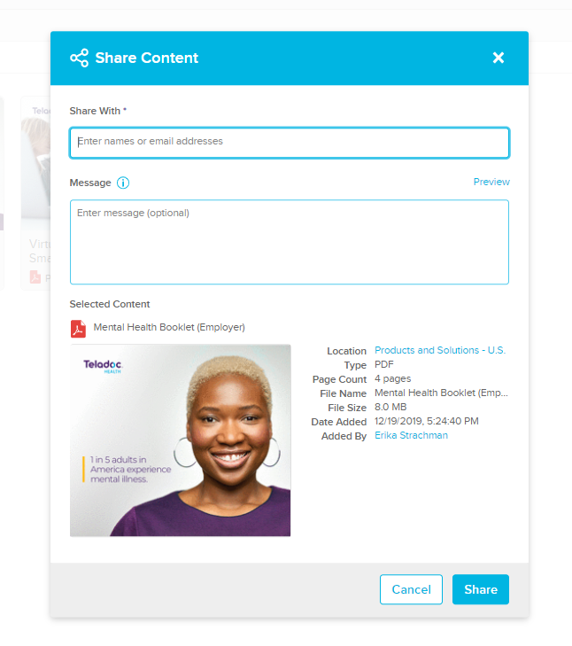
Sharing content internally
Once you’ve found the content you want to share, click the three dots in the top right. Then hit “share”.
You can type in the names of the people you want to share the content with and enter a message if you want. Then click “share”. The person will be notified via email as well as in Highspot.

Slide 50
Bookmarking a Spot to Your Favorites

Slide 51
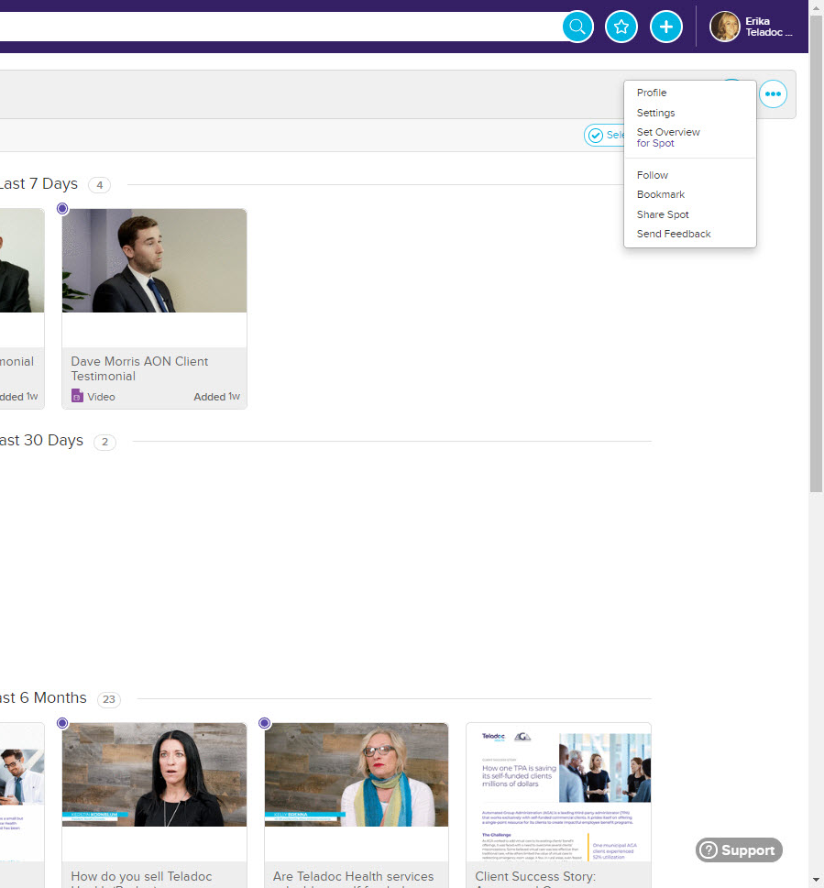
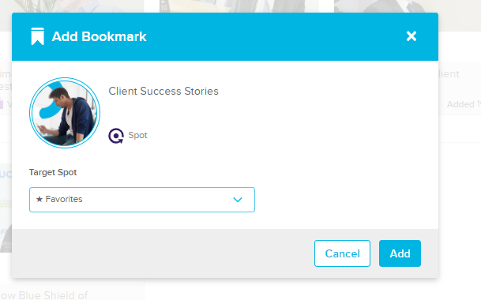
Bookmarking a spot to your favorites
Once you’re in the spot you want to bookmark, click on the three little dots and then click “bookmark”
You can then click favorites (if it doesn’t prepopulate) and click add. When you go to your homepage, your favorite spots will be on the left-hand side.

Slide 52
Highspot Glossary

Slide 53
Glossary of Highspot terms
Content: Any document, image, spreadsheet, etc. that you can find in Highspot
Spot: A collection of related items, which provides an easy and flexible way to find content
Lists and list groups: Within a spot, content is organized into lists that can be collected under list groups – a good way to think about it is like playlists in iTunes or Spotify. A list is like a playlist and a list group is like a folder of playlists
Pitch: The ability to quickly and easily share content with prospects and clients, with or without templates, tracking how viewers are engaging with content
Share: A way to send content to an internal colleague within Highspot, which isn’t tracked
Remix: A way to easily rearrange, combine, or delete slides to customize content – you can easily and quickly create custom presentations without having to leave Highspot
Recommended content: Machine learning is used to recommend content and will continue to adapt based on how you use Highspot – let’s content find you!

Slide 54


Presenter’s contact:
estrachman@teladochealth.com
617.336.2784

Slide 55


Thank you

