Slide 1
Security Questionnaires – Solution Analysis & Design Team
Global Growth Summit 2021

Slide 2
Security Questionnaires and Assessments
Purpose and Scope
Teladoc Health receives security questionnaire and assessment requests from current and prospective customers, internal teams and third party organizations. The primary purpose of these security requests is to provide information to interested parties regarding the organization’s technical security posture and compliance with industry-recognized standards and frameworks.
For many customers, this information is required to support the sales and procurement processes, for implementation planning and for regularly scheduled product and application technical reviews and updates.
Commonly requested information topics include: technical product, application, networking, architecture, IT, data and security controls and compliance.
Questionnaires and assessments are received in a variety of document formats, through online portal applications and often with direct customer conversations.
Requirements for security questionnaires range from standard checklists to industry framework-based documents with multiple hundreds of questions requiring responses.
Most customers manage the security questionnaire and assessment process directly. Some choose to enlist third party consulting companies to administer for the customer.
Teladoc Health is working to standardize responses applicable for the integrated organization.

Slide 3
Security Questionnaires and Assessments
Process and Support
Questionnaires and assessments submitted by requestor to SecurityDocumentsRequest@InTouchHealth.com
Request must include the completed and submitted Security Document Request (SDR) through the Salesforce.com Request object. The SDR is also available in a Word document and attached here:
The Security Document Request (SDR) serves to provide necessary information, including the product(s) and application(s) addressed, which assists with properly documenting and completing the security review.
The Service Level Agreement (SLA) for review and completion of security questionnaires and assessments is two weeks from the date the completed Security Document Request is received.
Security questionnaire status updates are provided daily by e-mail communication
For legacy Teladoc Health products and applications, including LP and Core, requests are submitted and this team will work and partner with the Teladoc Health colleagues to provide requested information
For legacy Livongo products and applications, requests can be submitted and this team will work with legacy Livongo Health colleagues to provide requested information.
For legacy InTouch Health products and applications, submit either through the SFDC Request object or with the attached Word document.

Slide 4
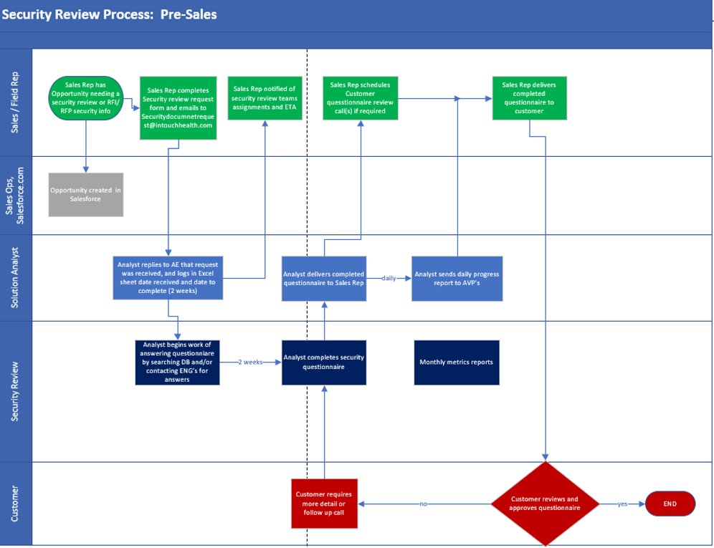
Security Questionnaires and Assessments
Process Request Workflow

Slide 5
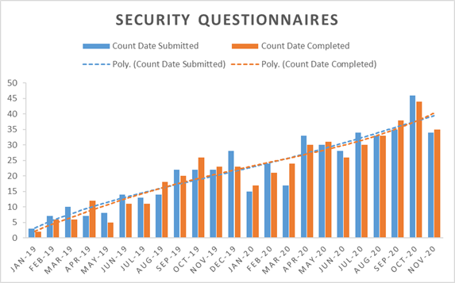
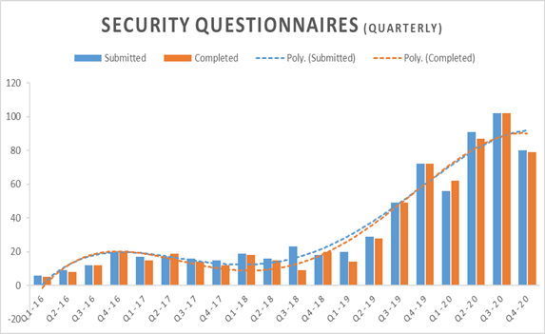
Month over Month Security Metrics
Solution Analysis and Design Team
“Extraordinary Designs for Extraordinary Customers”
Security Questionnaires:

