Slide 1
Using the Teladoc Health Virtual Experience Center
2020

Slide 2
Objectives
The Virtual Experience Center is where you can take your clients and prospects on an immersive journey and showcase our solutions from hospital to the home
Quick and easy steps to request an Experience Center briefing
Simple to use, powerful customization capabilities that will make your briefing specific to each client or prospect
Notes:
I know we are all in the same boat with virtual meeting fatigue. The good news is, we’ve created a unique and innovative way for you to transform your standard presentations. Today I will introduce you to the Teladoc Health
- Virtual Experience Center- where you can take your clients and prospects on an immersive journey and showcase our breadth solutions from hospital to the home
- One of the great features of the Virtual EC is the ability to quickly and easily request it and I will show you how.
- And finally I’ll walk through the ease of use and most importantly powerful customization capabilities that will make your briefing specific to each client or prospect.

Slide 3

Notes:
But first, here is a quick video to introduce you to the Experience Center

Slide 4
Why we created the Experience Center
Value for customers
  Ability to virtually experience our whole story – from hospital to home
  Receive a technology update
  Hear about our strategic direction
  Virtual, interactive experience with customized high-level messaging
Value for host company
87% said their briefing contributed to strengthening their relationship with the host company and 90% said they would recommend, based on their briefing experience
71% made a decision to purchase products or services discussed in their briefings as a result of the experience
74% of purchasers said the amount of their purchase increased as a result the briefing — by an average of 31%
41% of purchasers said that the briefing shortened their purchase cycles
Source: Association of Briefing Program Managers, 28th annual Research Report on the Effectiveness of Briefings
Notes:
To give you a little insight as to why we created the experience center, we’ve found there is true value not only to our customes but also to us as the host.
For our customers it gives them the ability to virtually experience our whole story- from the hospital to the home. They can also receive technology updates, hear about our strategic direction and ultimately receive customized high-level messaging in a unique way.
For the host company, studies have shown that 87% of attendees said their briefing contributed to strengthening their relationship with the host company
71% made a decision to purchase products or services discussed in their briefings as a result of the experience
74% of purchasers said the amount of their purchase increased as a result the briefing — by an average of 31%
41% of purchasers said that the briefing shortened their purchase cycles

Slide 5
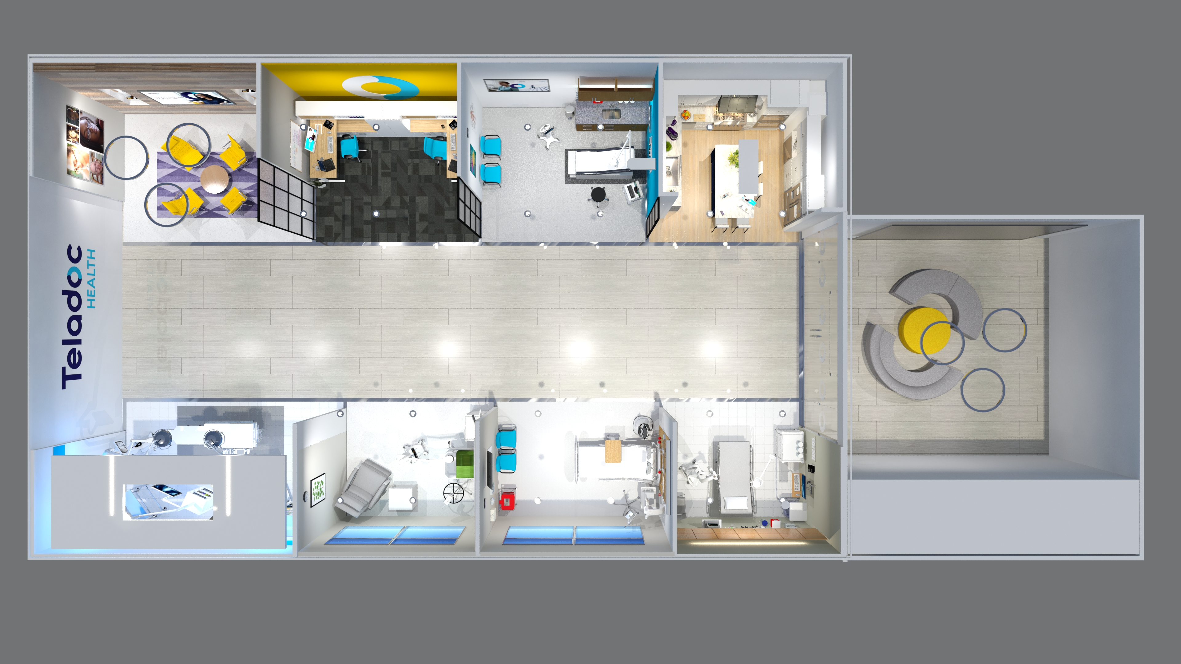
When to schedule a briefing
Each briefing is unique and customized, which is why a briefing request should be submitted once you’re in the proposal phase of the sales cycle.

Slide 6
Requesting an Experience Center briefing via Salesforce

Slide 7
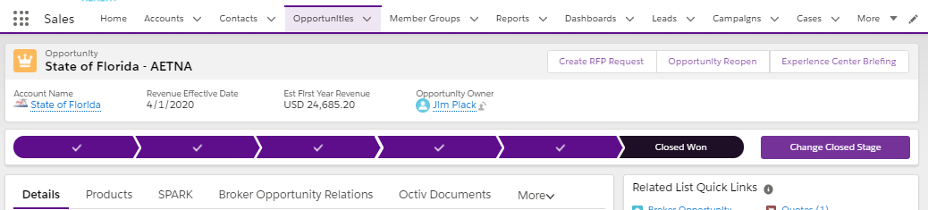
Creating a New Briefing Request
All requests for an Experience Center Briefing begin from an Opportunity record.
Select the “Experience Center Briefing” button on the opportunity.
Note: If you do not see the button you may have to click on the down arrow to display additional selections.
Notes:
If you are in the Teladoc Health salesforce instance you need to request via salesforce

Slide 8
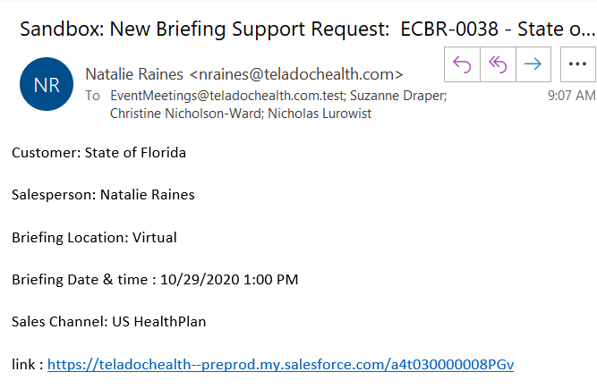
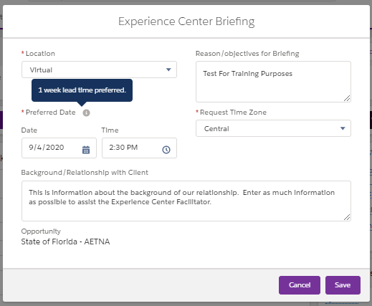
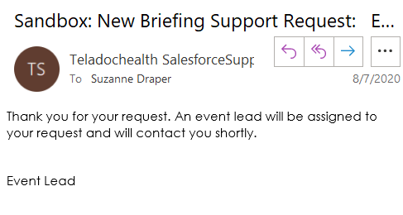
Creating a New Briefing Request - Continued
A request form will appear with required fields noted by *
It is important to give at least 1 week lead time and share as much information as possible so we can prepare for your guests
Email to Briefing Facilitator
Once the user clicks “Save” the record will be created and an email will be sent to the requestor and the Briefing Facilitator
Email to Sales/CM Requestor

Slide 9
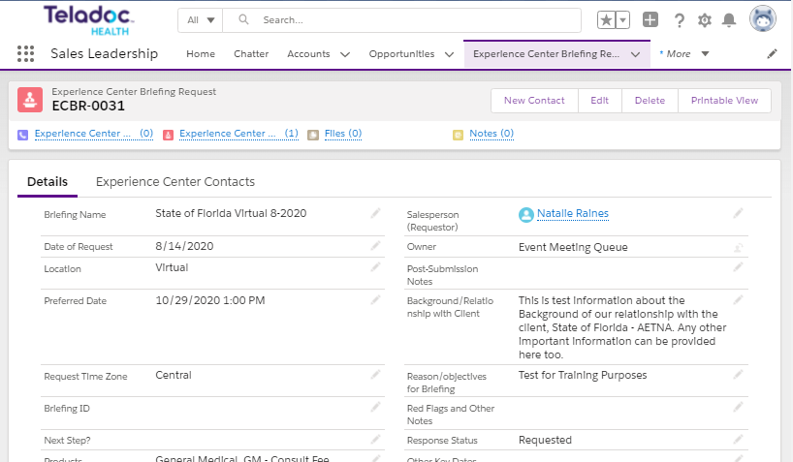
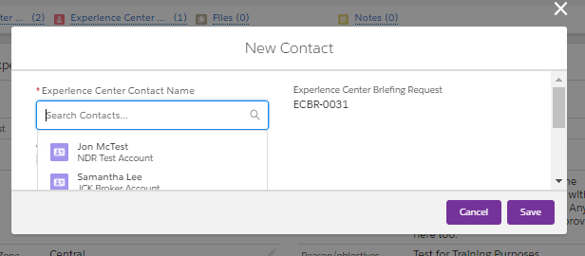

Add Contacts to the Briefing
Each of your contacts will receive a personalized link to access the briefing, so you'll need to add each attendee to your request. Email address is a required contact field.
To add contacts to the request click the “New Contact” button
Contact form will display and allow you to add an existing contact OR a new contact can be added
Notes:
Make sure you add internal and external attendees

Slide 10
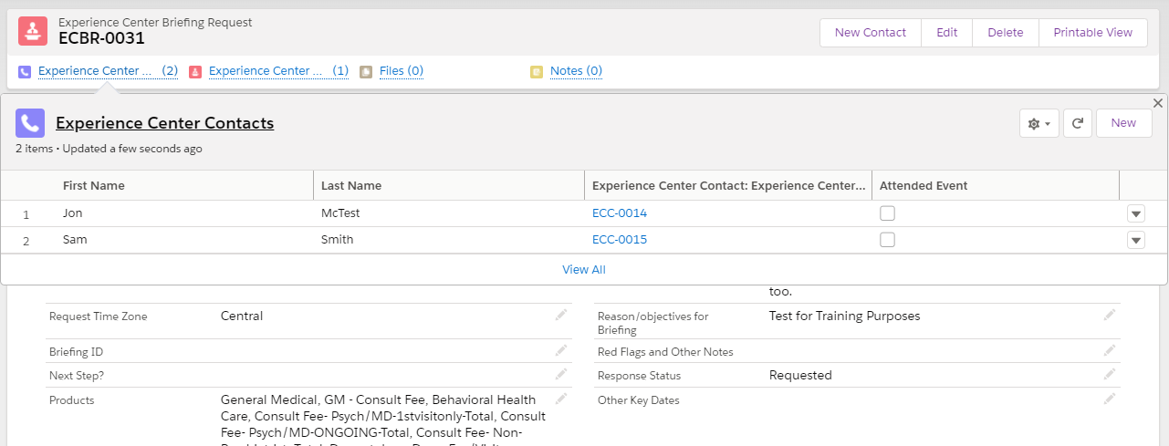
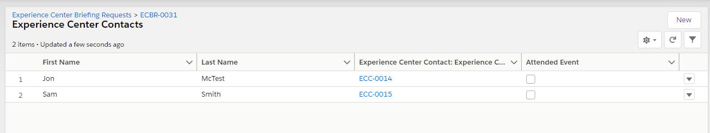
View List of Attendees
To view a list of contacts that have been invited to attend: 1. Hover over the Experience Center Contacts link
OR
2. Click on it to see list in a new window

Slide 11
Requesting an Experience Center briefing via SharePoint

Slide 12
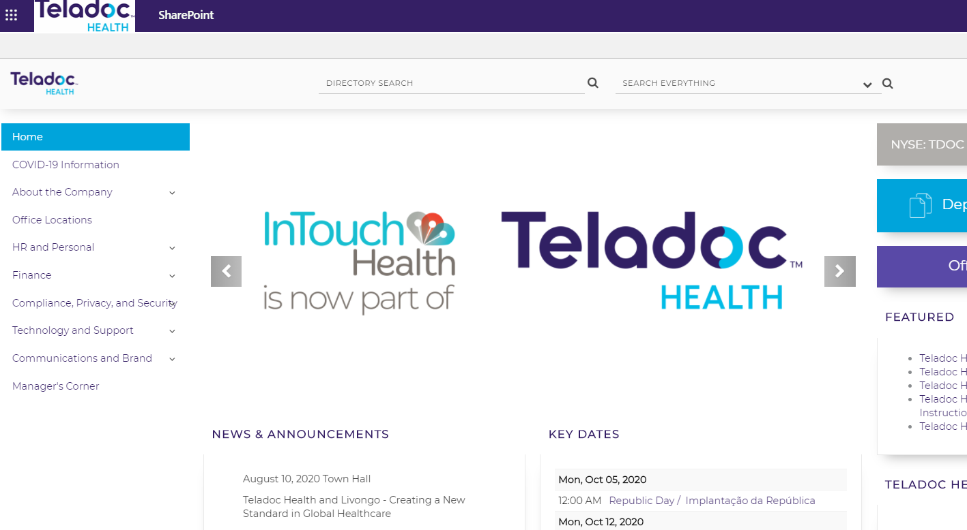
Requesting a Briefing in SharePoint
If you don’t have access to the core Salesforce.com instance, you can request an Experience Center briefing via SharePoint.
Go to Teladoc Health Home page on SharePoint hover over “Communications and Brand” and select Experience Center from the drop-down.
Notes:
If you’re not currently using the teladoc health instance in SF, you will request through SharePoint

Slide 13
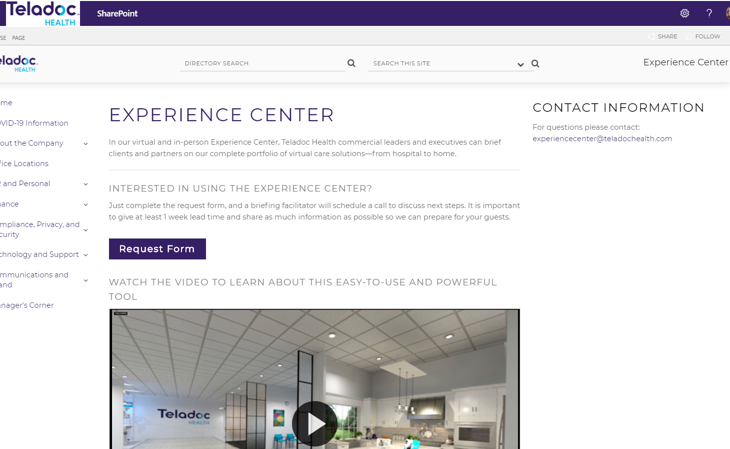
Requesting a Briefing in SharePoint
Click “Request Form”
Notes:
https://www.surveymonkey.com/r/ZWQ9XM3

Slide 14
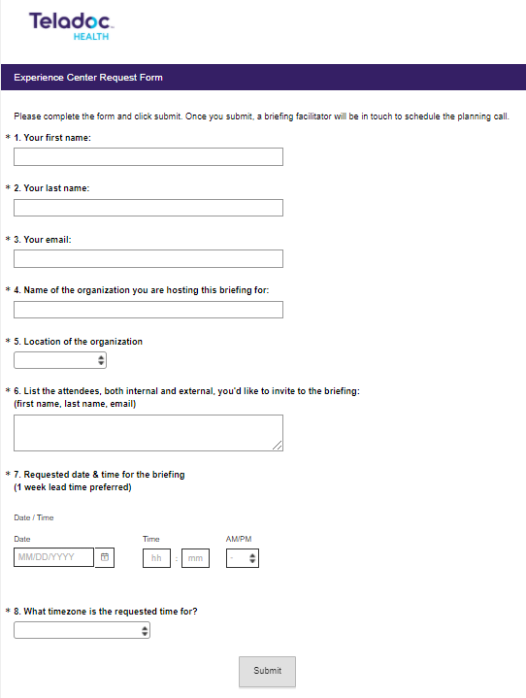
Requesting a Briefing in SharePoint
A request form will appear with required fields noted by *
It is important to give at least 1-week lead time and share as much information as possible so we can prepare for your guests
Once the user clicks “Submit” you will see a confirmation page that your request went through. And an email will be sent to the briefing facilitator

Slide 15
Customizing the briefing

Slide 16
Customization Planning Call
Once your request is submitted, a Briefing Facilitator will schedule a planning call with you to prepare a successful experience for your guests. Together, we will:
Finalize list of attendees
Determine additional Teladoc Health presenters, if needed
Customize invitation email
Select content and customize the space for your briefing
Schedule walkthrough with presenter(s)

Slide 17
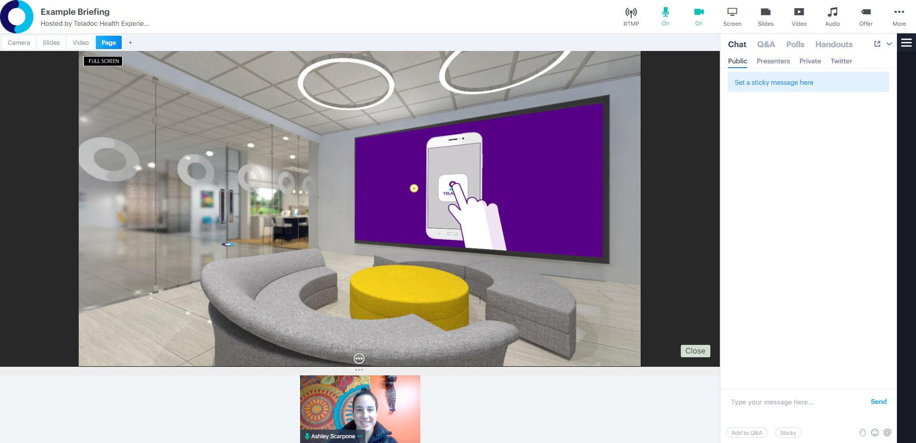
During the Briefing
You, as the host, will be able to lead the discussion while utilizing this powerful Experience Center
The Briefing Facilitator will partner with you during the session to help guide users through the materials & provide technical support if needed

Slide 18
After the Briefing
The Briefing Facilitator will deploy a post-briefing email to all attendees which will include:
Highspot links to content shared
A survey where we can gather feedback from attendees on the briefing
Also, the Briefing Facilitator will go back to the Experience Center record in Salesforce to check off the contacts who attended, include their survey results and add any relevant notes.
The check box for “Attended Event” will only be used by the Briefing Facilitator to track event attendance
Notes:
And I will be able to add the survey results for each attendee into their contact record

Slide 19

Thank you
If you have any questions or suggestions regarding the Experience Center, ​
please email: ExperienceCenter@teladochealth.com
Notes:
That concludes today’s training on the Virtual Experience Center. Thank you and have a great day.

